Slide 1


w
Welt
Notes:
Aim: To introduce the key vocabulary ‘wo’ (where).
Procedure:
1. Present and say the word.
2. Bring up the question mark, and then straightaway the image and the English translation.
3. Do the gesture for ‘where’ (if desired) and say the word several times. Students say it with the teacher.
Word frequency (1 is the most frequent word in German):
wo [94]
Source: Jones, R.L. & Tschirner, E. (2011). A frequency dictionary of German: core vocabulary for learners. Routledge

Slide 2


w
wo?
where?
Notes:
Aim: To introduce the key vocabulary ‘wo’ (where).
Procedure:
1. Present and say the word.
2. Bring up the question mark, and then straightaway the image and the English translation.
3. Do the gesture for ‘where’ (if desired) and say the word several times. Students say it with the teacher.
Word frequency (1 is the most frequent word in German):
wo [94]
Source: Jones, R.L. & Tschirner, E. (2011). A frequency dictionary of German: core vocabulary for learners. Routledge

Slide 3


w
Welt
Wo?
Wasser
where?
Was?
gewinnen
what?
Notes:
Aim: To introduce the key vocabulary ‘wo’ (where).
Procedure:
1. Present and say the word.
2. Bring up the question mark, and then straightaway the image and the English translation.
3. Do the gesture for ‘where’ (if desired) and say the word several times. Students say it with the teacher.
Word frequency (1 is the most frequent word in German):
wo [94]
Source: Jones, R.L. & Tschirner, E. (2011). A frequency dictionary of German: core vocabulary for learners. Routledge

Slide 4


Slide 5


Slide 6
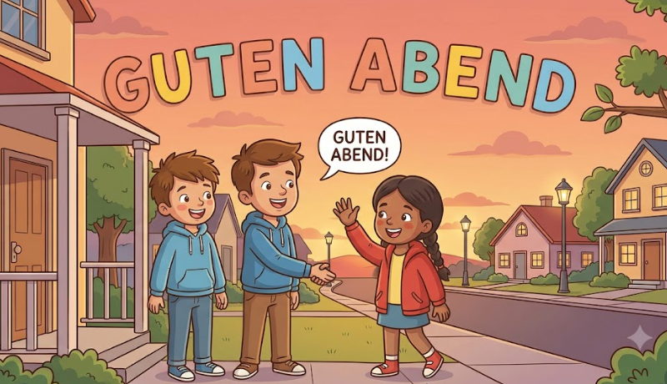

Slide 7
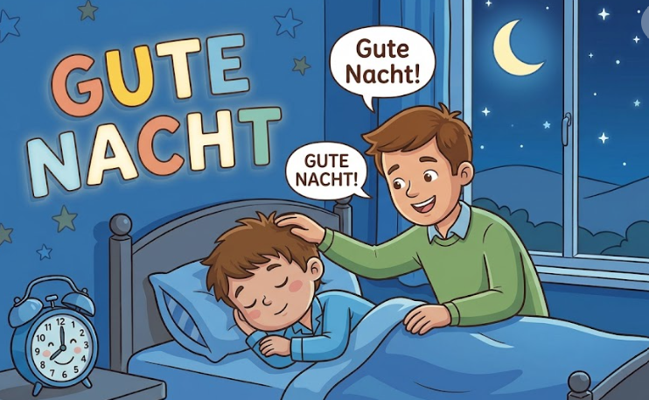

Slide 8
Notes:
Four corners / repetition

Slide 9
Guten Morgen | Guten Morgen
Guten Tag | Guten Tag
Guten Abend | Guten Abend
Gute Nacht | Gute Nacht
Notes:
Frere Jacques - guten Morgen, guten Morgen - guten Tag, guten Tag - guten Abend, guten Abend - gute Nacht, gute Nacht

Slide 10

Notes:
Introduce the goodbyes

Slide 11
2
1
Notes:
Heads or Tails

Slide 12
Guten Morgen | Tschüss
Guten Tag | Auf Wiedersehen
Guten Abend
Gute Nacht
Notes:
Have a hello and goodbye conversation

Slide 13
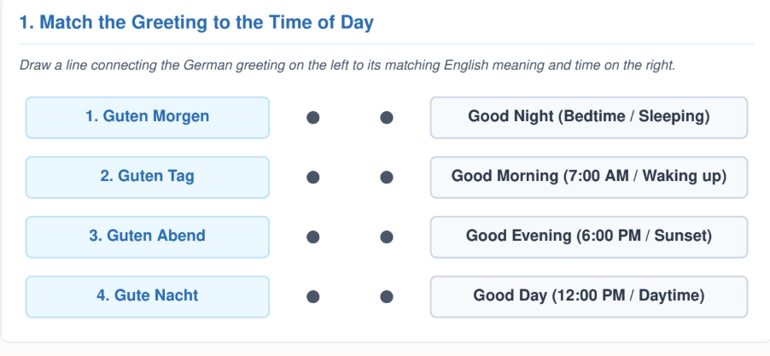

Slide 14
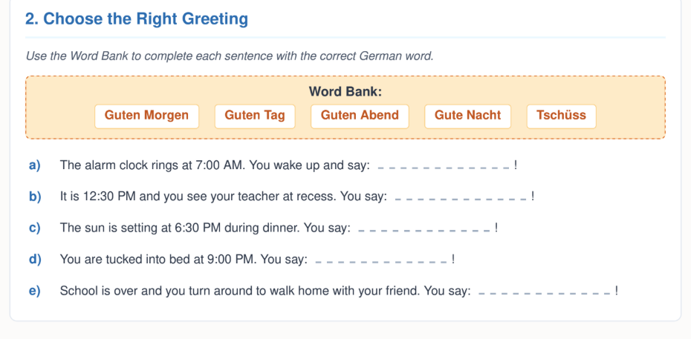

Slide 15
