Slide 1


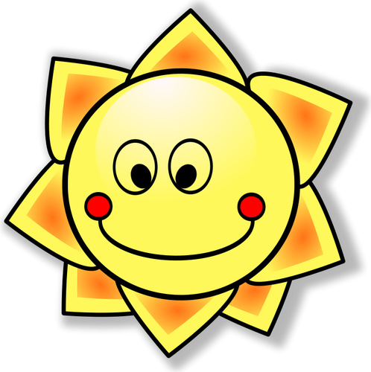
j/soft g
X
jour
Notes:
Timing: 1 minute
Aim: To introduce SSC [j/soft g]
Procedure:
1. Present the letter(s) and say the [j/soft g] sound first, on its own. Students repeat it with you.
2. Bring up the word ”jour” on its own, say it, students repeat it, so that they have the opportunity to focus all of their attention on the connection between the written word and its sound.
3. A possible gesture for this would be to mime waking up at daybreak, by stretching out ones arms and yawning.
4. Roll back the animations and work through 1-3 again, but this time, dropping your voice completely to listen carefully to the students saying the [j/soft g] sound, pronouncing ”jour” and, if using, doing the gesture.
Word frequency (1 is the most frequent word in French):
jour [78].
Source: Londsale, D., & Le Bras, Y. (2009). A Frequency Dictionary of French: Core vocabulary for learners London: Routledge.

Slide 2

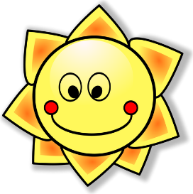

j/soft g
j’ai
génial
[I have]
X
jour
sujet
jamais
[subject]
[never]
déjà
[already]
Notes:
Timing: 2 minutes
Aim: To introduce SSC [j/soft g]
Procedure:
1. Introduce and elicit the pronunciation of the individual SSC [j/soft g] and then the source word again ‘jour’ (with gesture, if using).
2. Then present and elicit the pronunciation of the five cluster words.
The cluster words have been chosen for their high-frequency, from a range of word classes, with the SSC (where possible) positioned within a variety of syllables within the words (e.g. initial, 2nd, final etc.). Additionally, we have tried to use words that build cumulatively on previously taught SSCs (see the Phonics Teaching Sequence document) and do not include new SSCs. Where new SSCs are used, they are often consonants which have a similar symbol-sound correspondence in English.
Word frequency (1 is the most frequent word in French):
j’ai [8 - avoir]; génial [3872] sujet [353]; déjà [58]; jamais [179]; jour [78].
Source: Londsale, D., & Le Bras, Y. (2009). A Frequency Dictionary of French: Core vocabulary for learners London: Routledge.

Slide 3
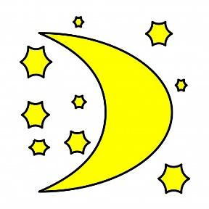
j/soft g
j’ai
génial
jour
sujet
jamais
déjà
Notes:
With sound and no pictures to focus all attention on the sound-symbol correspondence.

Slide 4
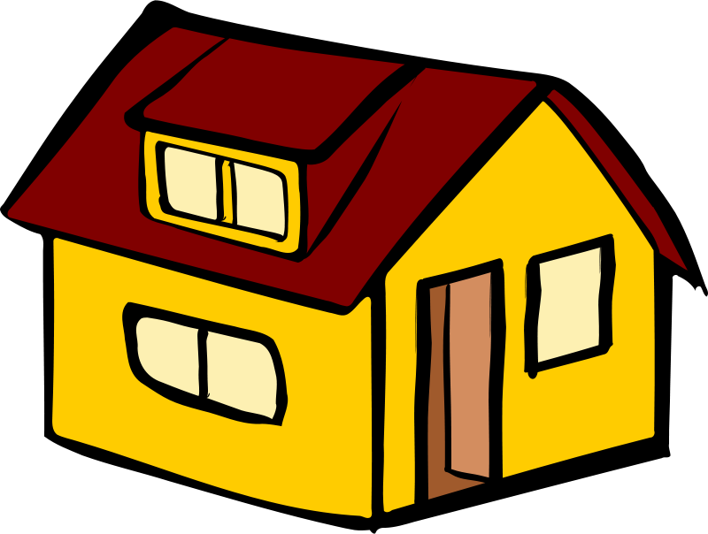
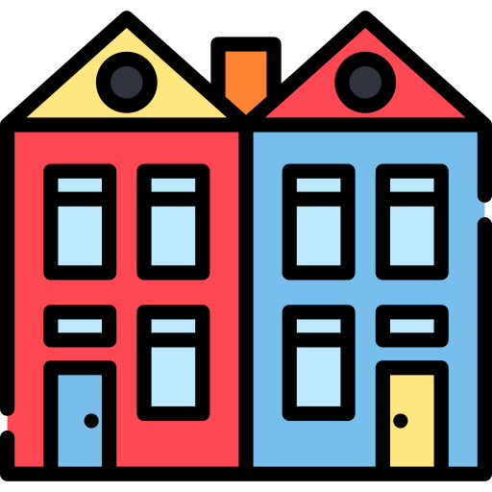
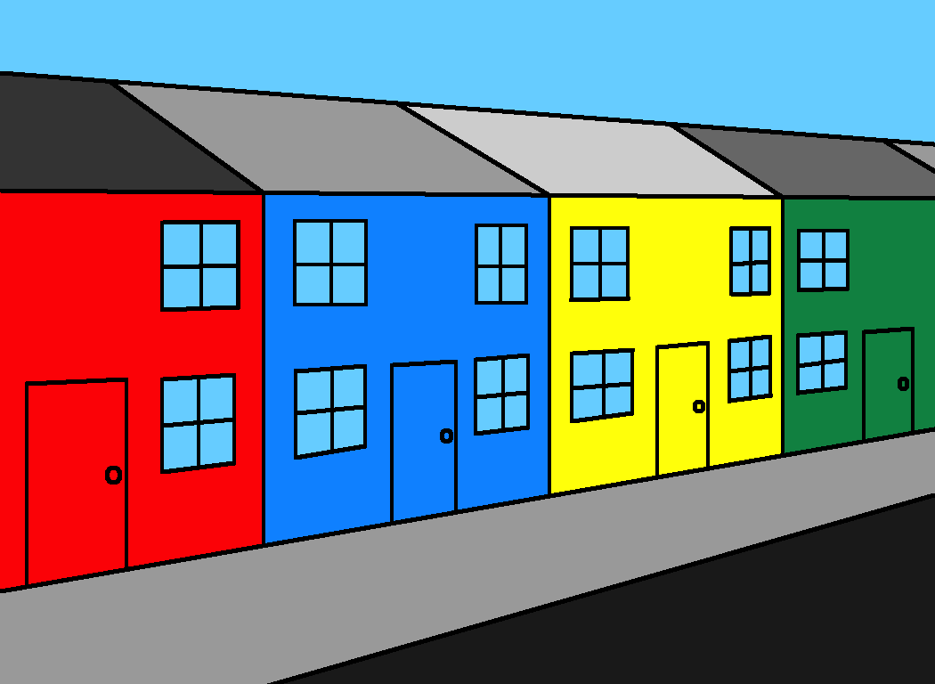
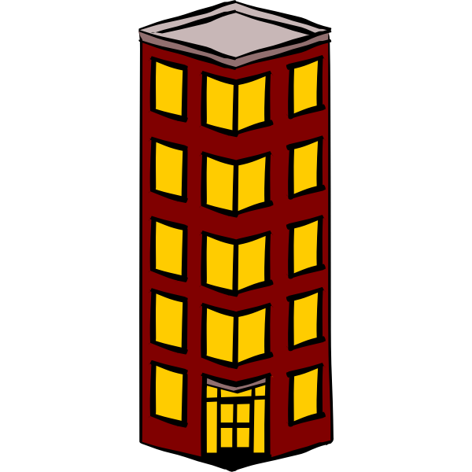
Ma maison
Où habites-tu?

Slide 5
j’habite dans…
une maison mitoyenne
une maison jumelée
une maison individuelle
un appartement

Slide 6
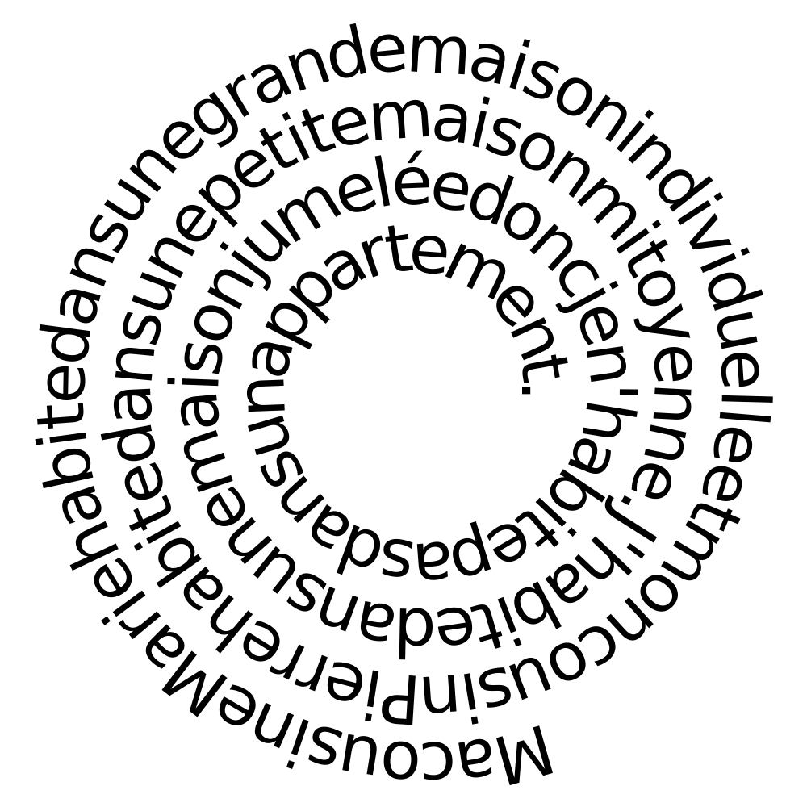

Slide 7
J’habite dans une maison individuelle I live in a detached house | J’habite dans une maison jumelée I live in a semi-detached house | J’habite dans une maison mitoyenne I live in a terraced house | J’habite dans un appartement I live in a flat | J’habite dans un cottage I live in a cottage
Mon cousin habite dans une maison individuelle My cousin lives in a detached house | Mon cousin habite dans une maison jumelée My cousin lives in a semi-detached house | Mon cousin habite dans une maison mitoyenne My cousin lives in a terraced house | Mon cousin habite dans un appartement My cousin lives in a flat | Mon cousin habite dans un cottage My cousin lives in a cottage
Ma famille habite dans une maison individuelle My family lives in a detached house | Ma famille habite dans une maison jumelée My family lives in a semi-detached house | Ma famille habite dans une maison mitoyenne My family lives in a terraced house | Ma famille habite dans un appartement My family lives in a flat | Ma famille habite dans un cottage My family lives in a cottage
Notes:
QQT

Slide 8
J’habite dans (Twinkle Twinkle)
J’habite dans une grande maison
Dans une maison individuelle
Mon cousin, il habite dans
Dans une maison mitoyenne
Ma famille, elle habite dans une
Maison jumelée et grande
Ma famille, elle n’habite pas
Dans un grand appartement
Notes:
Song - to the tune of Twinkle Twinkle

