Slide 1


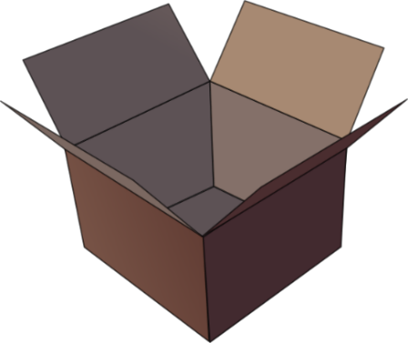
SFC
Silent final consonant
dans
X
Notes:
Timing: 1 minute
Aim: To introduce SSC [SFC]
Explanation in English, if desired: Something that makes French sounds very different from English is that some consonants at the ends of words are silent. This means you don’t pronounce/sound them out at all. As in the word ‘dans’ in French.
Procedure:
1. Present the letter(s) and say the [SFC] sound first, on its own. Students repeat it with you.
2. Bring up the word ”dans” on its own, say it, students repeat it, so that they have the opportunity to focus all of their attention on the connection between the written word and its sound.
3. A possible gesture for this would be to hold ones finger to ones lips to indicate ‘Shhhh!’.
4. Roll back the animations and work through 1-3 again, but this time, dropping your voice completely to listen carefully to the students saying the [SFC] sound, pronouncing ”dans” and, if using, doing the gesture.
Word frequency (1 is the most frequent word in French):
dans [11]
Source: Londsale, D., & Le Bras, Y. (2009). A Frequency Dictionary of French: Core vocabulary for learners London: Routledge.

Slide 2







SFC
petit
prix
€15.95
grand
mot
dans
X
mais
[but]
Notes:
Timing: 2 minutes
Aim: To introduce SSC [SFC]
Procedure:
1. Introduce and elicit the pronunciation of the individual SSC [SFC] (in this case is SFC – silent final consonant so nothing to pronounce as an individual sound!) and then the source word again ‘dans’ (with gesture, if using).
2. Then present and elicit the pronunciation of the five cluster words.
The cluster words have been chosen for their high-frequency, from a range of word classes, with the SSC (where possible) positioned within a variety of syllables within the words (e.g. initial, 2nd, final etc.). Additionally, we have tried to use words that build cumulatively on previously taught SSCs (see the Phonics Teaching Sequence document) and do not include new SSCs. Where new SSCs are used, they are often consonants which have a similar symbol-sound correspondence in English.
Word frequency (1 is the most frequent word in French):
dans [11]; petit [138] prix [310]; mot [220]; mais [30]; grand [59].
Source: Londsale, D., & Le Bras, Y. (2009). A Frequency Dictionary of French: Core vocabulary for learners London: Routledge.

Slide 3


Slide 4

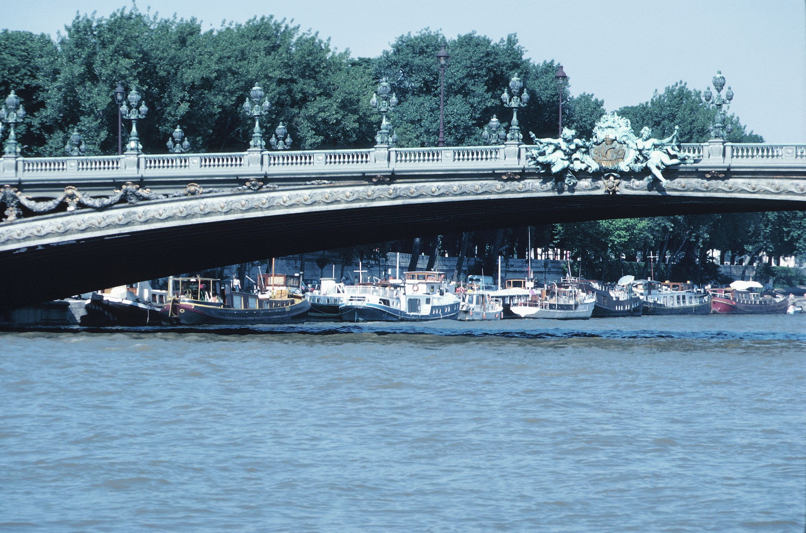
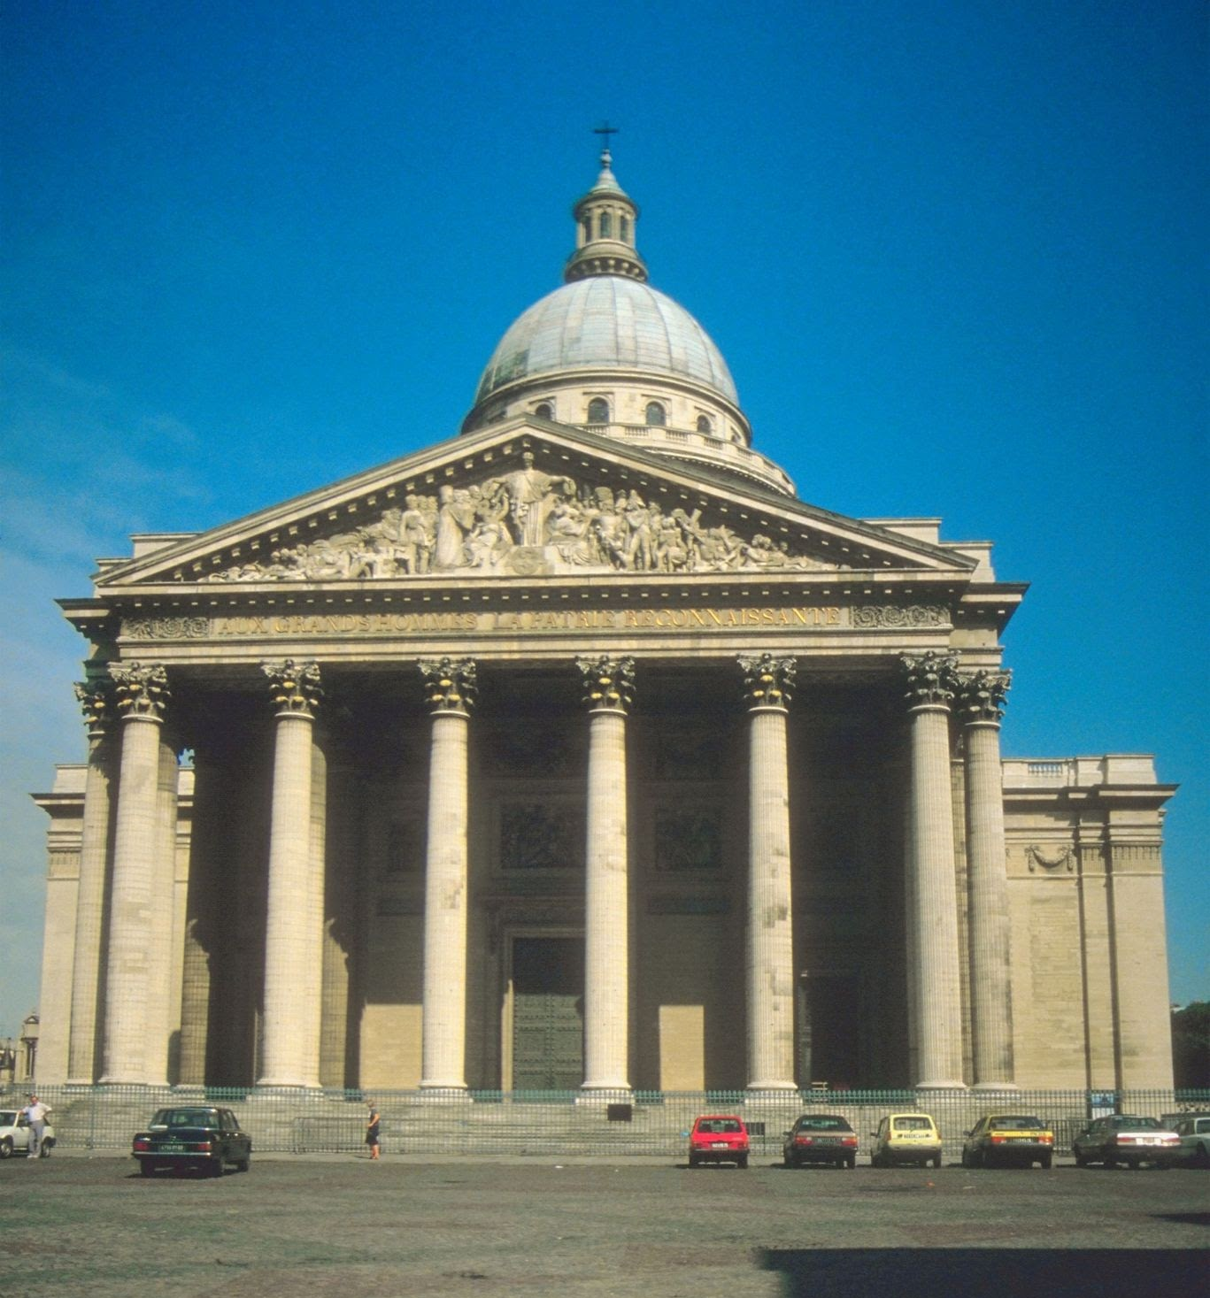
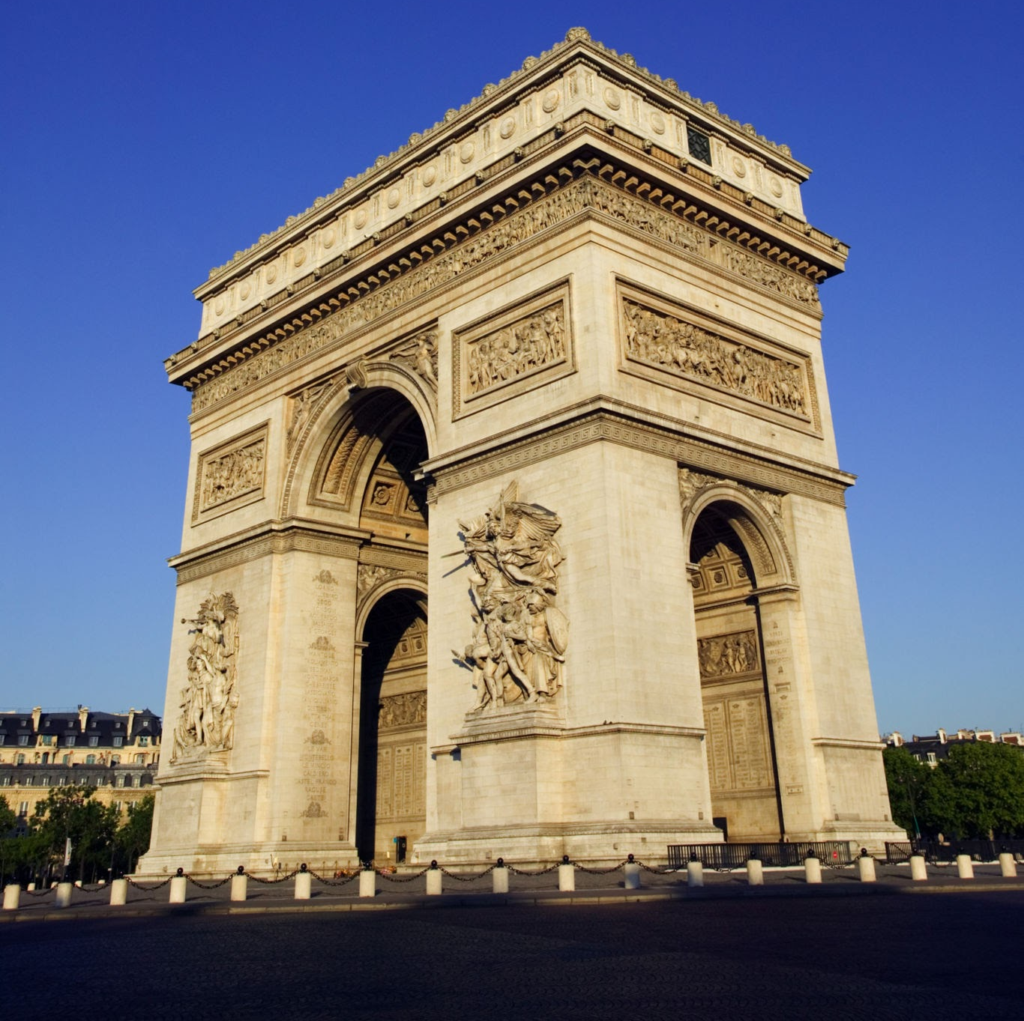
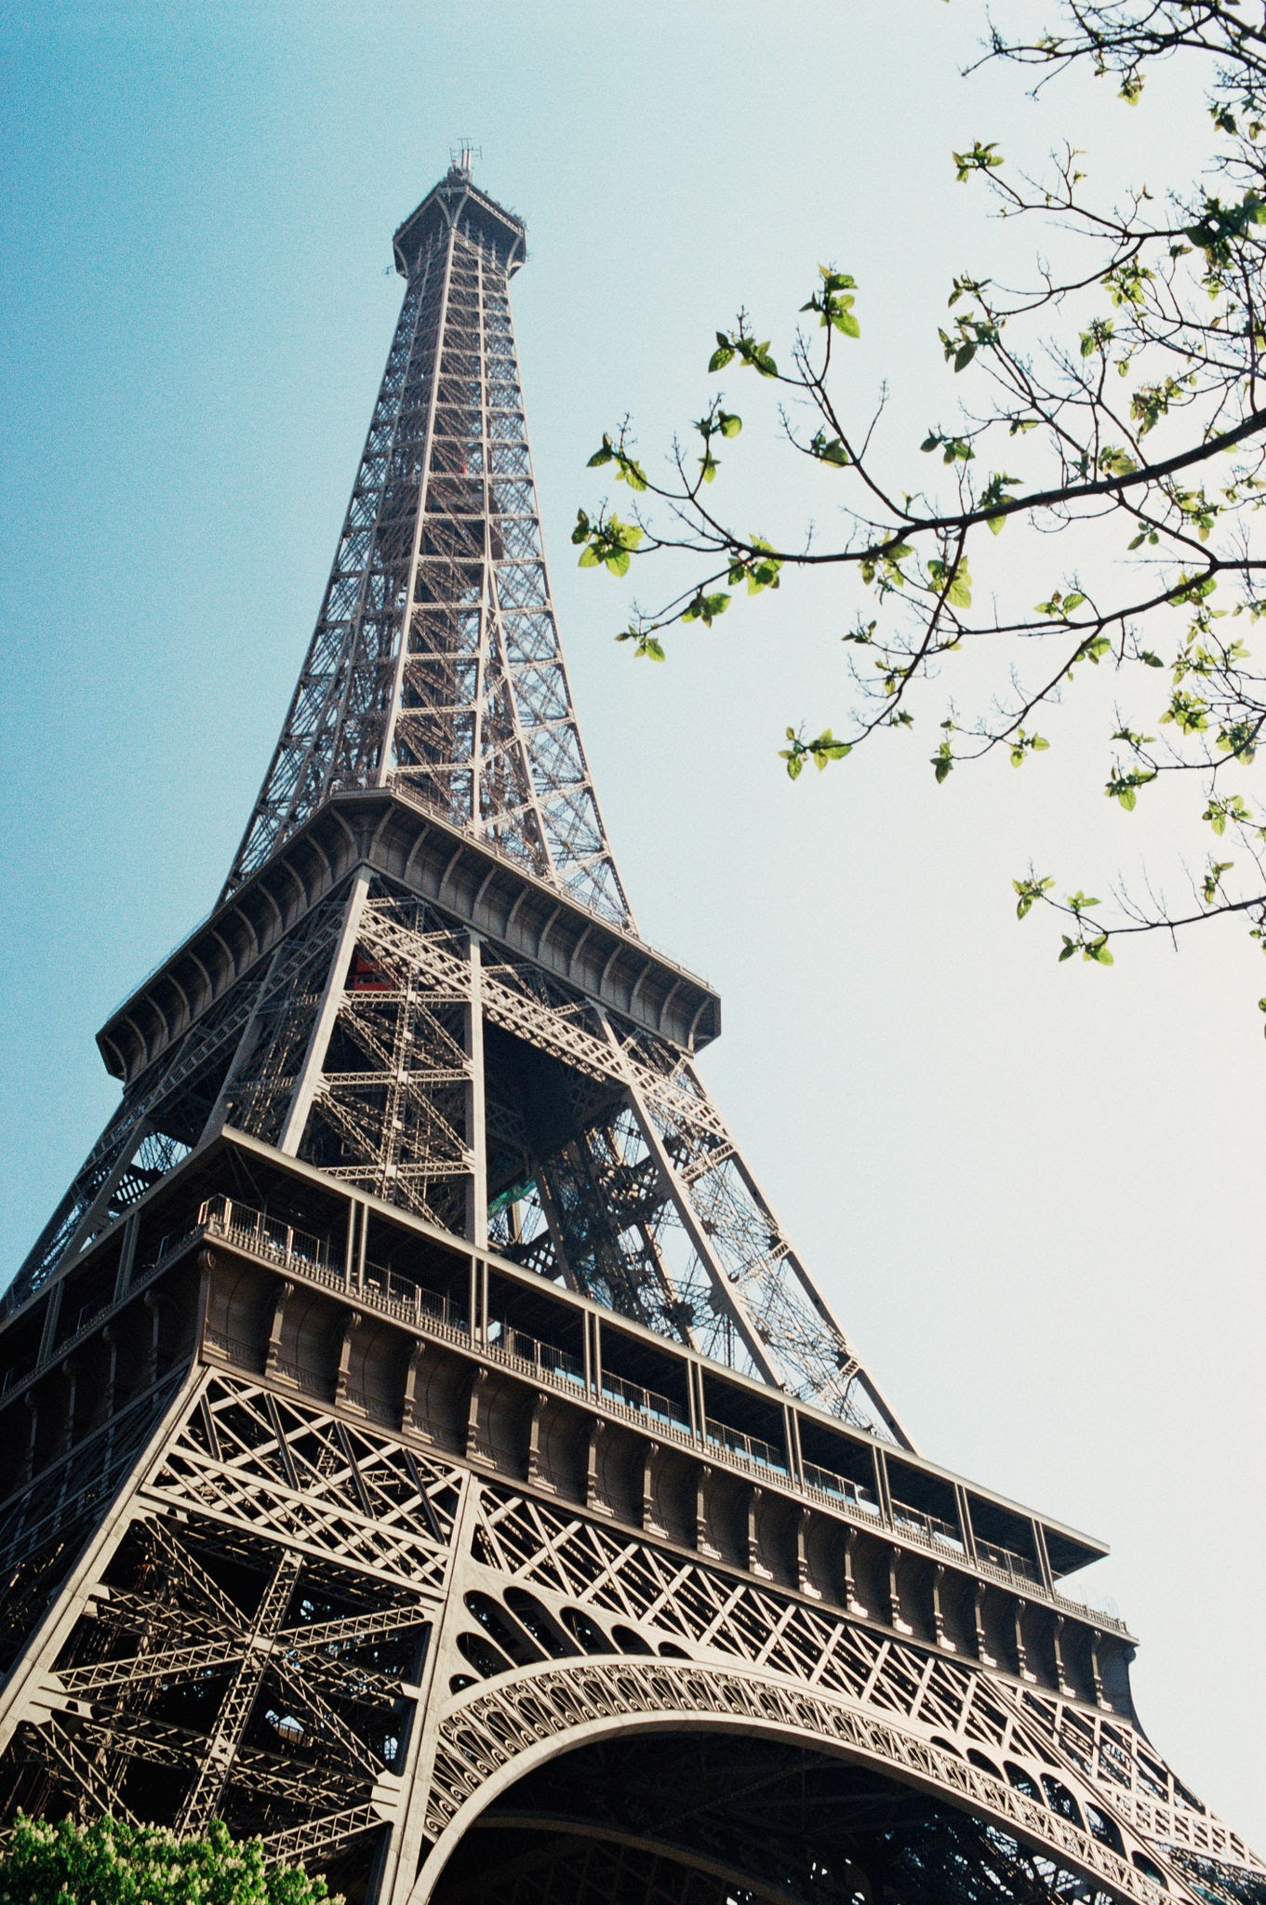
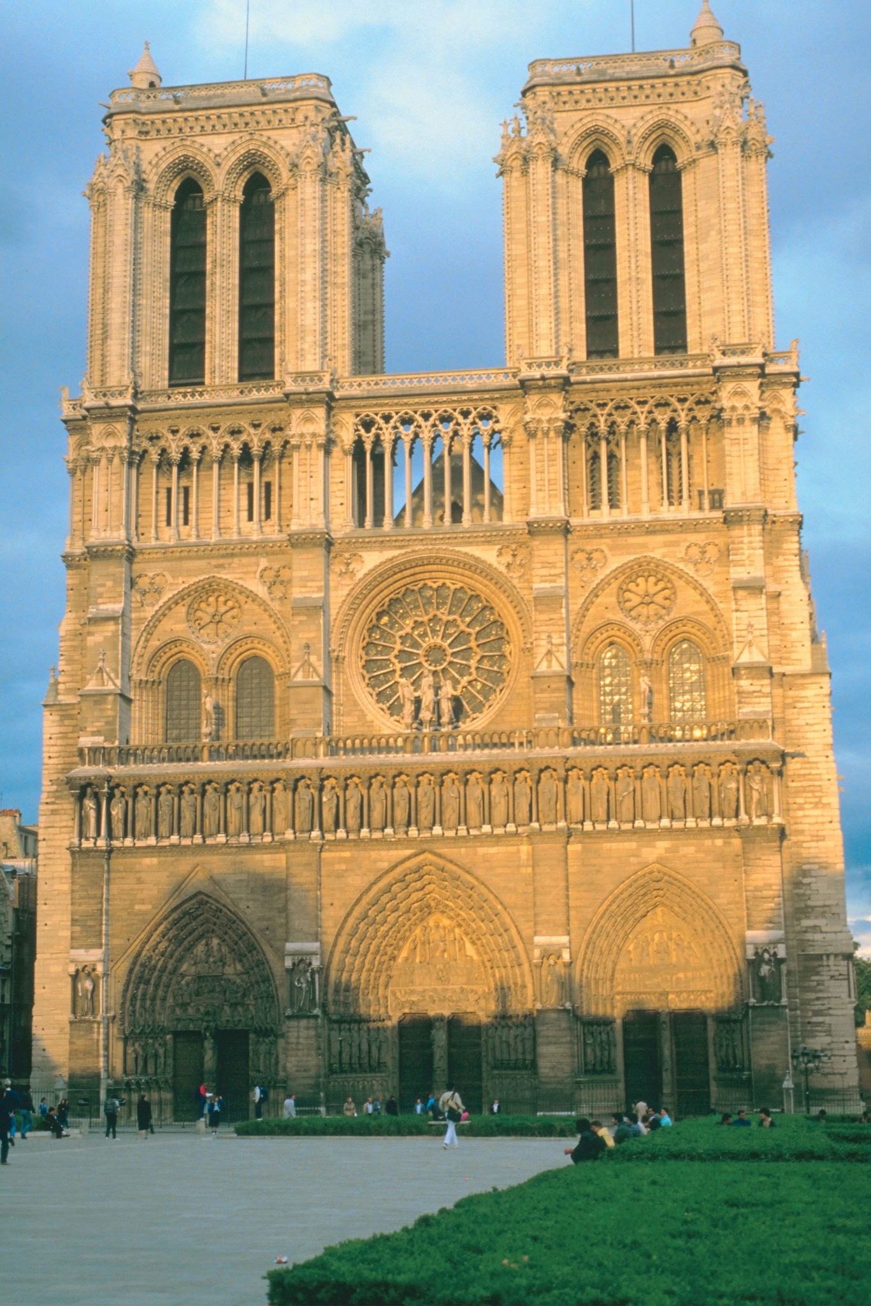
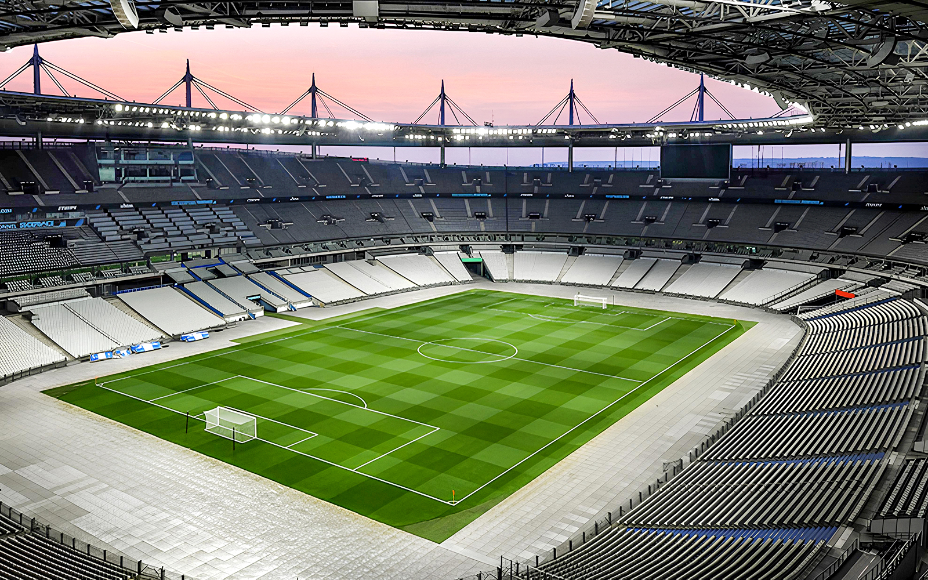
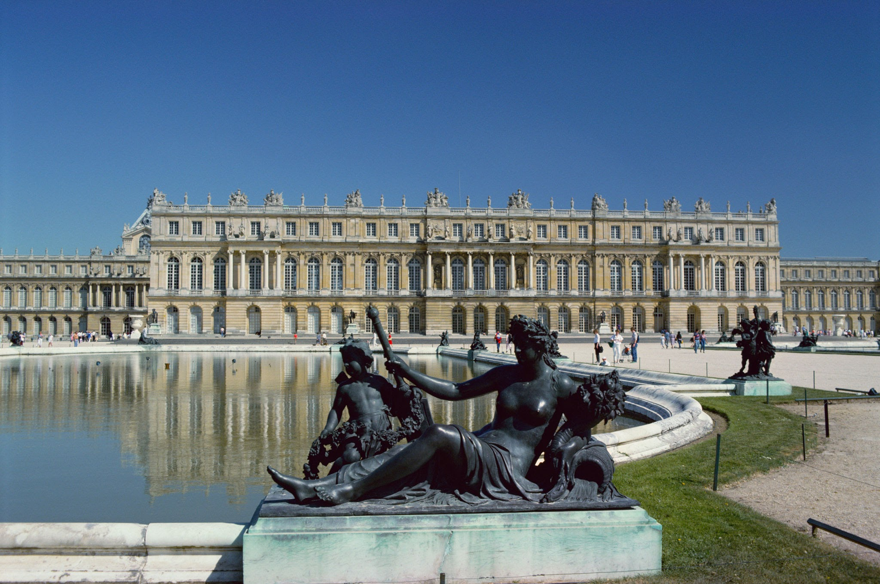
Que visiter à Paris?

Slide 5
Je visite…
la Stade de France
la Seine
la tour Eiffel
la cathédrale de Notre Dame

Slide 6
Je visite la tour Eiffel

Slide 7
Je visite la Stade de France

Slide 8
Je visite la cathédrale de Notre Dame

Slide 9
Je visite la Seine

