Slide 1



SFE
Silent final -e
[shy]
timide
Notes:
Without sound to elicit pronunciation (without first hearing the teacher).
Teacher to elicit pronunciation by asking “Comment dit-on …"

Slide 2




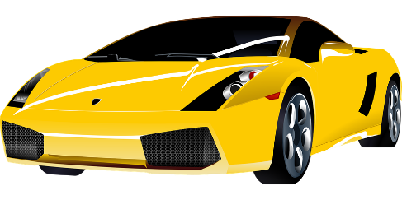



SFE
monde
moderne
[silent final –e]
[shy]
centre
timide
douze
vie
[life]
Notes:
Timing: 2 minutes
Aim: To introduce SSC [SFE]
Procedure:
1. Introduce and elicit the pronunciation of the individual SSC [SFE] and then the source word again ‘timide’ (with gesture, if using).
2. Then present and elicit the pronunciation of the five cluster words.
The cluster words have been chosen for their high-frequency, from a range of word classes, with the SSC (where possible) positioned within a variety of syllables within the words (e.g. initial, 2nd, final etc.). Additionally, we have tried to use words that build cumulatively on previously taught SSCs (see the Phonics Teaching Sequence document) and do not include new SSCs. Where new SSCs are used, they are often consonants which have a similar symbol-sound correspondence in English.
Word frequency (1 is the most frequent word in French):
monde [77]; moderne [1239] centre [491]; vie [132]; douze [1664]; timide [3835].
Source: Londsale, D., & Le Bras, Y. (2009). A Frequency Dictionary of French: Core vocabulary for learners London: Routledge.

Slide 3

Qui est ton ami?

Slide 4
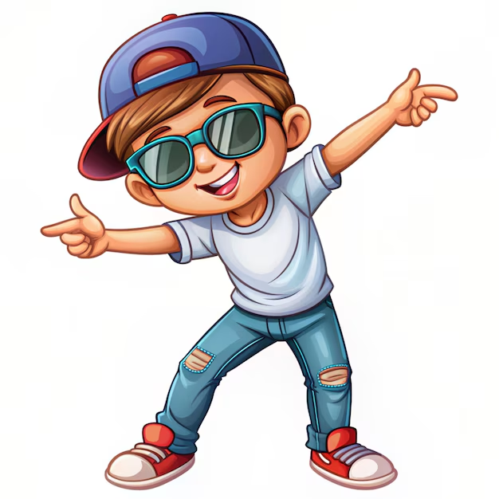





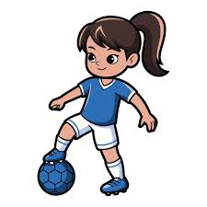

il
elle

Slide 5
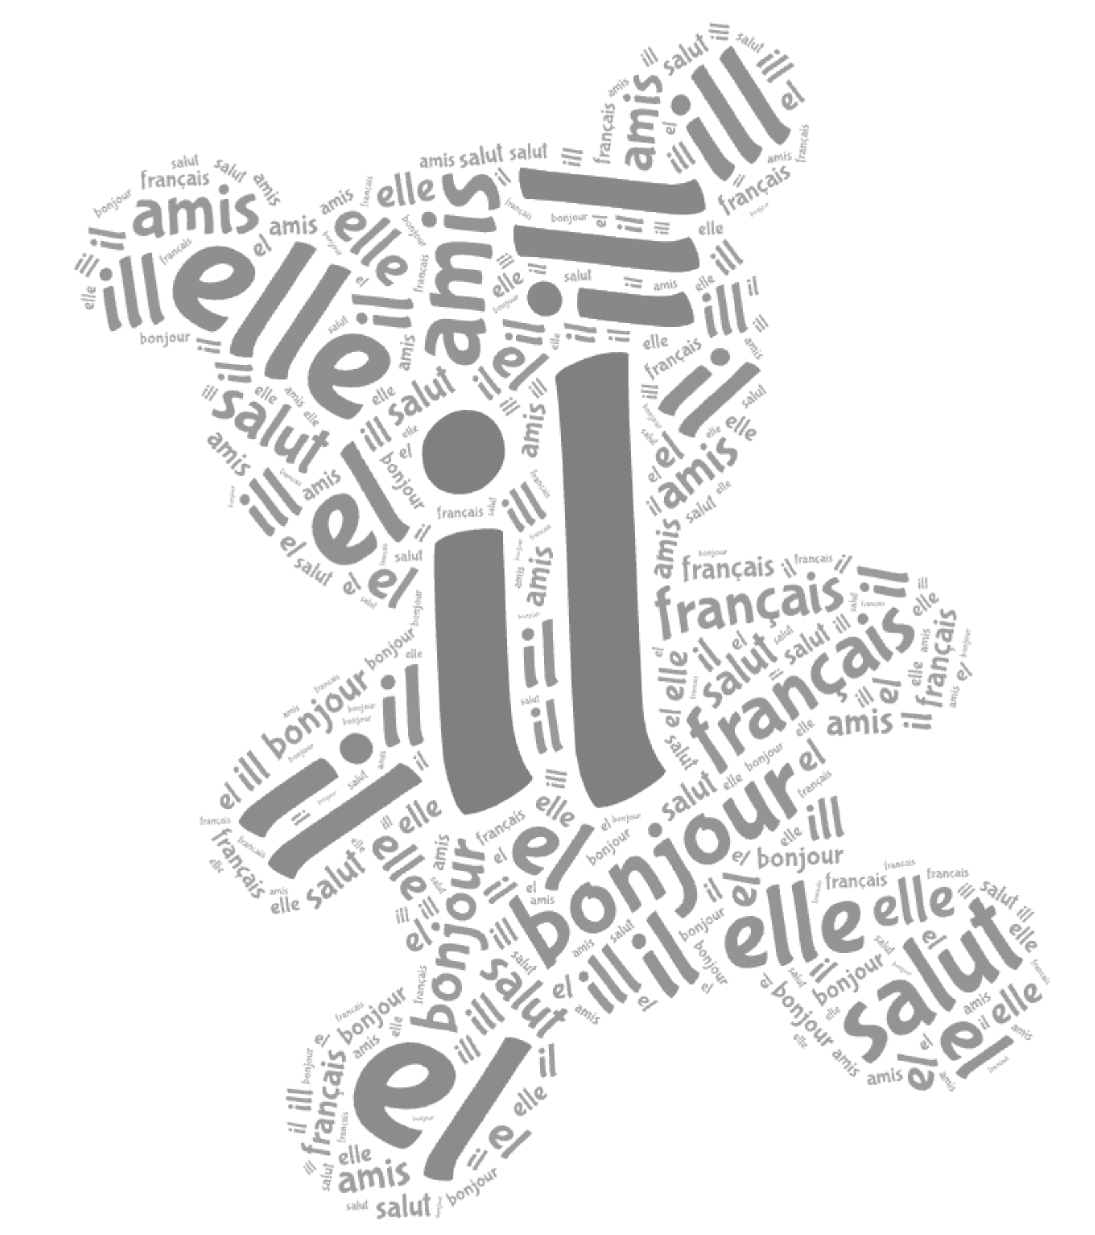
il
elle

Slide 6

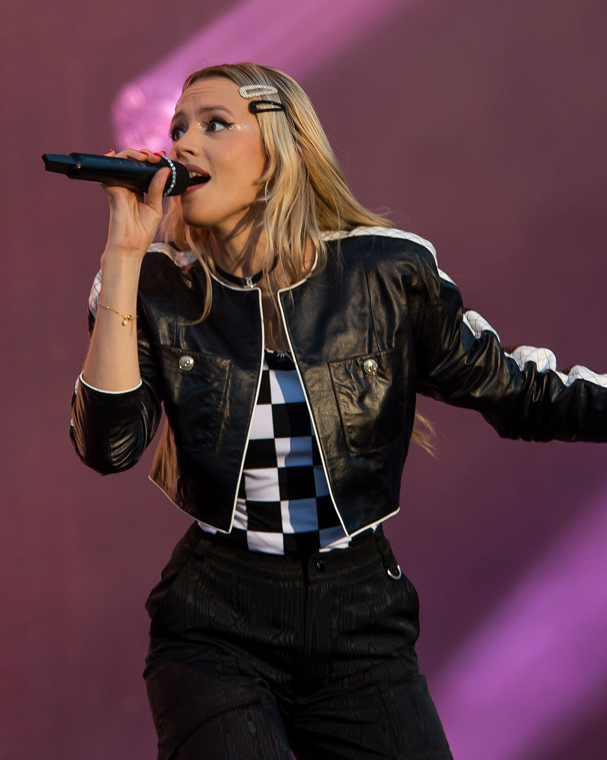
il s’appelle Kylian Mbappé
elle s’appelle Angèle

Slide 7
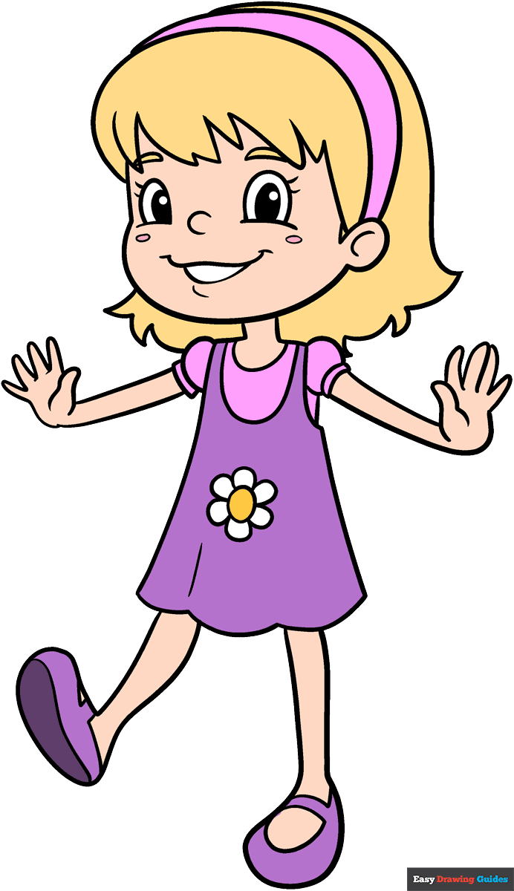
Elle
1. _________ s’appelle Alice.

Slide 8
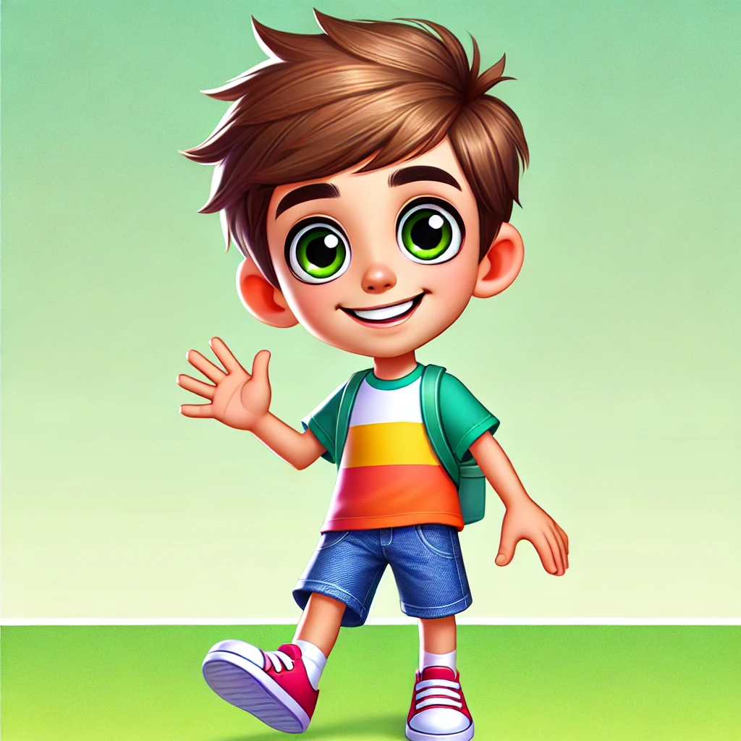
Il
2. _________ s’appelle Robert.

Slide 9

Il
3. _________ s’appelle Léo.

Slide 10
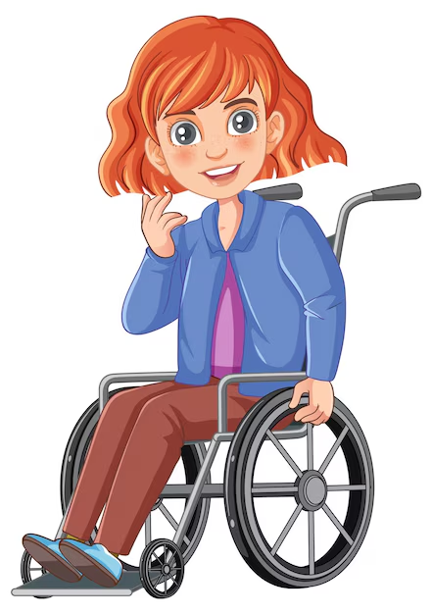
Elle
4. _________ s’appelle Louise.

Slide 11

Il
5. _________ s’appelle Gabriel.

Slide 12

il s’appelle ……
elle s’appelle …..

