Slide 1

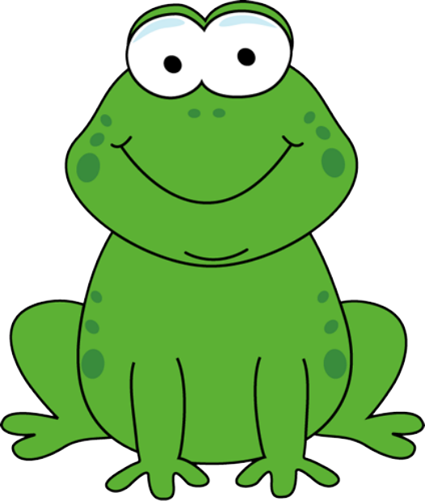
a
animal
Notes:
Timing: 1 minute
Aim: To introduce/consolidate SSC [a]
Procedure:
1. Present the letter(s) and say the [a] sound first, on its own. Students repeat it with you.
2. Bring up the word ”animal” on its own, say it, students repeat it, so that they have the opportunity to focus all of their attention on the connection between the written word and its sound.
3. A possible gesture for this would be to mimic an animal’s motion, perhaps holding ones arms and hands close to the chest as ‘paws’.
4. Roll back the animations and work through 1-3 again, but this time, dropping your voice completely to listen carefully to the students saying the [a] sound, pronouncing ”animal” and, if using, doing the gesture.
Word frequency (1 is the most frequent word in French):
animal [1002]
Source: Londsale, D., & Le Bras, Y. (2009). A Frequency Dictionary of French: Core vocabulary for learners London: Routledge.

Slide 2



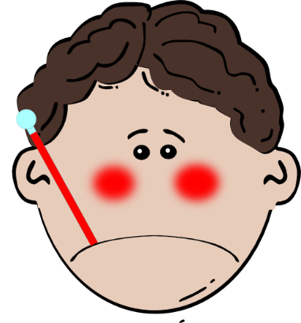

a
ça va ?
table
animal
malade
sac
mal
[badly]
Notes:
Timing: 2 minutes
Aim: To introduce/consolidate SSC [a]
Procedure:
1. Introduce and elicit the pronunciation of the individual SSC [a] and then the source word again ‘animal’ (with gesture, if using).
2. Then present and elicit the pronunciation of the five cluster words.
The cluster words have been chosen for their high-frequency, from a range of word classes, with the SSC (where possible) positioned within a variety of syllables within the words (e.g. initial, 2nd, final etc.). Additionally, we have tried to use words that build cumulatively on previously taught SSCs (see the Phonics Teaching Sequence document) and do not include new SSCs. Where new SSCs are used, they are often consonants which have a similar symbol-sound correspondence in English.
Word frequency (1 is the most frequent word in French):
animal [1002]; ça va? [54 (cela), 53 (aller)]; malade [1066] mal [277]; table [1019]; sac [2343]
Source: Londsale, D., & Le Bras, Y. (2009). A Frequency Dictionary of French: Core vocabulary for learners London: Routledge.

Slide 3
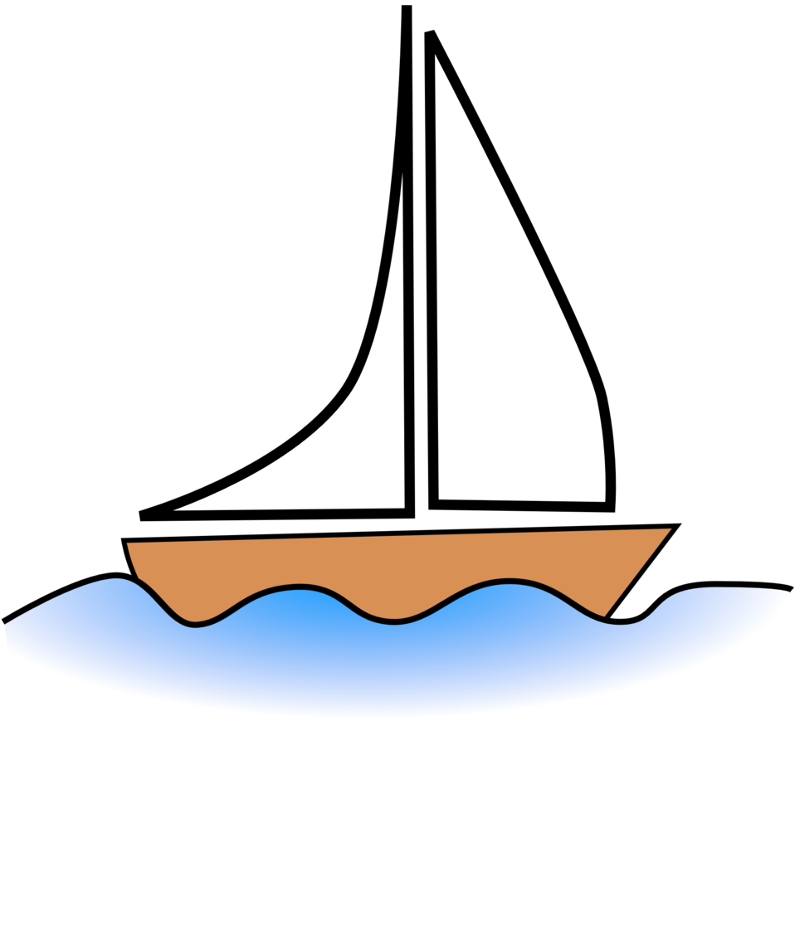



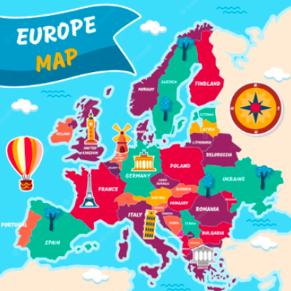
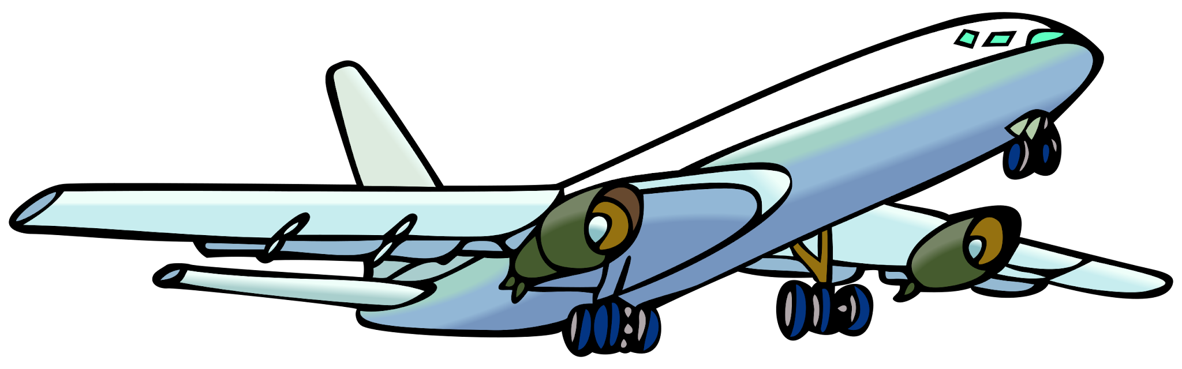

Où voyages-tu?

Slide 4
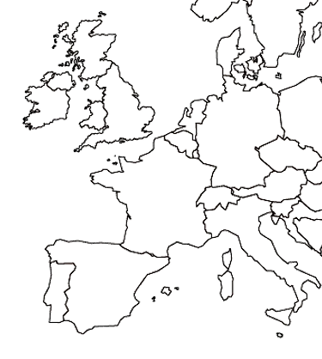




Je voyage…
en France
en Angleterre
en Belgique
en Suisse

Slide 5
Spain
Germany
Germany / Netherlands / Spain / Portugal
Portugal
Netherlands

Slide 6
Je voyage…
en Espagne
en Allemagne
au Portugal
aux Pays-Bas

Slide 7
en Espagne
en Allemagne
en Angleterre
en France
au Portugal
aux Pays-Bas
en Belgique
en Suisse

Slide 8
Je voyage…
en
au
aux

Slide 9
Quel est le problème?
Je voyage au France.
je voyage en allemagne.
J’aime voyager en England.
Je voyage en Suise.
Normalement je voyage aux Belgique ou en Pays-Bas.
Je voyage en France.
Je voyage en Allemagne.
J’aime voyager en Angleterre.
Je voyage en Suisse.
Normalement je voyage en Belgique ou aux Pays-Bas.

Slide 10


