Slide 1


ain/in
train
Notes:
Timing: 1 minute
Aim: To introduce SSC [ain/in]
Procedure:
1. Present the letter(s) and say the [ain/in] sound first, on its own. Students repeat it with you.
2. Bring up the word ”train” on its own, say it, students repeat it, so that they have the opportunity to focus all of their attention on the connection between the written word and its sound.
3. A possible gesture for this would be to move both arms simultaneously forwards and back in a circular motion, simulating the motion of train wheel connecting rods.
4. Roll back the animations and work through 1-3 again, but this time, dropping your voice completely to listen carefully to the students saying the [ain/in] sound, pronouncing ”train” and, if using, doing the gesture.
Word frequency (1 is the most frequent word in French):
train [232].
Source: Londsale, D., & Le Bras, Y. (2009). A Frequency Dictionary of French: Core vocabulary for learners London: Routledge.

Slide 2

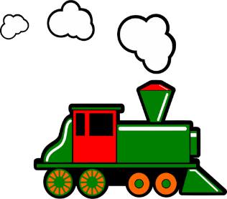


ain/in
fin
matin
[end]
vingt
train
main
maintenant
[now]
Notes:
Timing: 2 minutes
Aim: To introduce SSC [ain/in]
Procedure:
1. Introduce and elicit the pronunciation of the individual SSC [ain/in] and then the source word again ‘train’ (with gesture, if using).
2. Then present and elicit the pronunciation of the five cluster words.
The cluster words have been chosen for their high-frequency, from a range of word classes, with the SSC (where possible) positioned within a variety of syllables within the words (e.g. initial, 2nd, final etc.). Additionally, we have tried to use words that build cumulatively on previously taught SSCs (see the Phonics Teaching Sequence document) and do not include new SSCs. Where new SSCs are used, they are often consonants which have a similar symbol-sound correspondence in English.
Word frequency (1 is the most frequent word in French):
fin [111]; matin [442] vingt[1273]; maintenant [192]; main [418]; train [232].
Source: Londsale, D., & Le Bras, Y. (2009). A Frequency Dictionary of French: Core vocabulary for learners London: Routledge.

Slide 3
ain/in
fin
matin
train
vingt
main
maintenant
Notes:
With sound and no pictures to focus all attention on the sound-symbol correspondence.

Slide 4
Voici ma famille (Frère Jacques)
Voici ma mère, voici ma mère
Voici mon père, voici mon père
Voici mes parents, voici mes parents
J’aime ma famille, j’aime ma famille
Voici ma soeur, voici ma soeur
Voici mon frère, voici mon frère
Voici les enfants, voici les enfants
Et moi aussi, et moi aussi
Notes:
Song - to the tune of Frère Jacques

Slide 5




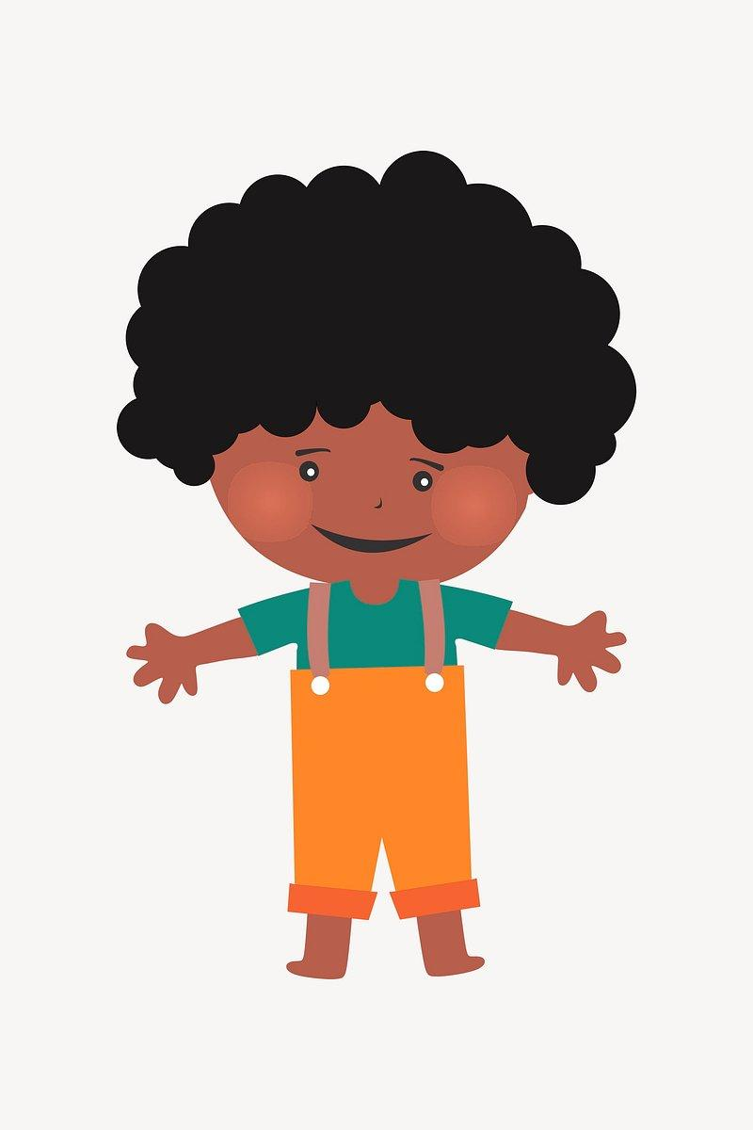

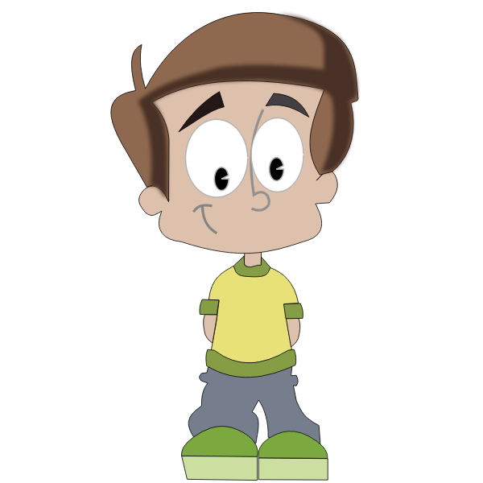

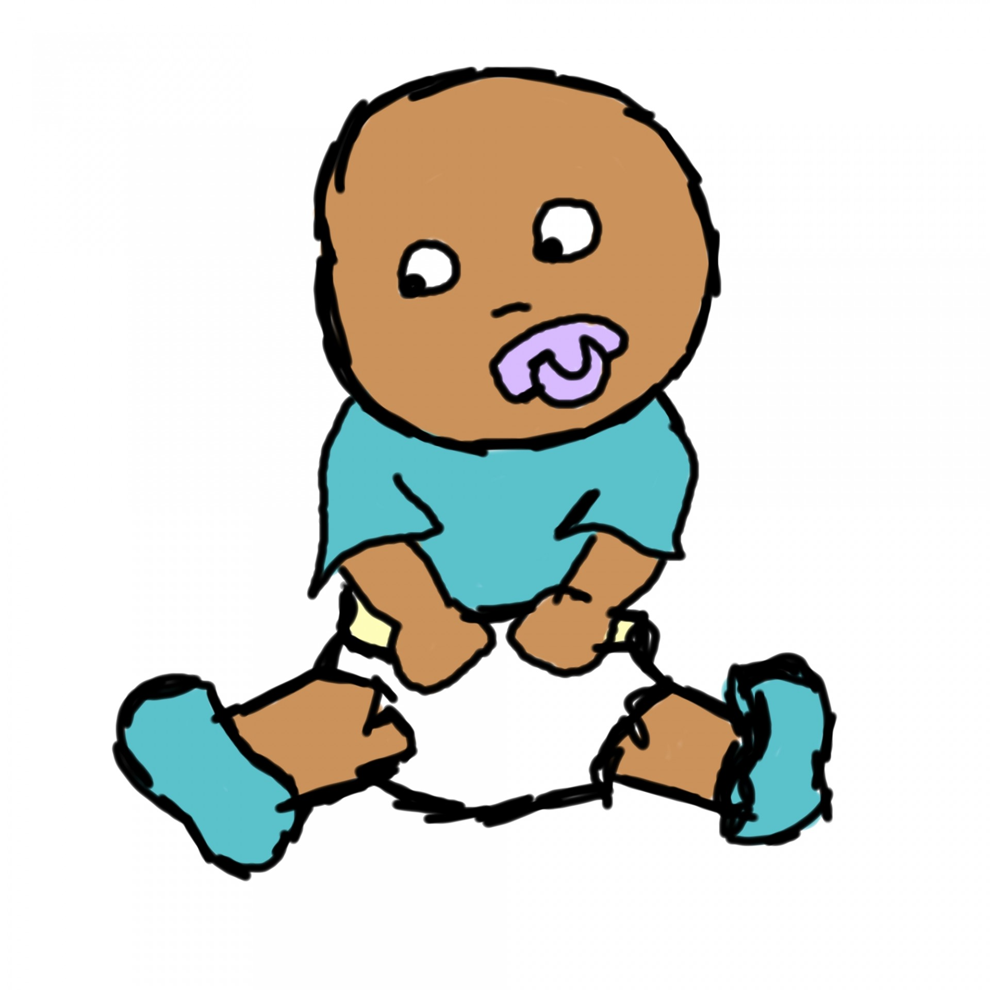
Voici ma famille
plus large
Qui est dans ta famille?

Slide 6
Voici…
ma tante
mon oncle
ma mère
mon père
mon cousin
ma cousine
moi
ma soeur
mon frère

Slide 7




mes cousins
ma cousine
mon cousin
ma tante
mon oncle
 | Voici ma mère et | Voici mon père et | Voici moi et | Voici ma soeur et | Voici mon frère et
raté! touché! coulé!

Slide 8
1)
2)
3)
ma tante
ma mère
mon frère
mon père
ma cousine
mon cousin
mes parents
mes cousins
mon oncle

