Slide 1


a
animal
Notes:
Timing: 1 minute
Aim: To introduce/consolidate SSC [a]
Procedure:
1. Present the letter(s) and say the [a] sound first, on its own. Students repeat it with you.
2. Bring up the word ”animal” on its own, say it, students repeat it, so that they have the opportunity to focus all of their attention on the connection between the written word and its sound.
3. A possible gesture for this would be to mimic an animal’s motion, perhaps holding ones arms and hands close to the chest as ‘paws’.
4. Roll back the animations and work through 1-3 again, but this time, dropping your voice completely to listen carefully to the students saying the [a] sound, pronouncing ”animal” and, if using, doing the gesture.
Word frequency (1 is the most frequent word in French):
animal [1002]
Source: Londsale, D., & Le Bras, Y. (2009). A Frequency Dictionary of French: Core vocabulary for learners London: Routledge.

Slide 2



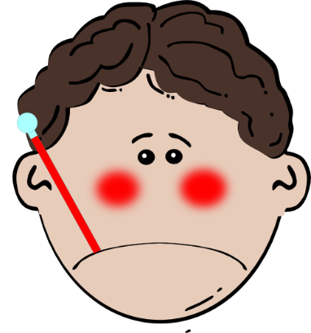

a
ça va ?
table
animal
malade
sac
mal
[badly]
Notes:
Timing: 2 minutes
Aim: To introduce/consolidate SSC [a]
Procedure:
1. Introduce and elicit the pronunciation of the individual SSC [a] and then the source word again ‘animal’ (with gesture, if using).
2. Then present and elicit the pronunciation of the five cluster words.
The cluster words have been chosen for their high-frequency, from a range of word classes, with the SSC (where possible) positioned within a variety of syllables within the words (e.g. initial, 2nd, final etc.). Additionally, we have tried to use words that build cumulatively on previously taught SSCs (see the Phonics Teaching Sequence document) and do not include new SSCs. Where new SSCs are used, they are often consonants which have a similar symbol-sound correspondence in English.
Word frequency (1 is the most frequent word in French):
animal [1002]; ça va? [54 (cela), 53 (aller)]; malade [1066] mal [277]; table [1019]; sac [2343]
Source: Londsale, D., & Le Bras, Y. (2009). A Frequency Dictionary of French: Core vocabulary for learners London: Routledge.

Slide 3
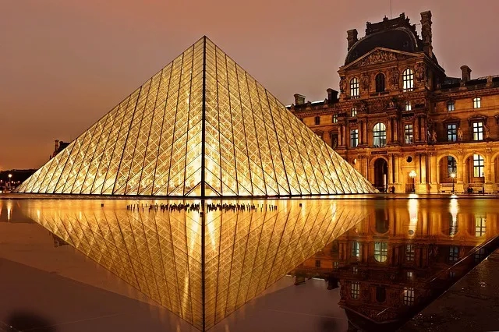
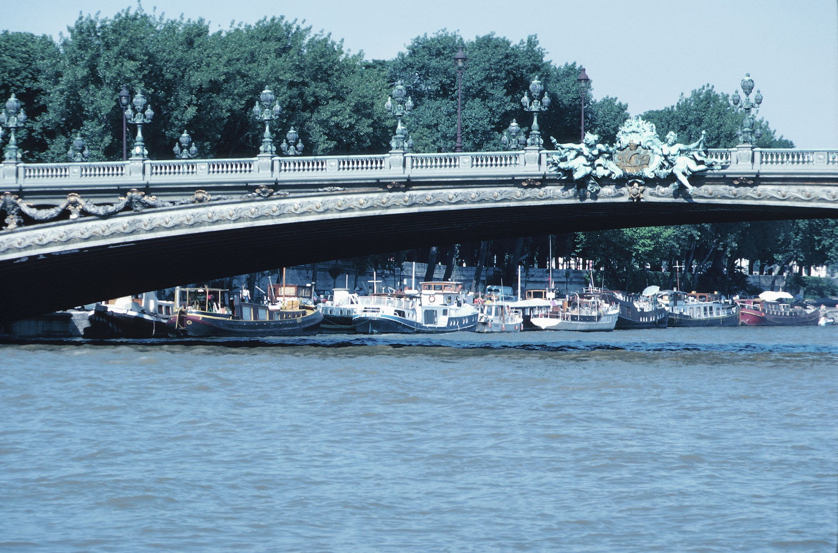
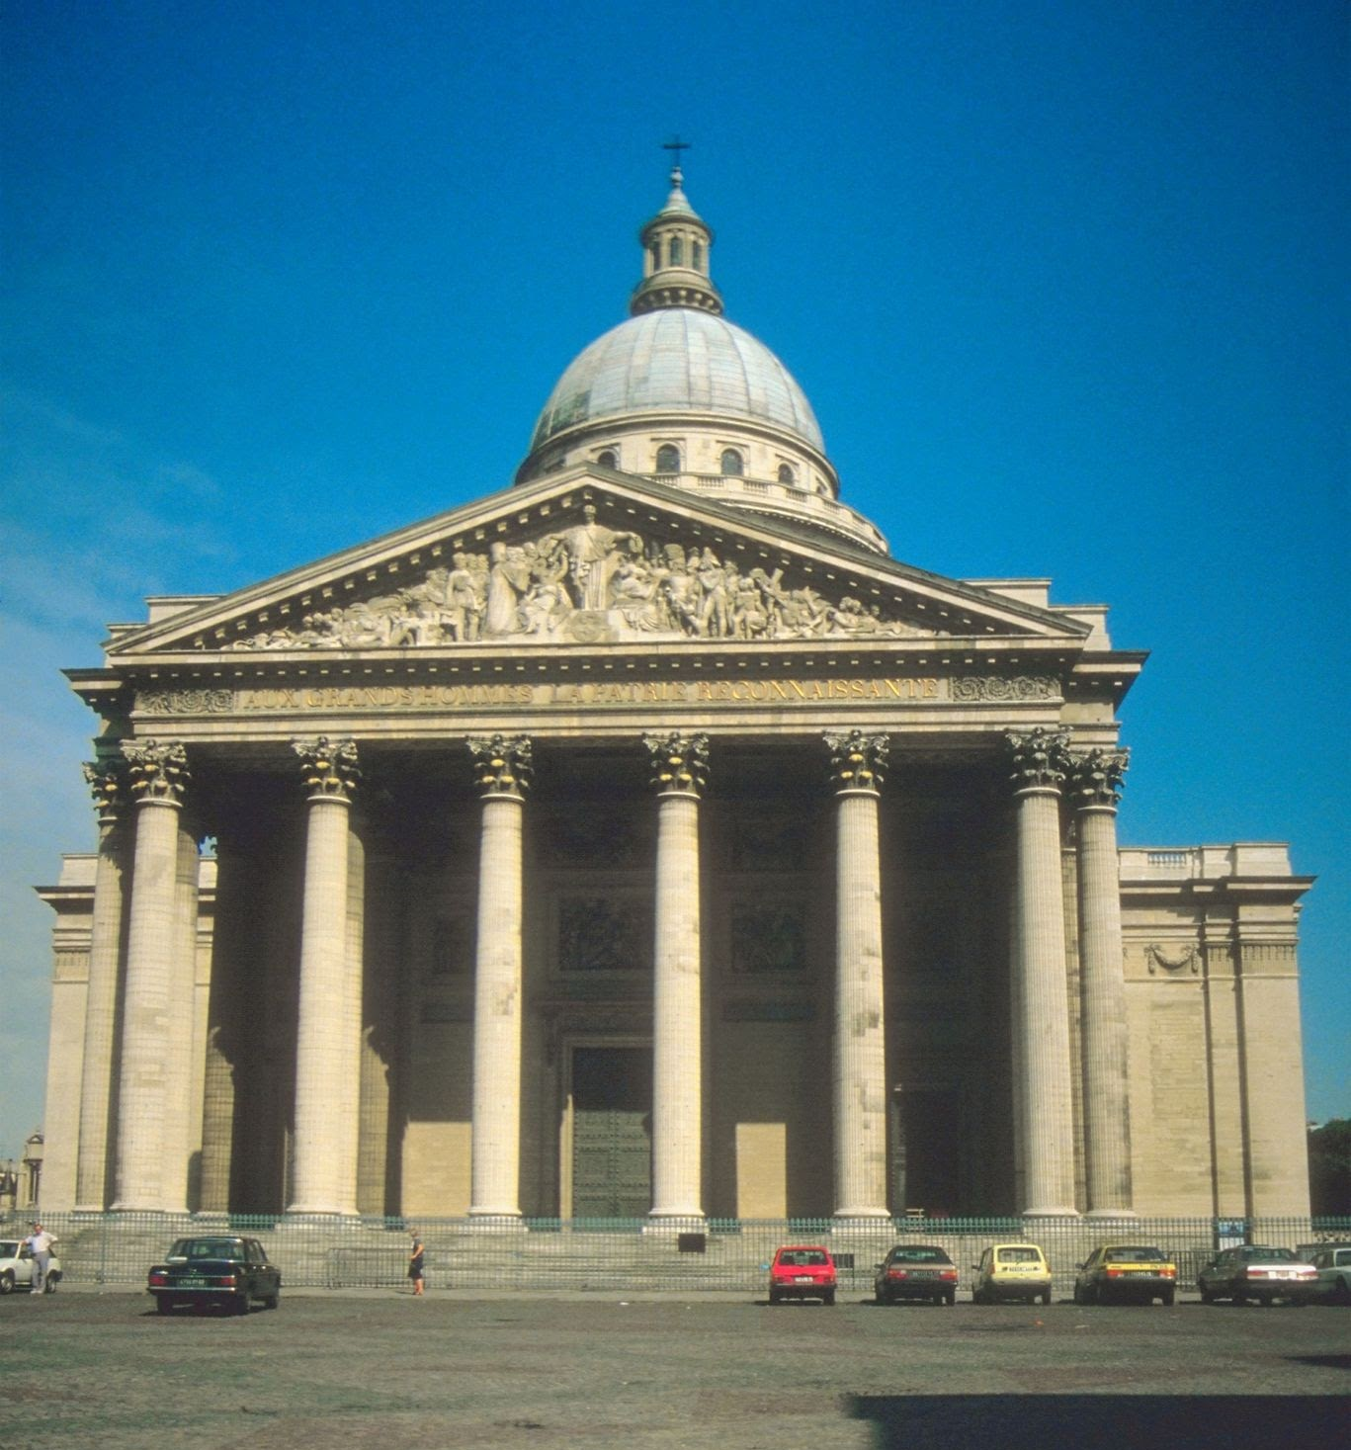
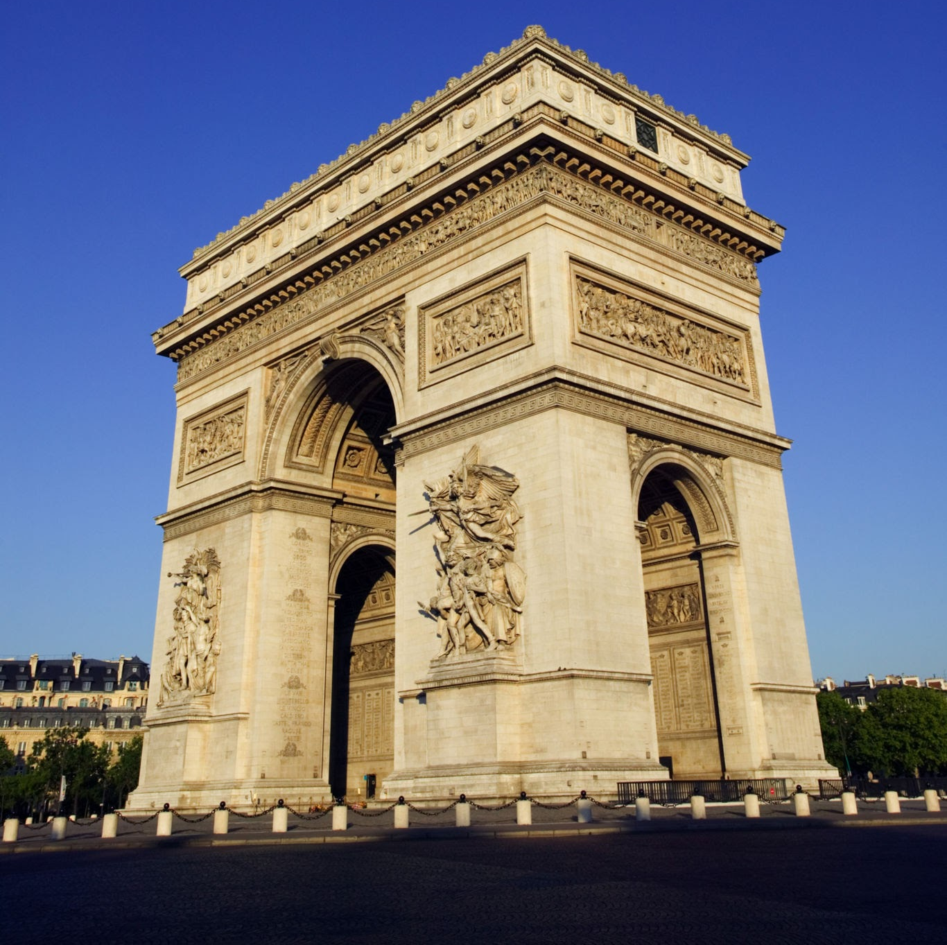
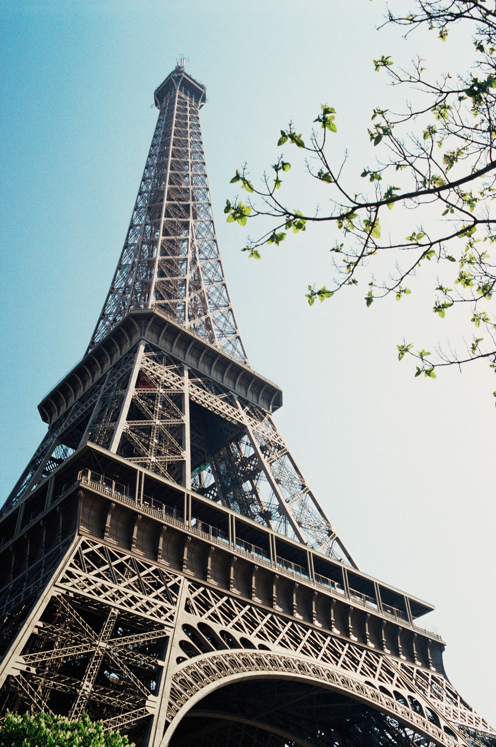
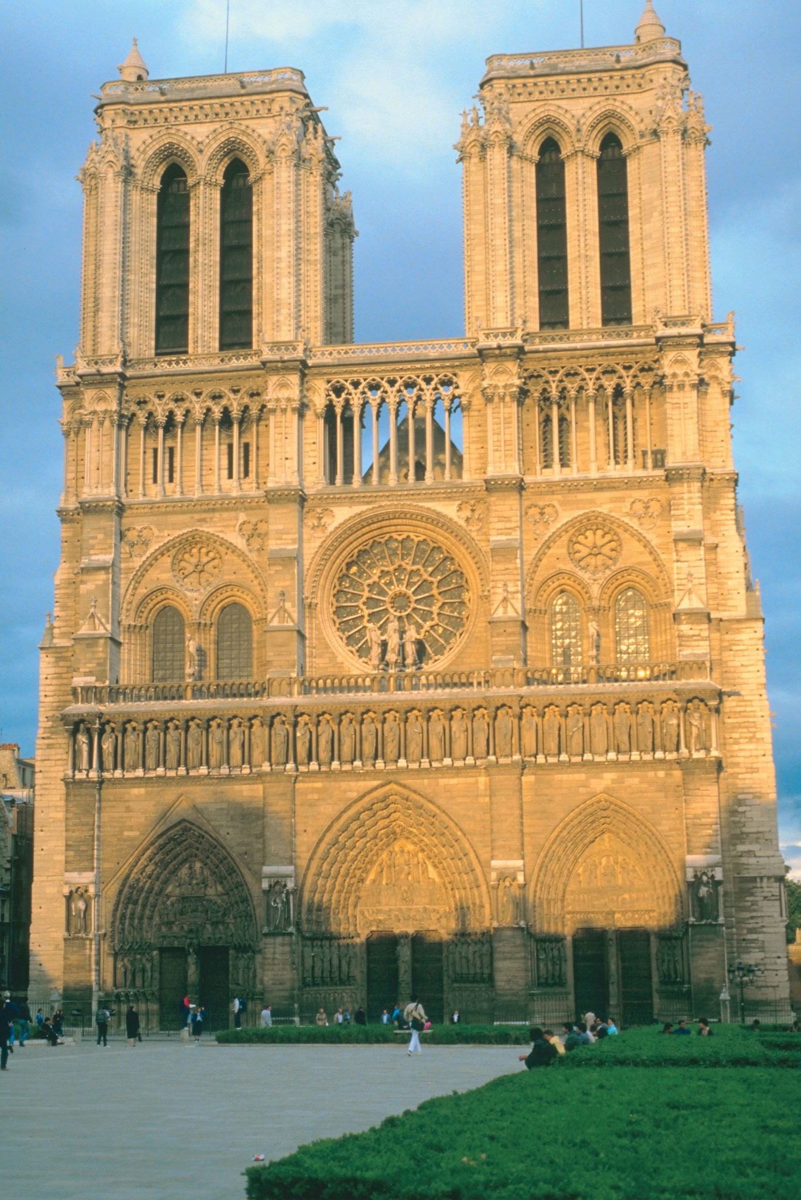
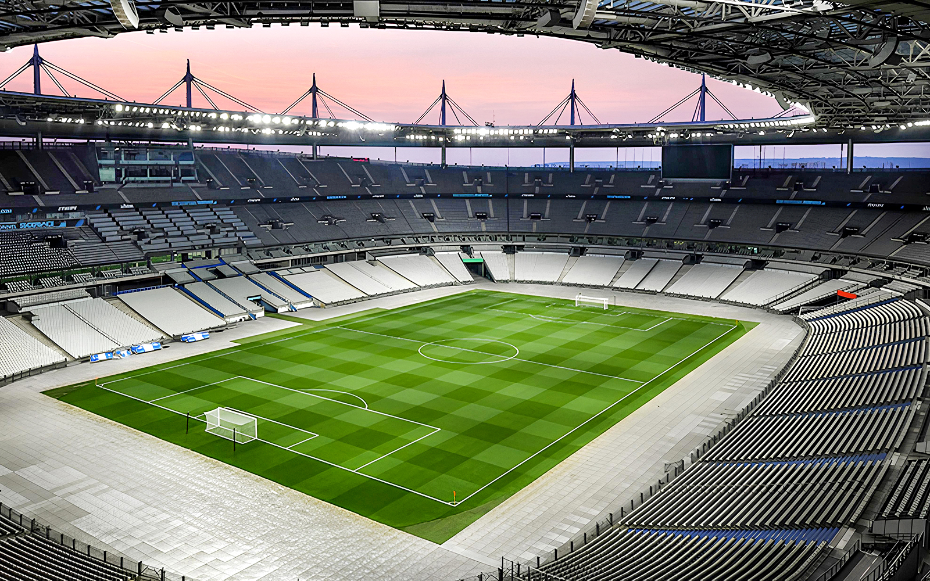
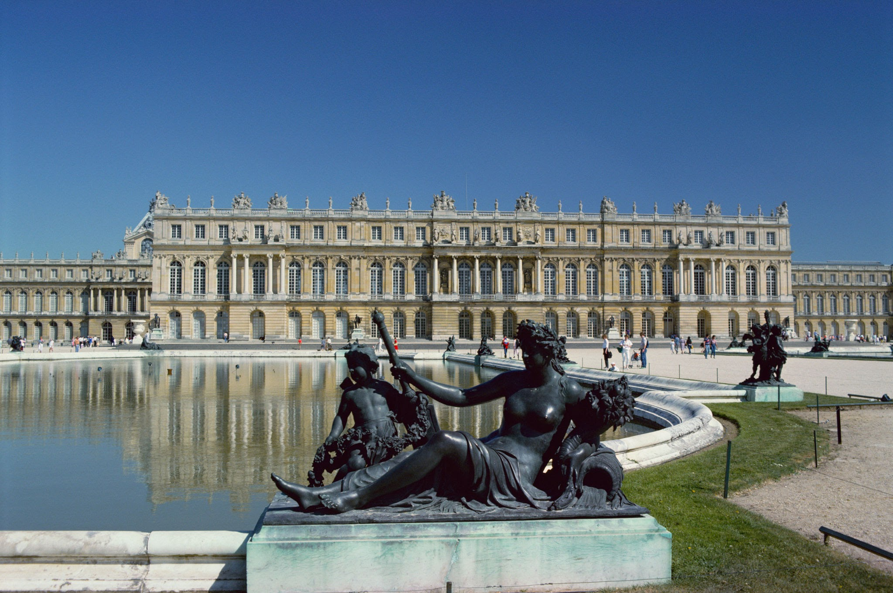
Que visiter à Paris?

Slide 4
Je visite…
le Panthéon
le Palais de Versailles
le musée du Louvre
l’Arc de Triomphe

Slide 5
Je visite…
la tour Eiffel
la Stade de France
l’Arc de Triomphe
le Panthéon
Notre Dame
la Seine
le Louvre
Versailles

Slide 6
Je visite…

Slide 7
Quel est le problème?
Je visite la Eiffel tour.
Je visite le Arc de Triomphe.
Je visite le Stade de France.
Je visite la Palais de Versailles.
Je visite la Pantheon.
Je visite la tour Eiffel.
Je visite l’Arc de Triomphe.
Je visite la Stade de France.
Je visite le Palais de Versailles.
Je visite le Panthéon.

Slide 8
P???S

