Slide 1
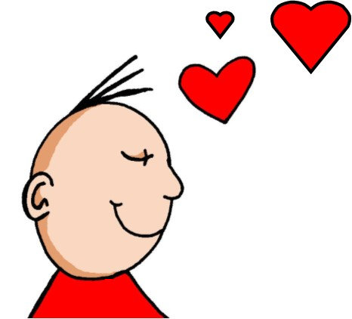

ie
Liebe
Notes:
Aim: To introduce/consolidate SSC [ie]
Procedure:
1. Present the letter(s) and say the [ie] sound first, on its own. Students repeat it with you.
2. Bring up the word ”Liebe” on its own, say it, students repeat it, so that they have the opportunity to focus all of their attention on the connection between the written word and its sound.
3. A possible gesture for this would be to fold both hands over your heart, and smile!
4. Roll back the animations and work through 1-3 again, but this time, dropping your voice completely to listen carefully to the students saying the [ie] sound, pronouncing ”Liebe” and, if using, doing the gesture.
Word frequency (1 is the most frequent word in German):
Liebe [843]
Source: Jones, R.L. & Tschirner, E. (2006). A frequency dictionary of German: core vocabulary for learners. Routledge

Slide 2
ie
Liebe
Notes:
With sound and no pictures to focus all attention on the sound-symbol correspondence.

Slide 3
ie
Liebe
Notes:
Without sound to elicit pronunciation - then can they say it - then listen to it
Teacher to elicit pronunciation by asking “Wie sagt man…”

Slide 4
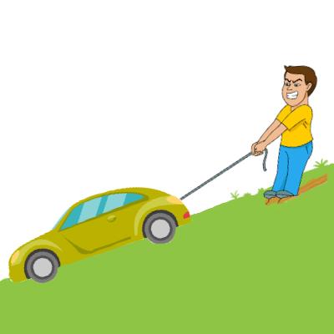
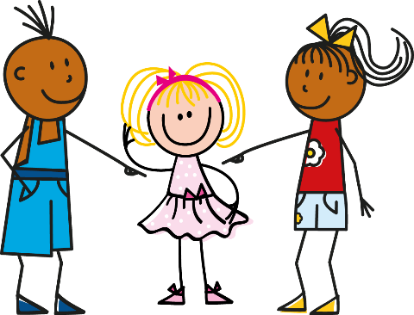
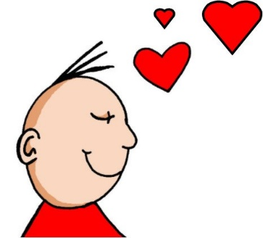



ie
ziehen
sie
Liebe
tief
Brief
liegen
2000 Kilometer
Notes:
Timing: 2 minutes - can they work out these words before hearing them?
Aim: To introduce/consolidate SSC [ie]
Procedure:
Introduce and elicit the pronunciation of the individual SSC [ie] and then the source word again ‘Liebe’ (with gesture, if using).
Then present and elicit the pronunciation of the five cluster words.
The cluster words have been chosen for their high-frequency, from a range of word classes, with the SSC (where possible) positioned within a variety of syllables within the words (e.g. initial, 2nd, final etc.). Additionally, we have tried to use words that build cumulatively on previously taught SSCs (see the Phonics Teaching Sequence document) and do not include new SSCs. Where new SSCs are used, they are often consonants which have a similar symbol-sound correspondence in English.
Word frequency (1 is the most frequent word in German):
Liebe [843]; ziehen[266] sie [10]; tief [506]; liegen [118]; Brief [813].
Source: Jones, R.L. & Tschirner, E. (2006). A frequency dictionary of German: core vocabulary for learners. Routledge

Slide 5
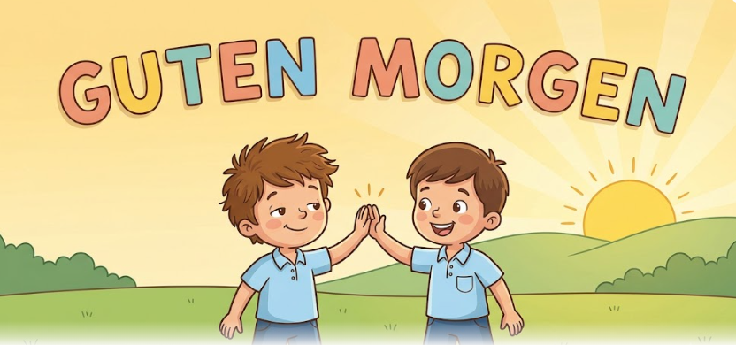
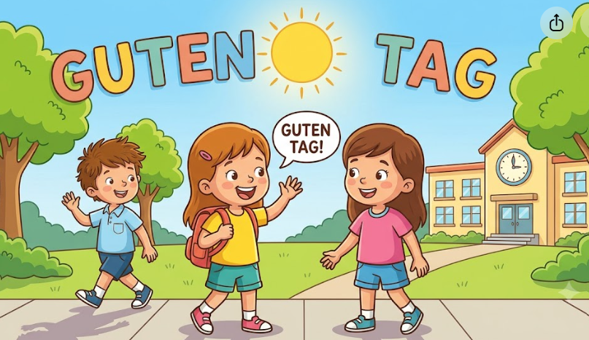
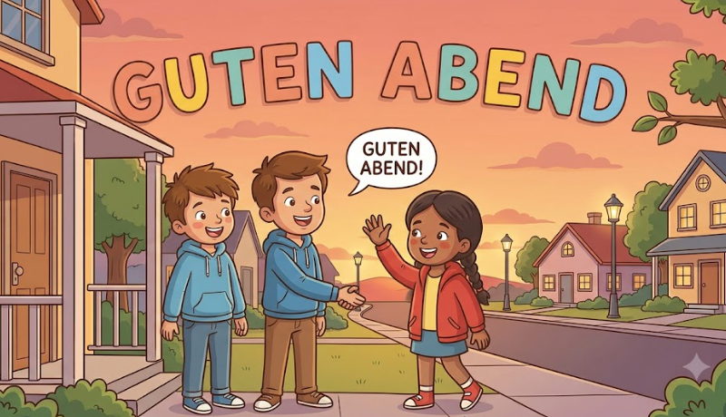
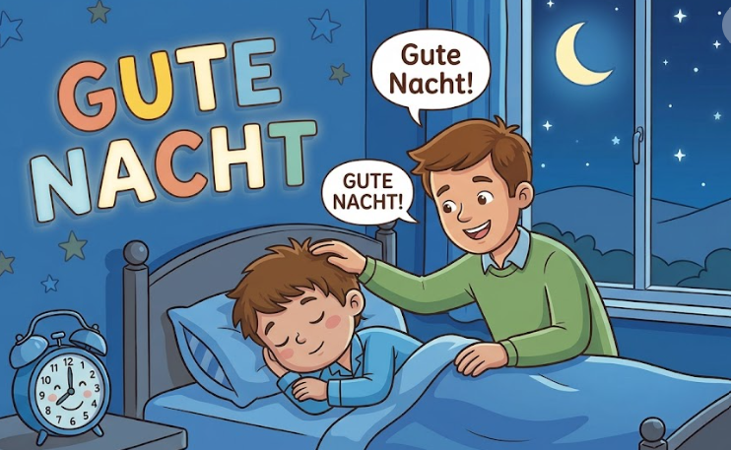
Guten Morgen | Guten Morgen
Guten Tag | Guten Tag
Guten Abend | Guten Abend
Gute Nacht | Gute Nacht
Notes:
Retrieval - Frere Jacques - guten Morgen, guten Morgen - guten Tag, guten Tag - guten Abend, guten Abend - gute Nacht, gute Nacht

Slide 6
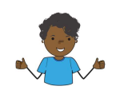
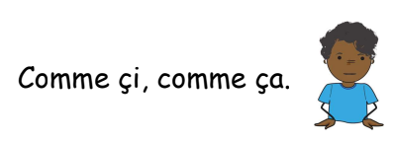
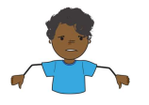
Wie geht’s?
Mir geht’s gut
Mir geht’s prima
Mir geht’s okay
Mir geht’s nicht gut
Notes:
Teach with actions -

Slide 7
gut
prima
okay
nicht gut
 | Guten Morgen. Mir geht’s….. | Guten Tag. Mir geht’s ……. | Guten Abend. Mir geht’s……. | Hallo. Mir geht’s…..

Slide 8
Wie geht’s?
Mir geht’s gut
Mir geht’s prima
Mir geht’s okay
Mir geht’s nicht gut
Notes:
Support for final activity if needed

