Slide 1
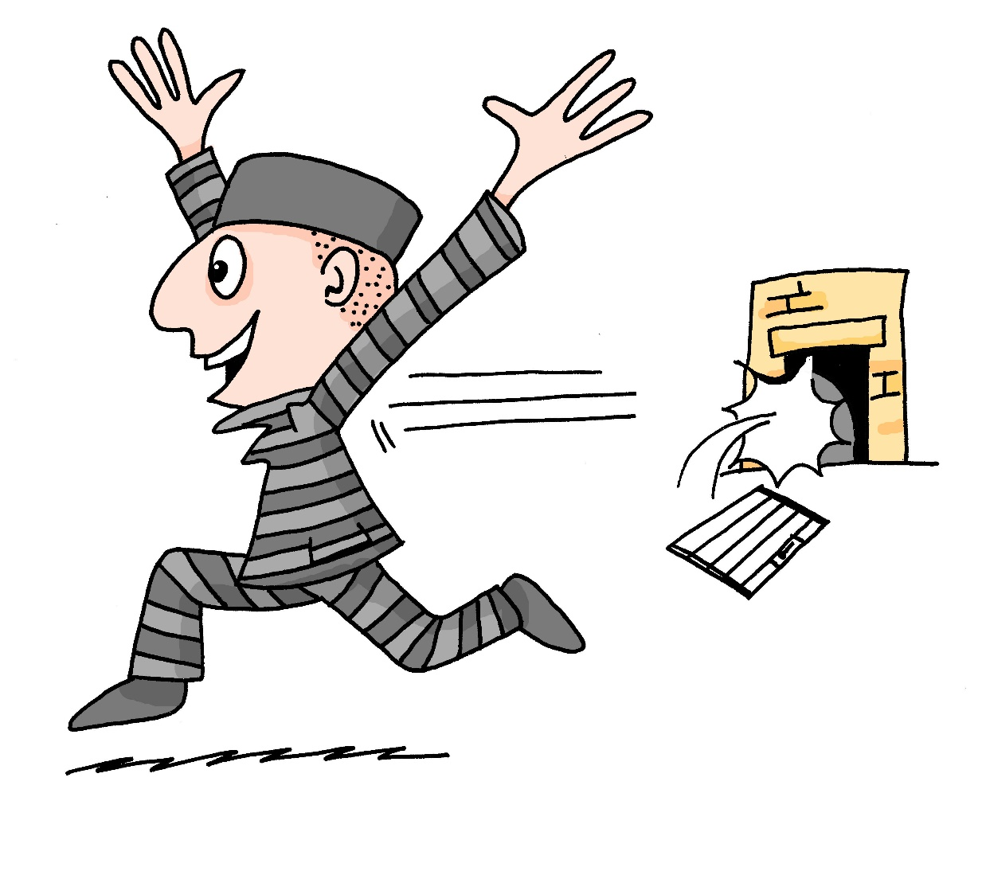

ei
frei
Notes:
Timing: 1 minute
Aim: To introduce/consolidate SSC [ei]
Procedure:
1. Present the letter(s) and say the [ei] sound first, on its own. Students repeat it with you.
2. Bring up the word ”frei” on its own, say it, students repeat it, so that they have the opportunity to focus all of their attention on the connection between the written word and its sound.
3. A possible gesture for this would be to stretch both arms up in the air (pointing outwards slightly to make a Y shape with your body), and smile!
4. Roll back the animations and work through 1-3 again, but this time, dropping your voice completely to listen carefully to the students saying the [ei] sound, pronouncing ”frei” and, if using, doing the gesture.
Word frequency (1 is the most frequent word in German):
frei [318]
Source: Jones, R.L. & Tschirner, E. (2006). A frequency dictionary of German: core vocabulary for learners. Routledge

Slide 2
ei
frei
Notes:
With sound and no pictures to focus all attention on the sound-symbol correspondence.

Slide 3
ei
frei
Notes:
Without sound to elicit pronunciation (without first hearing the teacher).
Teacher to elicit pronunciation by asking “Wie sagt man…”

Slide 4





ei
leider
ein
[unfortunately]
/a
frei
klein
allein
sein
[alone]
[to be]
Notes:
Timing: 2 minutes
Aim: To introduce/consolidate SSC [ei]
Procedure:
Introduce and elicit the pronunciation of the individual SSC [ei] and then the source word again ‘frei’ (with gesture, if using).
Then present and elicit the pronunciation of the five cluster words.
The cluster words have been chosen for their high-frequency, from a range of word classes, with the SSC (where possible) positioned within a variety of syllables within the words (e.g. initial, 2nd, final etc.). Additionally, we have tried to use words that build cumulatively on previously taught SSCs (see the Phonics Teaching Sequence document) and do not include new SSCs. Where new SSCs are used, they are often consonants which have a similar symbol-sound correspondence in English.
Word frequency (1 is the most frequent word in German):
frei [318]; leider [642] ein [5]; klein [114]; sein [3]; allein [258].
Source: Jones, R.L. & Tschirner, E. (2006). A frequency dictionary of German: core vocabulary for learners. Routledge

Slide 5
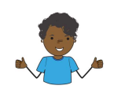
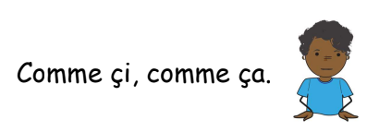
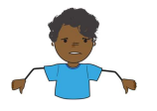
Guten Morgen / Guten Tag Wie geht’s?
Mir geht’s gut
Mir geht’s prima
Mir geht’s okay
Mir geht’s nicht gut
Notes:
Greet 5 people in the class and ask them how they are

Slide 6
1 | 2 | 3 | 4 | 5 | 6
7 | 8 | 9 | 10 | 11 | Die Zahlen
eins
zwei
drei
vier
fünf
sechs
sieben
acht
neun
zehn
elf

Slide 7
1 | 2 | 3 | 4 | 5 | 6
7 | 8 | 9 | 10 | 11 | Die Zahlen
eins
zwei
drei
vier
fünf
sechs
sieben
acht
neun
zehn
elf
Notes:
For plenary

