Slide 1

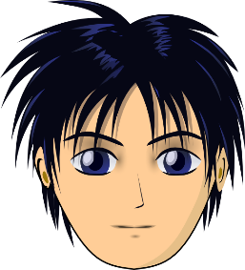
ê/è
tête
Notes:
Timing: 1 minute
Aim: To introduce SSC [ê/è]
Procedure:
1. Present the letter(s) and say the [ê/è] sound first, on its own. Students repeat it with you.
2. Bring up the word ”tête” on its own, say it, students repeat it, so that they have the opportunity to focus all of their attention on the connection between the written word and its sound.
3. A possible gesture for this would be to point to one’s head.
4. Roll back the animations and work through 1-3 again, but this time, dropping your voice completely to listen carefully to the students saying the [ê/è] sound, pronouncing ” tête” and, if using, doing the gesture.
Word frequency (1 is the most frequent word in French):
tête [343].
Source: Londsale, D., & Le Bras, Y. (2009). A Frequency Dictionary of French: Core vocabulary for learners London: Routledge.

Slide 2
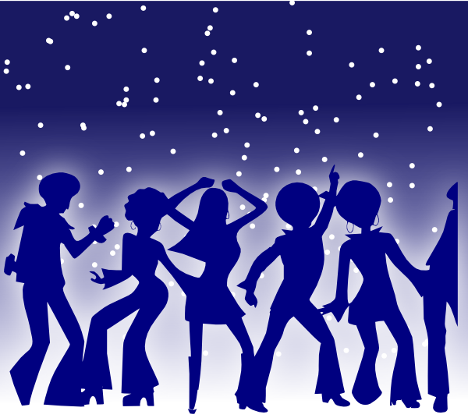
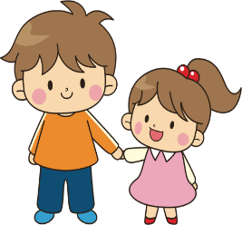

ê/è
fête
frère
collège
tête
être
[to be]
problème
Notes:
Timing: 2 minutes
Aim: To introduce SSC [ê/è]
Procedure:
1. Introduce and elicit the pronunciation of the individual SSC [ê/è] and then the source word again ‘tête’ (with gesture, if using).
2. Then present and elicit the pronunciation of the five cluster words.
The cluster words have been chosen for their high-frequency, from a range of word classes, with the SSC (where possible) positioned within a variety of syllables within the words (e.g. initial, 2nd, final etc.). Additionally, we have tried to use words that build cumulatively on previously taught SSCs (see the Phonics Teaching Sequence document) and do not include new SSCs. Where new SSCs are used, they are often consonants which have a similar symbol-sound correspondence in English.
Word frequency (1 is the most frequent word in French):
fête [1490]; frère [1043] collège [2116]; problème [188]; être[5]; tête [343].
Source: Londsale, D., & Le Bras, Y. (2009). A Frequency Dictionary of French: Core vocabulary for learners London: Routledge.

Slide 3
ê/è
fête
frère
collège
tête
être
problème
Notes:
With sound and no pictures to focus all attention on the sound-symbol correspondence.

Slide 4
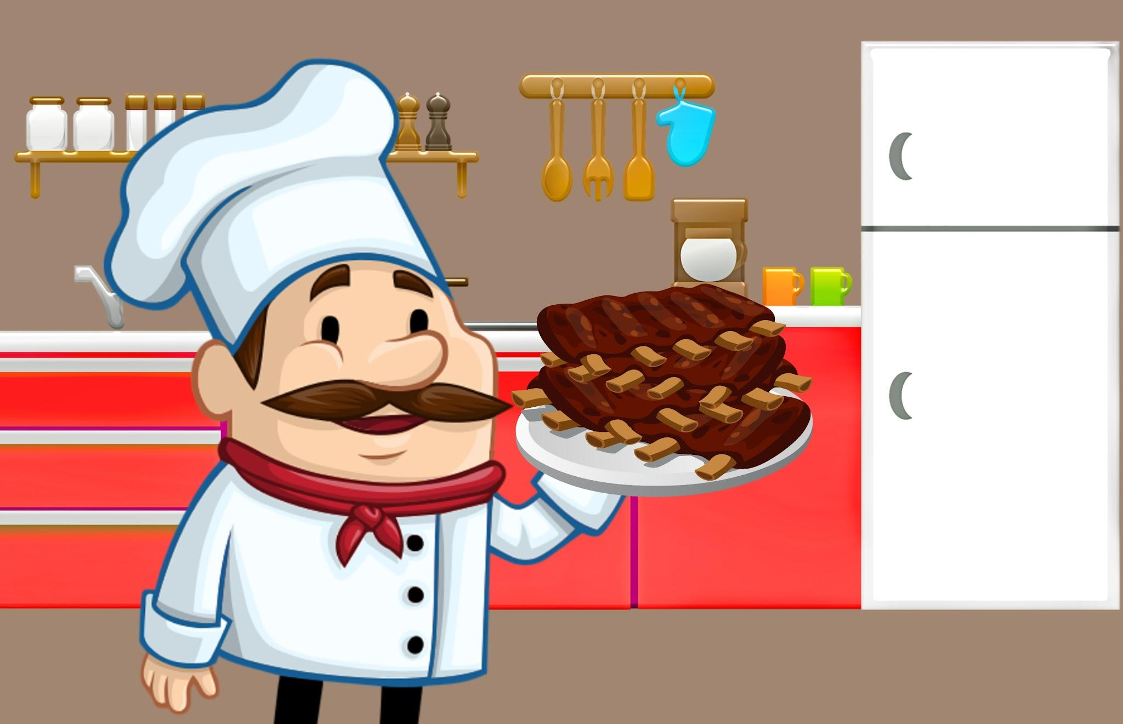

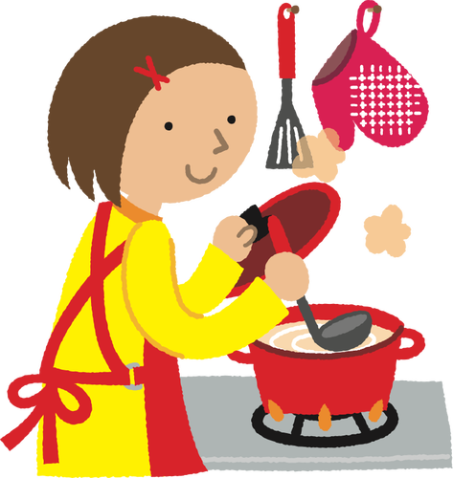
Aimes-tu la cuisine française?

Slide 5
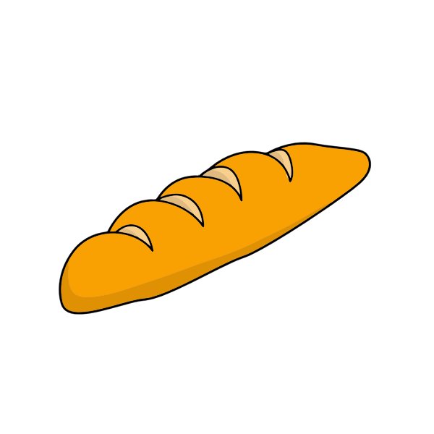
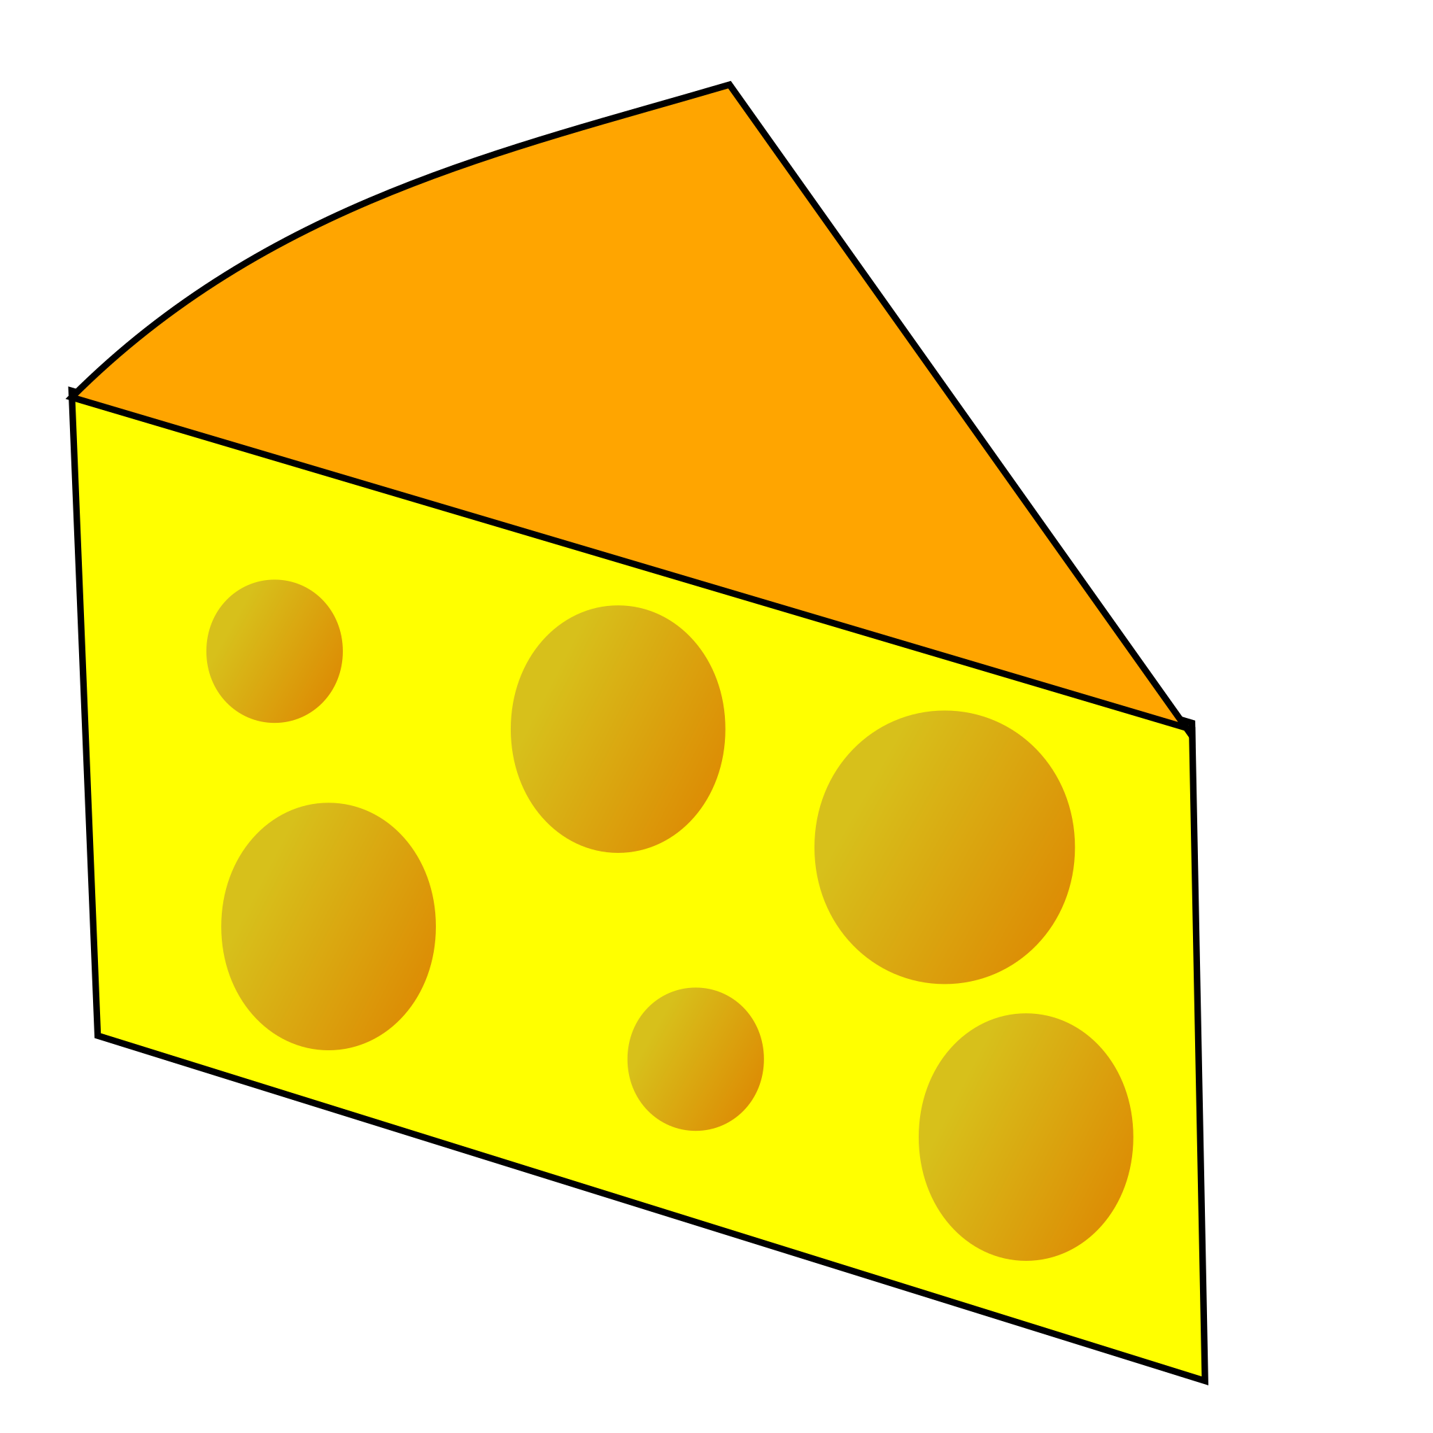
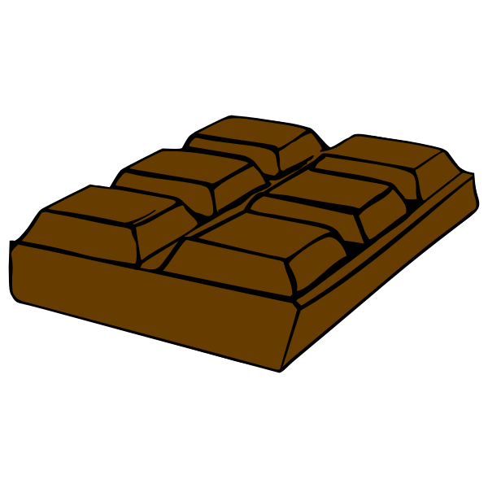
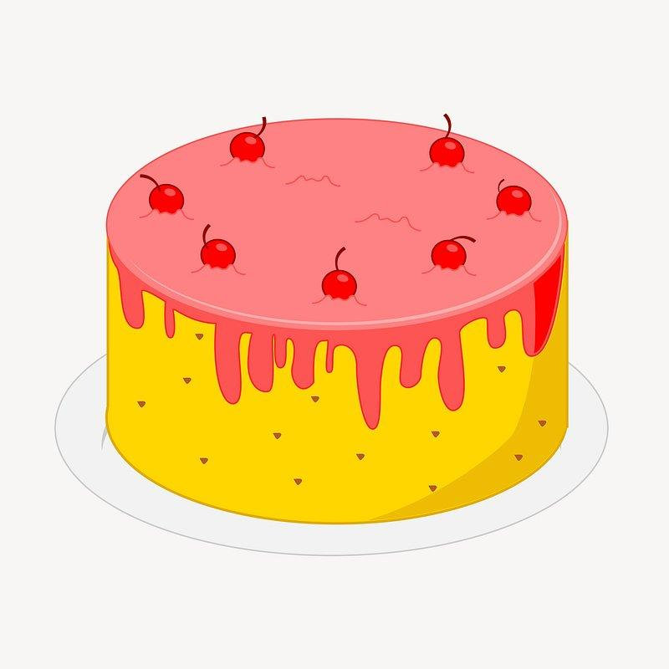
J’aime…
le pain
le chocolat
le fromage
le gâteau

Slide 6

Encore une fois!
J’aime la cuisine française!
J’aime et j’aime
Ma soeur aime Aussi, j’aime
la pomme
la banane
la poire
l’ananas.
la pêche.
la cerise.
la fraise.
l’orange.
le gâteau.
le pain!
le fromage!
le chocolat!

Slide 7







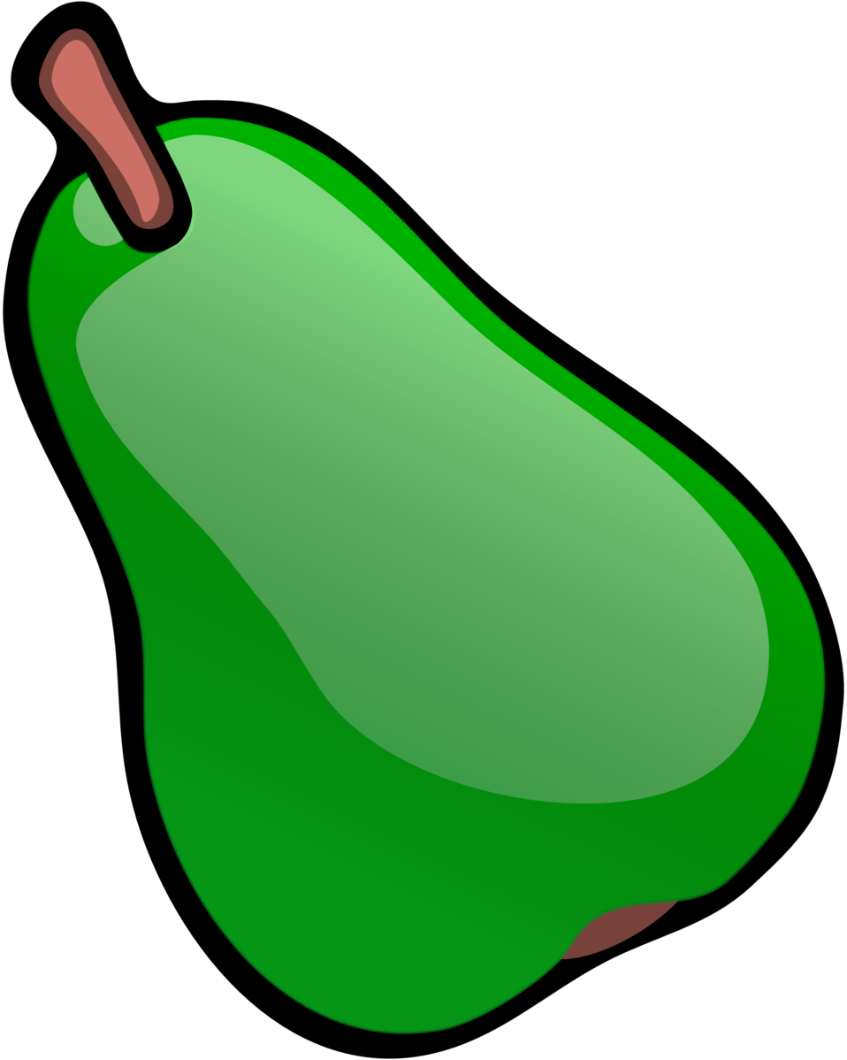
J’aime…

