Slide 1


oi
[to see]
voir
Notes:
Without sound to elicit pronunciation (without first hearing the teacher).
Teacher to elicit pronunciation by asking “Comment dit-on …"

Slide 2
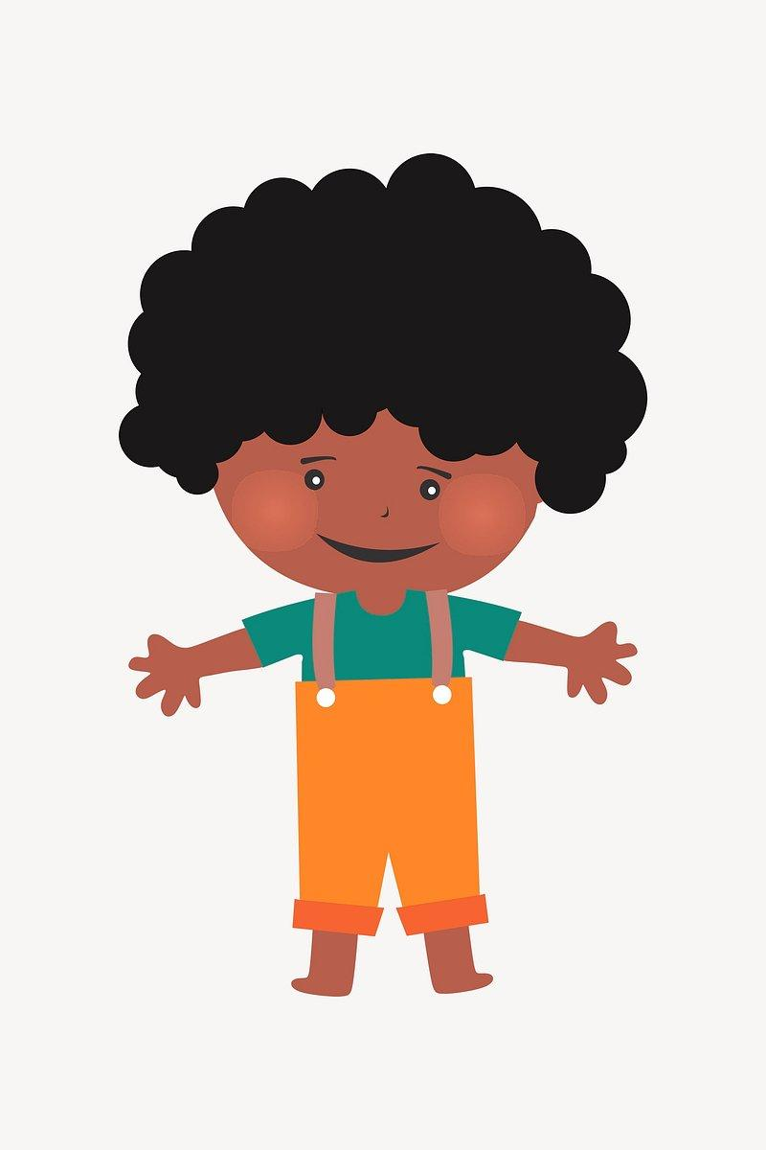



oi
moi
voici
[here is]
to see
voir
Au revoir !
trois
Pourquoi ?
[why?]
Notes:
Timing: 2 minutes
Aim: To introduce/consolidate SSC [oi]
Procedure:
1. Introduce and elicit the pronunciation of the individual SSC [oi] and then the source word again ‘voir’ (with gesture, if using).
2. Then present and elicit the pronunciation of the five cluster words.
The cluster words have been chosen for their high-frequency, from a range of word classes, with the SSC (where possible) positioned within a variety of syllables within the words (e.g. initial, 2nd, final etc.). Additionally, we have tried to use words that build cumulatively on previously taught SSCs (see the Phonics Teaching Sequence document) and do not include new SSCs. Where new SSCs are used, they are often consonants which have a similar symbol-sound correspondence in English.
Word frequency (1 is the most frequent word in French):
droite [1293]; avoir [8] au revoir [n/a]; pourquoi[193]; trois[115]; voir [69].
Source: Londsale, D., & Le Bras, Y. (2009). A Frequency Dictionary of French: Core vocabulary for learners London: Routledge.

Slide 3
Voici ma famille (Frère Jacques)
Voici ma mère, voici ma mère
Voici mon père, voici mon père
Voici mes parents, voici mes parents
J’aime ma famille, j’aime ma famille
Voici ma soeur, voici ma soeur
Voici mon frère, voici mon frère
Voici les enfants, voici les enfants
Et moi aussi, et moi aussi
Notes:
Song - to the tune of Frère Jacques

Slide 4







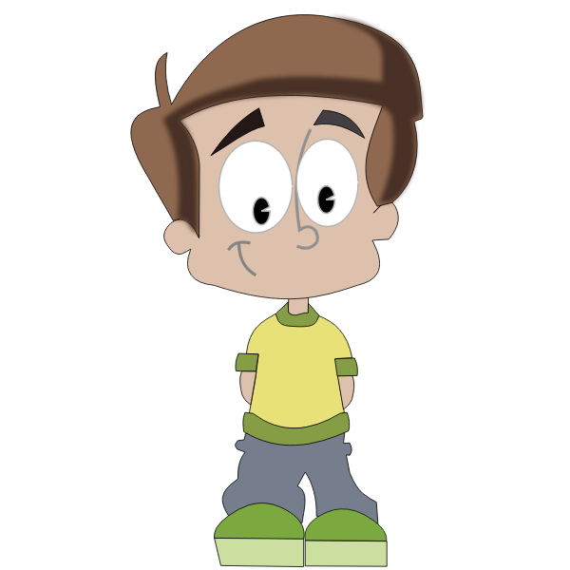


Voici ma famille
plus grande
Qui est dans ta famille?

Slide 5
Voici mes grands-parents
ma grand-mère
mon grand-père

Slide 6

ma grand-mère
mon grand-père
ma tante
mon oncle
ma mère
mon père
mon cousin
ma cousine
moi
ma soeur
mon frère

Slide 7
1 | 2 | 3
4 | 5 | 6
7 | 8 | 9

