Slide 1


ou
nous
Notes:
Timing: 1 minute
Aim: To introduce SSC [ou]
Procedure:
1. Present the letter(s) and say the [ou] sound first, on its own. Students repeat it with you.
2. Bring up the word ”nous” on its own, say it, students repeat it, so that they have the opportunity to focus all of their attention on the connection between the written word and its sound.
3. A possible gesture for this would be to have both hands draw semi-circles out away from the body. Hands start by the sides of the body, circle swiftly outwards and join up again in front, indicating the inclusion of the self in a larger group.
4. Roll back the animations and work through 1-3 again, but this time, dropping your voice completely to listen carefully to the students saying the [ou] sound, pronouncing ”nous” and, if using, doing the gesture.
Word frequency (1 is the most frequent word in French):
nous [31]
Source: Londsale, D., & Le Bras, Y. (2009). A Frequency Dictionary of French: Core vocabulary for learners London: Routledge.

Slide 2




ou
Où?
jouer
[where?]
Bonjour !
nous
douze
toujours
[always; still]
Notes:
Timing: 2 minutes
Aim: To introduce SSC [ou]
Procedure:
1. Introduce and elicit the pronunciation of the individual SSC [ou] and then the source word again ‘nous’ (with gesture, if using).
2. Then present and elicit the pronunciation of the five cluster words.
The cluster words have been chosen for their high-frequency, from a range of word classes, with the SSC (where possible) positioned within a variety of syllables within the words (e.g. initial, 2nd, final etc.). Additionally, we have tried to use words that build cumulatively on previously taught SSCs (see the Phonics Teaching Sequence document) and do not include new SSCs. Where new SSCs are used, they are often consonants which have a similar symbol-sound correspondence in English.
Word frequency (1 is the most frequent word in French):
nous [31]; trouver [83] jouer [219]; bonjour [1972]; toujours [103]; douze [1664].
Source: Londsale, D., & Le Bras, Y. (2009). A Frequency Dictionary of French: Core vocabulary for learners London: Routledge.

Slide 3
ou
trouver
jouer
Bonjour !
nous
douze
toujours
Notes:
With sound and no pictures to focus all attention on the sound-symbol correspondence.

Slide 4
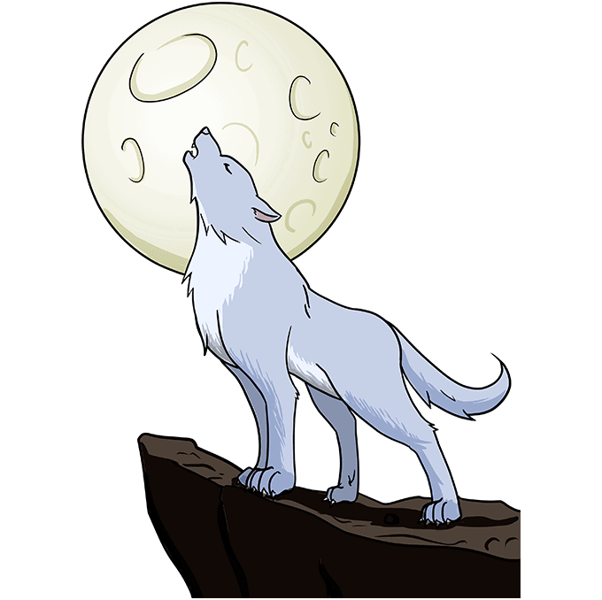
ou
L’hibou entend le cri du loup.
le cri du loup
le cri du loup
L’hibou entend le cri du loup.
/ou/-/ou/-/ou/
Notes:
Song to the tune of “London Bridge is falling down” - optional

Slide 5
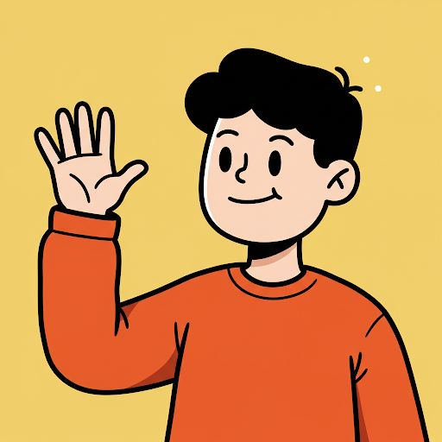
Bonjour, Salut,
Bonjour, Salut,
Au revoir! À plus tard!
Bonjour, Salut,
Bonjour, Salut
Au revoir! À plus tard!

Slide 6
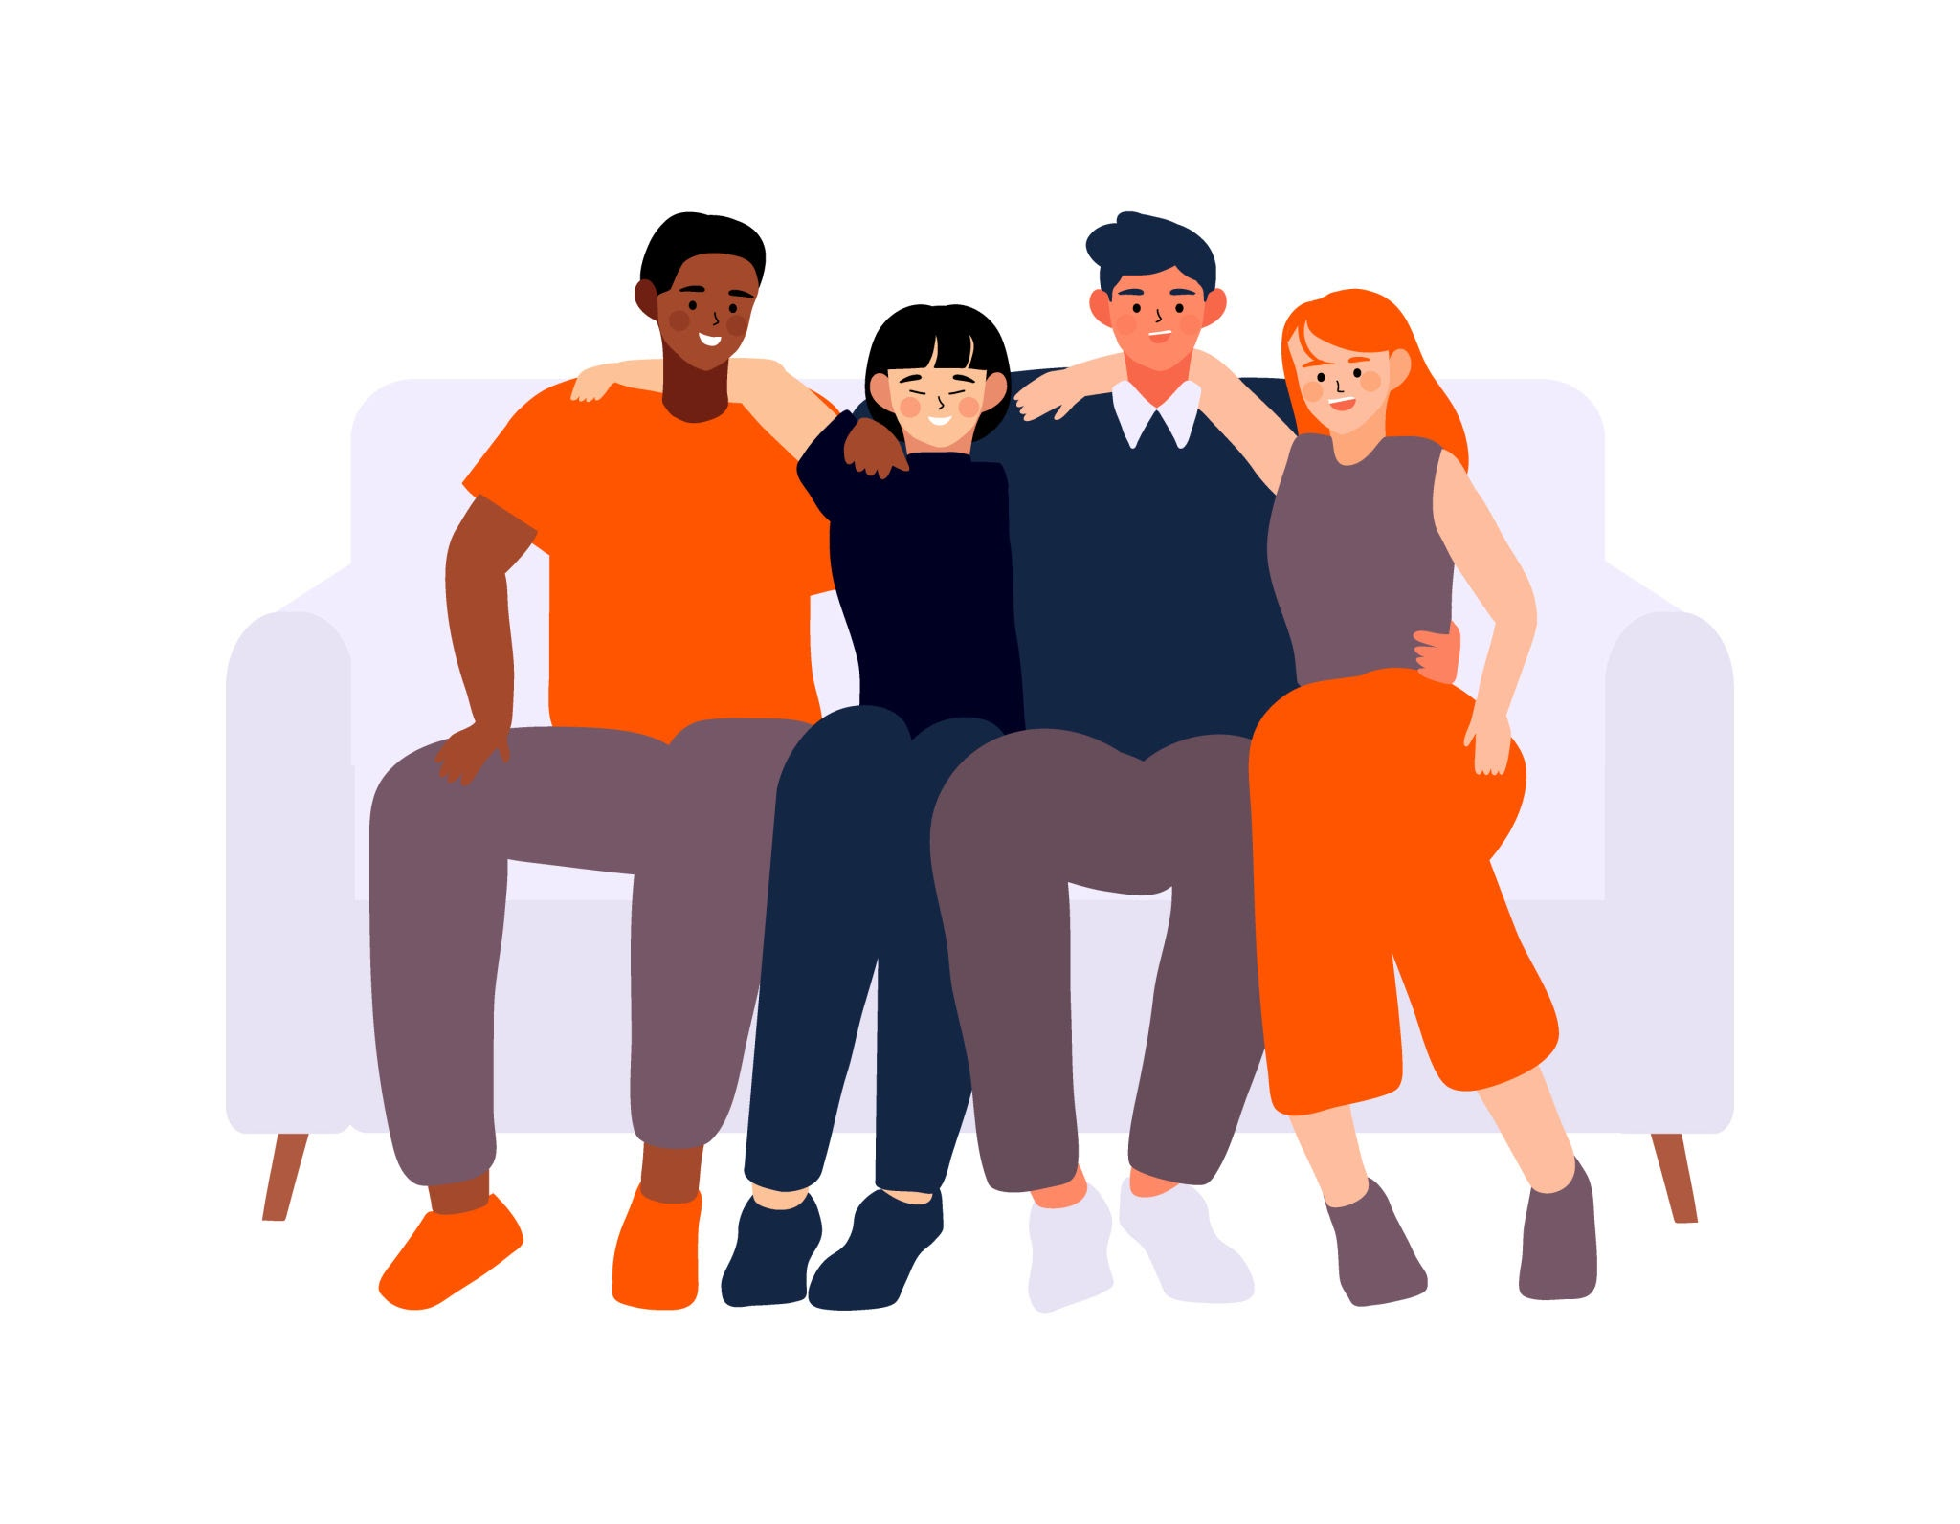

Une conversation entre amis

Slide 7


Comment tu t’appelles?
Je m’appelle Eloïse!

Slide 8
Comment tu t’appelles?
Je m’appelle Louis!

Slide 9
Comment tu t’appelles?
Je m’appelle ???

Slide 10
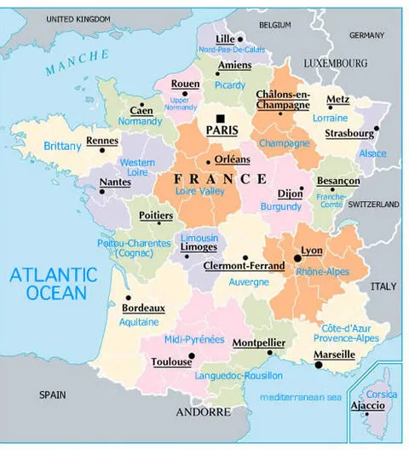
Où habites-tu?
J’habite à Strasbourg!

Slide 11
Où habites-tu?
J’habite à Toulouse!

Slide 12
Où habites-tu?
J’habite à ???

Slide 13
Comment tu t’appelles?
Où habites-tu?
Je m’appelle…
J’habite à…

Slide 14
Bonjour!
J’habite à Luxembourg. Enchantée!
Au revoir!
Salut! Comment ça va?
Je m’appelle Lucas. Comment tu t’appelles?
J’habite à Paris. Où habites-tu?
Ça va bien, et toi? Comment ça va?
Comme ci, comme ça. Comment tu t’appelles?
À plus tard, Clara. Enchanté!
Je m’appelle Clara. Où habites-tu?

Slide 15
Bonjour!
J’habite à Paris. Où habites-tu?
Salut! Comment ça va?
Ça va bien, et toi? Comment ça va?
J’habite à Luxembourg. Enchantée!
Au revoir!
Comme ci, comme ça. Comment tu t’appelles?
Je m’appelle Lucas. Comment tu t’appelles?
À plus tard, Clara. Enchanté!
Je m’appelle Clara. Où habites-tu?

Slide 16
Ana Bruxelles | Chloé Nîmes | Inès Bordeaux | Léa Nantes | Lola Mende | Manon Grenoble
Clément Limoges | Enzo Poitiers | Jules Lyon | Lucas Rennes | Mehdi Lille | Morgan Orléans
Lucie Caen | Marie Le Havre | Nadia Rouen | Yasmina Genève | Maxime Marseille | Zoé Dijon
Raphaël Toulon | Théo Nancy | Yanis Amiens | Pierre Épernay | Rachid Nice | Axel Monaco

Slide 17
