Slide 1

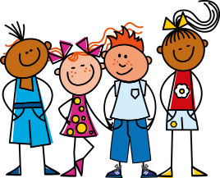
ou
nous
Notes:
Timing: 1 minute
Aim: To introduce SSC [ou]
Procedure:
1. Present the letter(s) and say the [ou] sound first, on its own. Students repeat it with you.
2. Bring up the word ”nous” on its own, say it, students repeat it, so that they have the opportunity to focus all of their attention on the connection between the written word and its sound.
3. A possible gesture for this would be to have both hands draw semi-circles out away from the body. Hands start by the sides of the body, circle swiftly outwards and join up again in front, indicating the inclusion of the self in a larger group.
4. Roll back the animations and work through 1-3 again, but this time, dropping your voice completely to listen carefully to the students saying the [ou] sound, pronouncing ”nous” and, if using, doing the gesture.
Word frequency (1 is the most frequent word in French):
nous [31]
Source: Londsale, D., & Le Bras, Y. (2009). A Frequency Dictionary of French: Core vocabulary for learners London: Routledge.

Slide 2




ou
Où?
jouer
[where?]
Bonjour !
nous
douze
toujours
[always; still]
Notes:
Timing: 2 minutes
Aim: To introduce SSC [ou]
Procedure:
1. Introduce and elicit the pronunciation of the individual SSC [ou] and then the source word again ‘nous’ (with gesture, if using).
2. Then present and elicit the pronunciation of the five cluster words.
The cluster words have been chosen for their high-frequency, from a range of word classes, with the SSC (where possible) positioned within a variety of syllables within the words (e.g. initial, 2nd, final etc.). Additionally, we have tried to use words that build cumulatively on previously taught SSCs (see the Phonics Teaching Sequence document) and do not include new SSCs. Where new SSCs are used, they are often consonants which have a similar symbol-sound correspondence in English.
Word frequency (1 is the most frequent word in French):
nous [31]; trouver [83] jouer [219]; bonjour [1972]; toujours [103]; douze [1664].
Source: Londsale, D., & Le Bras, Y. (2009). A Frequency Dictionary of French: Core vocabulary for learners London: Routledge.

Slide 3
ou
Où?
jouer
Bonjour !
nous
douze
toujours
Notes:
Timing: 2 minutes
Aim: To introduce SSC [ou]
Procedure:
1. Introduce and elicit the pronunciation of the individual SSC [ou] and then the source word again ‘nous’ (with gesture, if using).
2. Then present and elicit the pronunciation of the five cluster words.
The cluster words have been chosen for their high-frequency, from a range of word classes, with the SSC (where possible) positioned within a variety of syllables within the words (e.g. initial, 2nd, final etc.). Additionally, we have tried to use words that build cumulatively on previously taught SSCs (see the Phonics Teaching Sequence document) and do not include new SSCs. Where new SSCs are used, they are often consonants which have a similar symbol-sound correspondence in English.
Word frequency (1 is the most frequent word in French):
nous [31]; trouver [83] jouer [219]; bonjour [1972]; toujours [103]; douze [1664].
Source: Londsale, D., & Le Bras, Y. (2009). A Frequency Dictionary of French: Core vocabulary for learners London: Routledge.

Slide 4
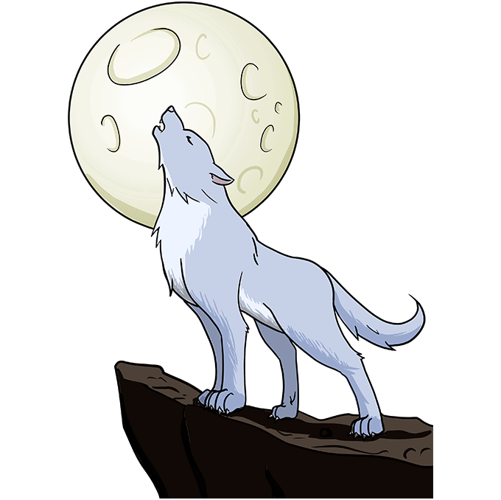
ou
L’hibou entend le cri du loup.
le cri du loup
le cri du loup
L’hibou entend le cri du loup.
/ou/-/ou/-/ou/
Notes:
Song to the tune of “London Bridge is falling down” - optional

Slide 5
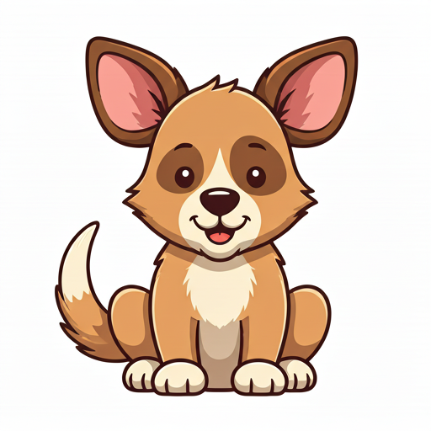
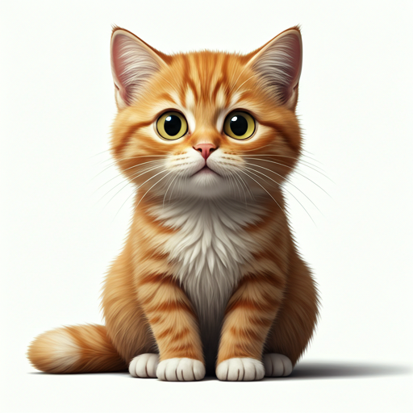
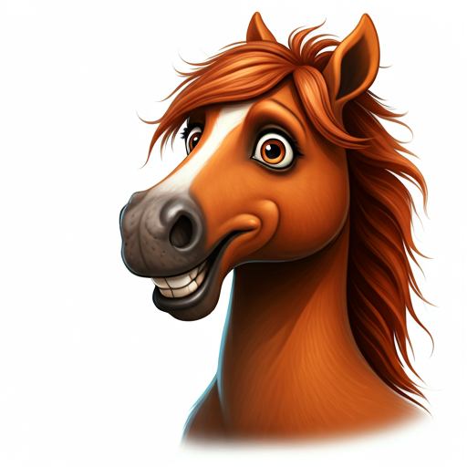
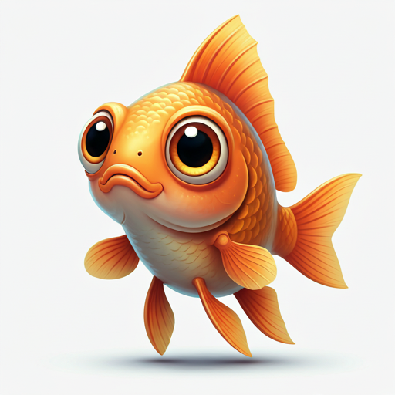
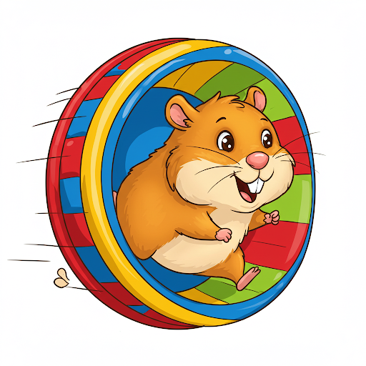
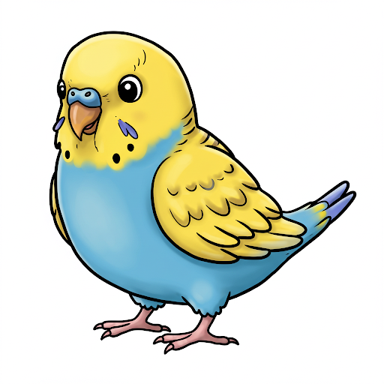
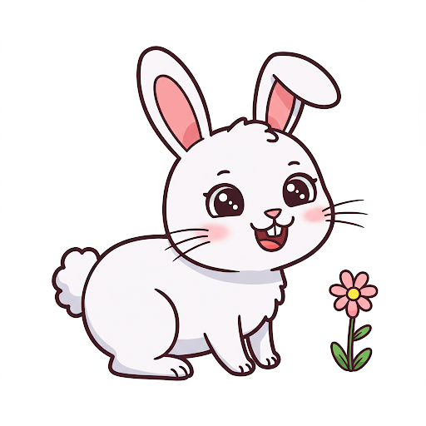
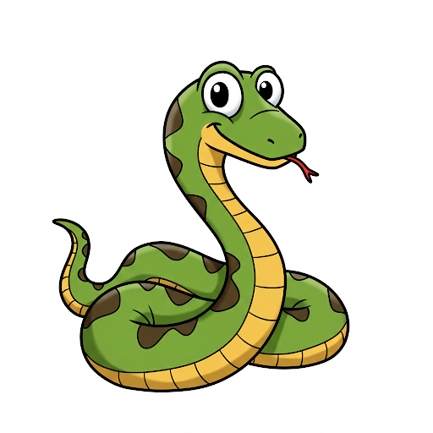
J’ai un chien
J’ai un chat
J’ai un cheval
J’ai un poisson
J’ai un serpent
J’ai un hamster
J’ai un oiseau
J’ai un lapin

Slide 6
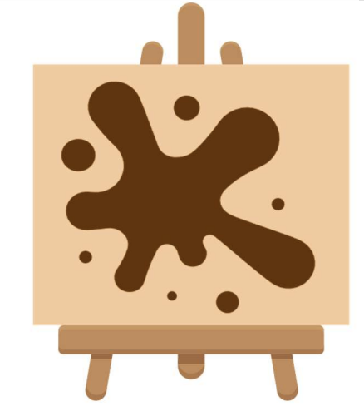
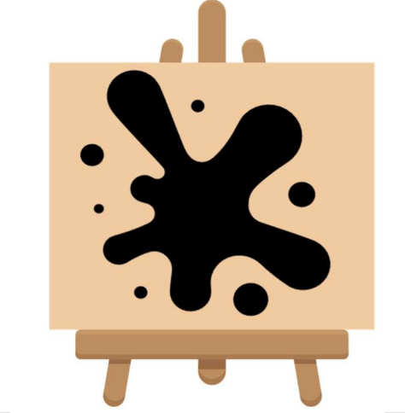
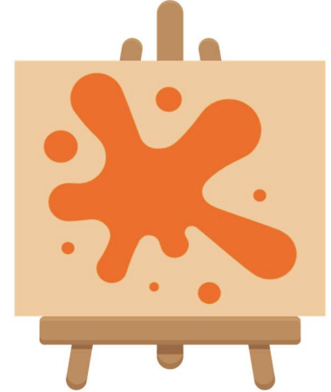

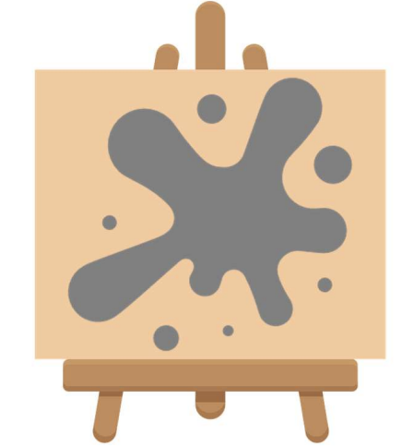
il est brun.
il est noir.
il est orange.
il est blanc.
il est gris.

Slide 7
lapin
chat
J’ai un .
Il est .
brun
blanc

Slide 8
cheval
poisson
J’ai un .
Il est .
orange
gris

Slide 9
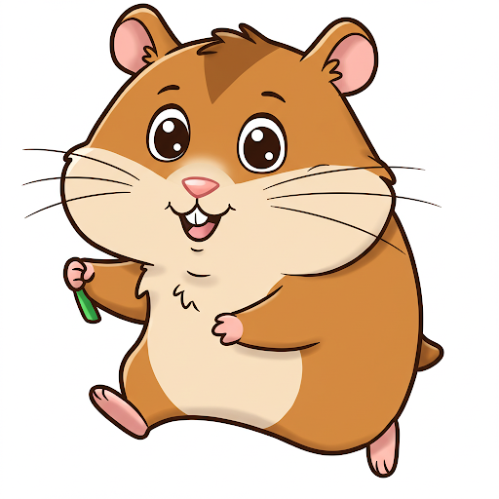
hamster
serpent
J’ai un .
Il est .
noir
brun

Slide 10
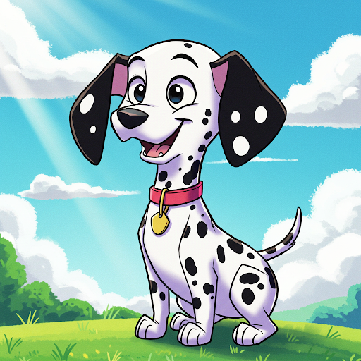
oiseau
chien
J’ai un .
Il est .
gris et orange
noir et blanc

Slide 11
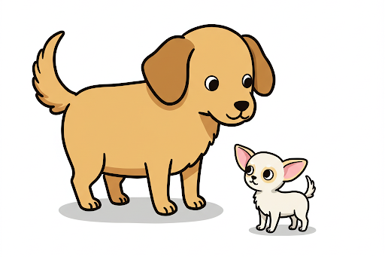
Il est grand.
Il est petit.

Slide 12
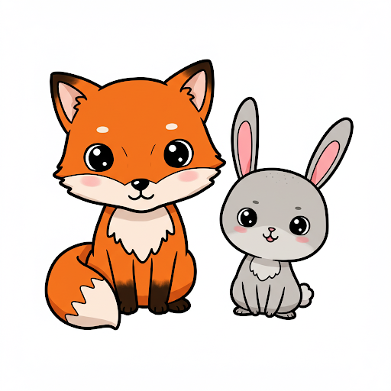
Il est mignon.
Il est adorable.
mignon = cute

Slide 13
Il est grand.
Il est petit.
Il est mignon.
Il est adorable.

Slide 14
1 | J’ai un chien. | J’ai un serpent. | Il est brun. | Il est gris. | Il est grand. | il est adorable.
2 | J’ai un lapin. | J’ai un poisson. | Il est orange. | Il est noir. | Il est petit. | Il est mignon.
3 | J’ai un hamster. | J’ai un cheval. | Il est gris. | Il est blanc. | Il est petit. | Il est adorable.
4 | J’ai un chat. | J’ai un oiseau. | Il est blanc. | Il est brun. | Il est grand. | Il est mignon.

