Slide 1

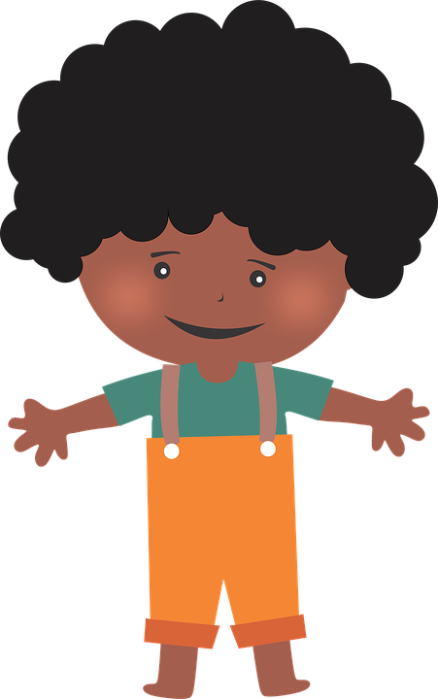
en/an
enfant
Notes:
Timing: 1 minute
Aim: To consolidate SSC [en/an]
Procedure:
1. Present the letter(s) and say the [en/an] sound first, on its own. Students repeat it with you.
2. Bring up the word ”enfant” on its own, say it, students repeat it, so that they have the opportunity to focus all of their attention on the connection between the written word and its sound.
3. A possible gesture for this would be to mime patting a child on the head/back
4. Roll back the animations and work through 1-3 again, but this time, dropping your voice completely to listen carefully to the students saying the [en/an] sound, pronouncing ”enfant” and, if using, doing the gesture.
Word frequency (1 is the most frequent word in French):
enfant [126].
Source: Londsale, D., & Le Bras, Y. (2009). A Frequency Dictionary of French: Core vocabulary for learners London: Routledge.

Slide 2

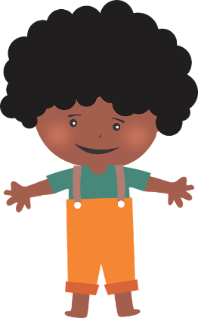
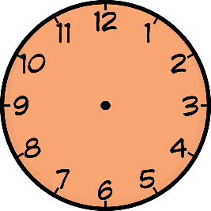

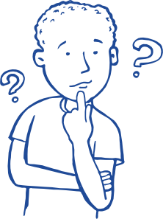

en/an
grand
quand ?
?
enfant
penser
encore
prendre
[to take]
Notes:
Timing: 2 minutes
Aim: To consolidate SSC [en/an]
Procedure:
1. Introduce and elicit the pronunciation of the individual SSC [en/an] and then the source word again ‘enfant’ (with gesture, if using).
2. Then present and elicit the pronunciation of the five cluster words.
The cluster words have been chosen for their high-frequency, from a range of word classes, with the SSC (where possible) positioned within a variety of syllables within the words (e.g. initial, 2nd, final etc.). Additionally, we have tried to use words that build cumulatively on previously taught SSCs (see the Phonics Teaching Sequence document) and do not include new SSCs. Where new SSCs are used, they are often consonants which have a similar symbol-sound correspondence in English.
Word frequency (1 is the most frequent word in French):
grand [59]; quand [119] penser [116]; prendre[43]; encore [51]; enfant [126].
Source: Londsale, D., & Le Bras, Y. (2009). A Frequency Dictionary of French: Core vocabulary for learners London: Routledge.

Slide 3
en/an
grand
quand ?
enfant
penser
encore
prendre
Notes:
With sound and no pictures to focus all attention on the sound-symbol correspondence.

Slide 4
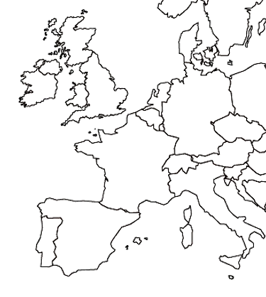
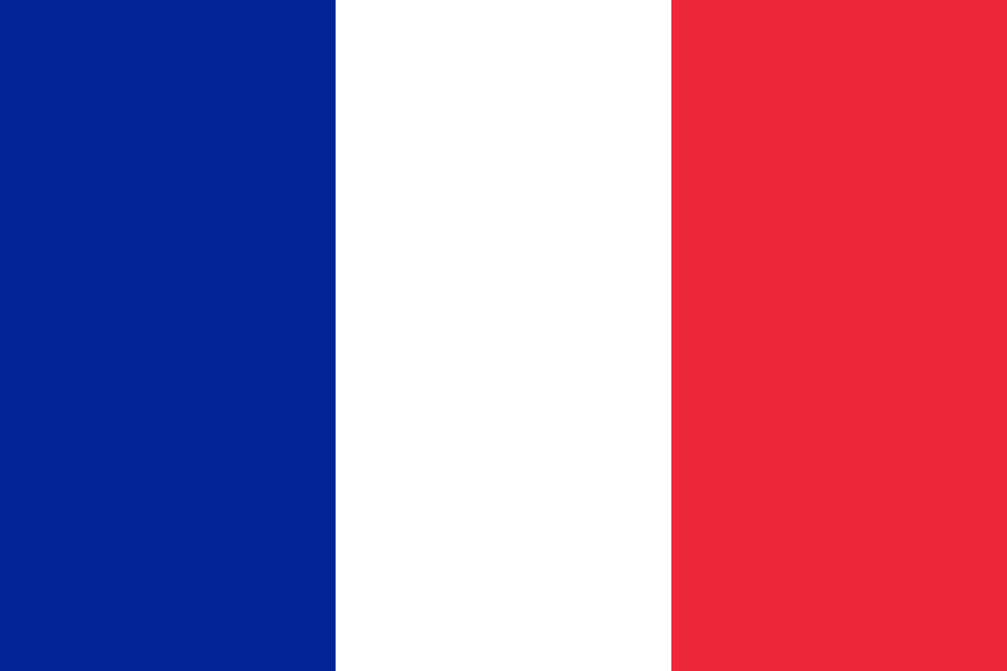
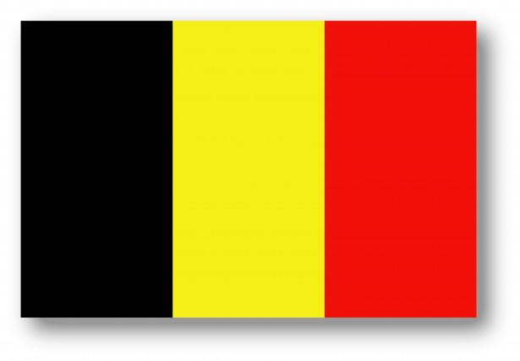

Je voyage…
en France
en Belgique
en Suisse

Slide 5
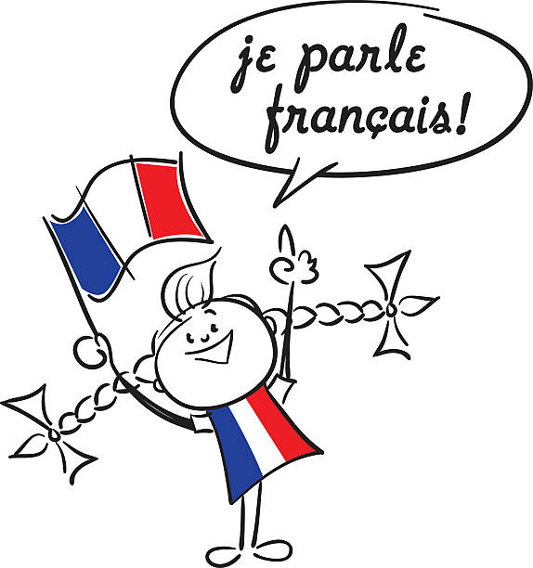
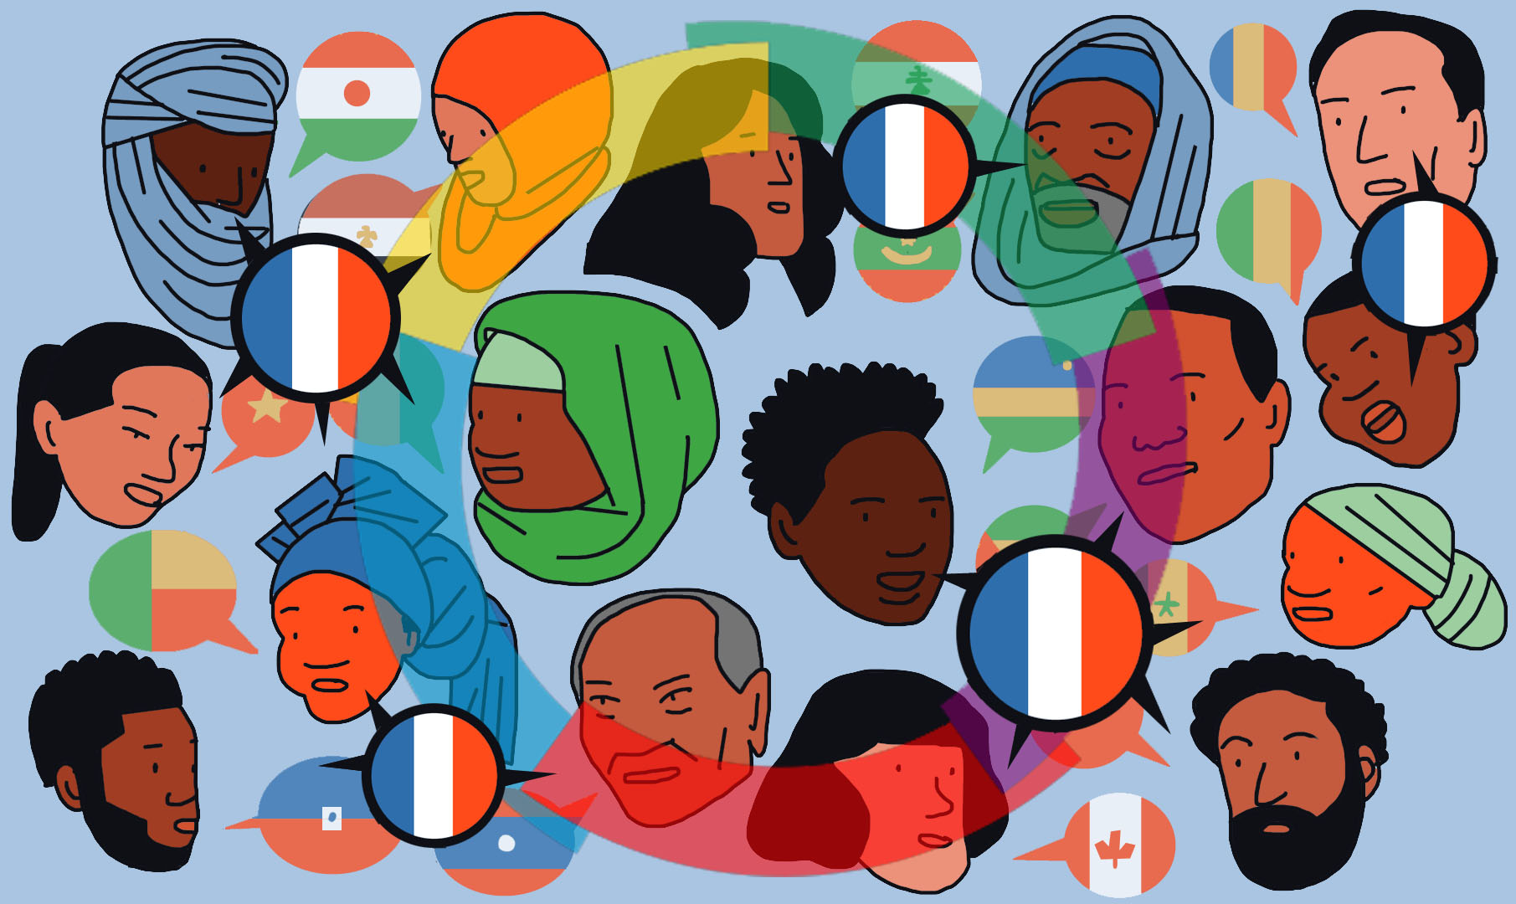
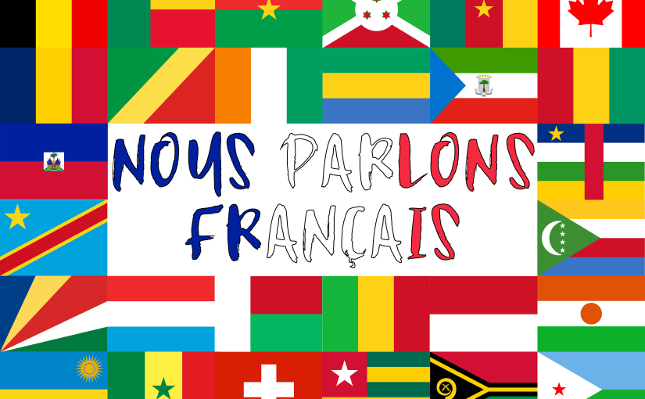

francophone =
_ _ _ _ _ _
_ _ _ _ _ _ _ _
F
r
e
n
c
h
s
p
e
a
k
i
n
g

Slide 6
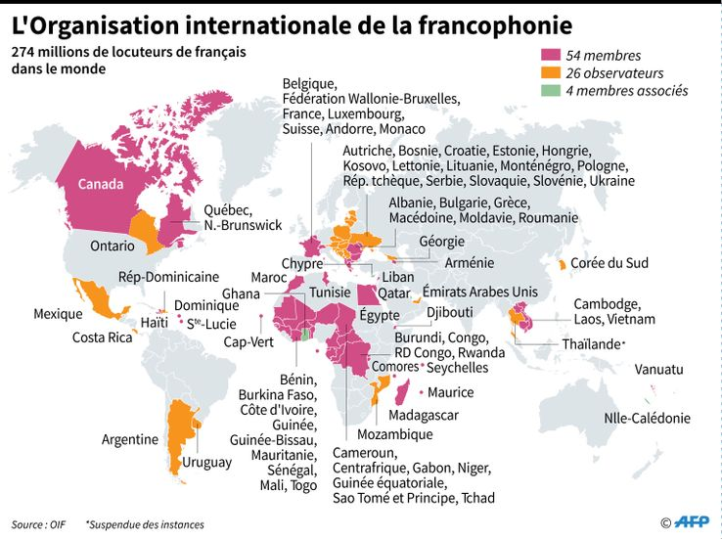
Le monde francophone
Why are there so many French-speaking countries in the world?

Slide 7

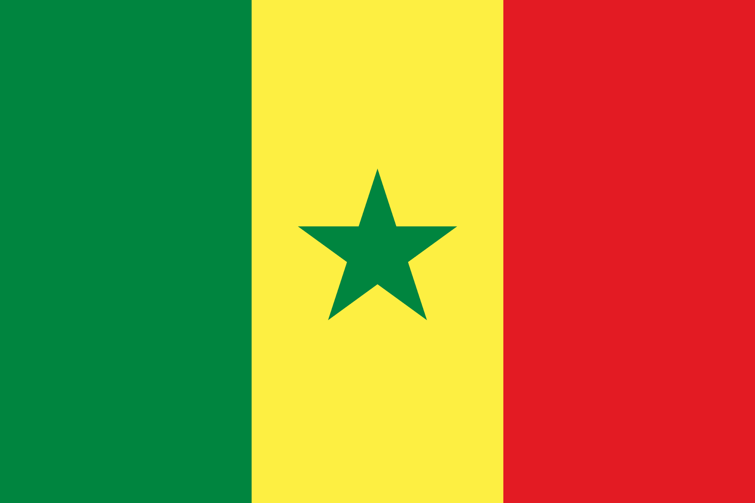


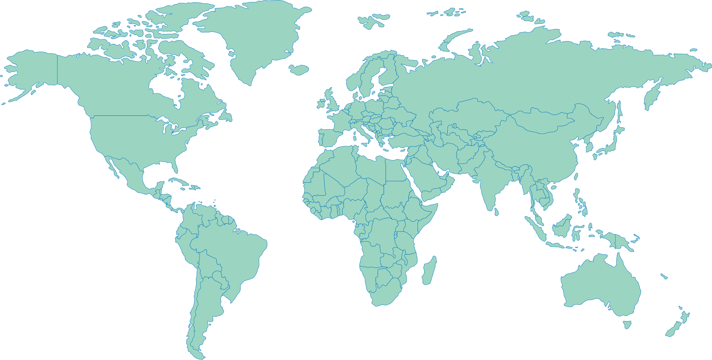
Je voyage…
au Canada
au Sénégal
en Tunisie
en Côte d’Ivoire

Slide 8



et en Guadeloupe
et en Guyane
et en Tunisie
et en Côte d’Ivoire
et au Sénégal
et au Canada
 | Je voyage en France | Je voyage en Suisse | Je voyage en Belgique | Je voyage en Espagne | Je voyage au Portugal | Je voyage aux Pays-Bas
raté!
touché!
coulé!

Slide 9

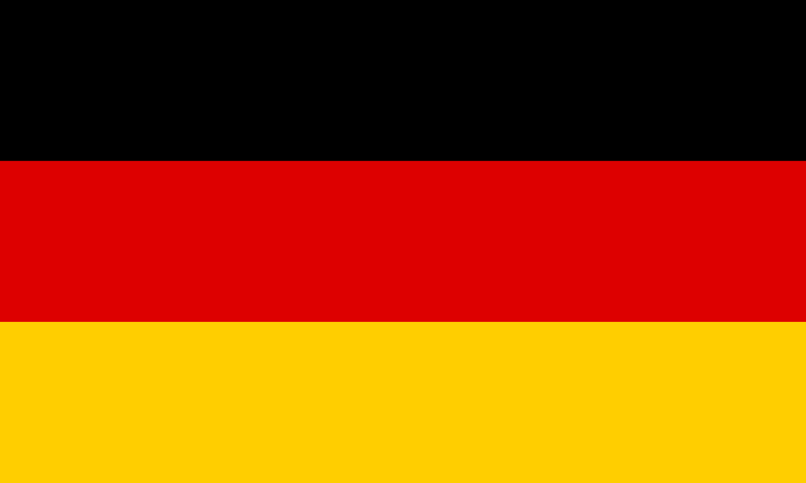
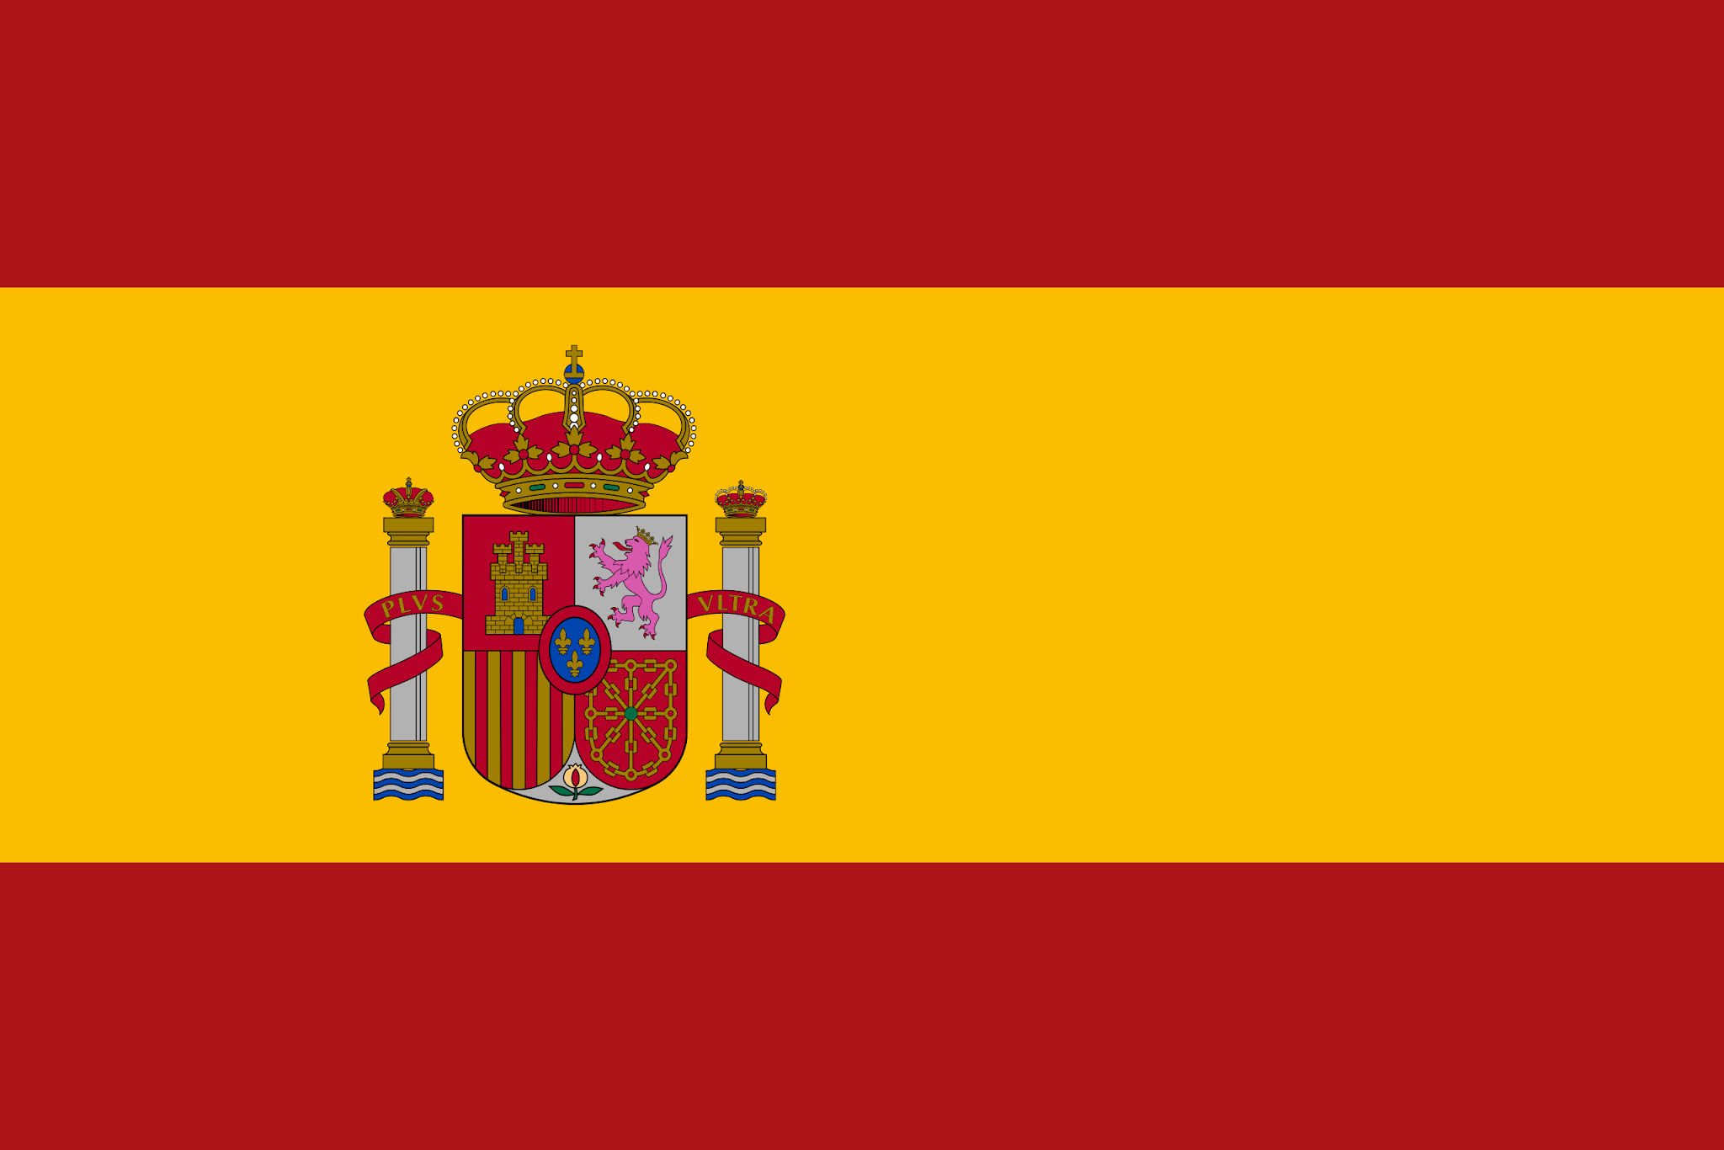
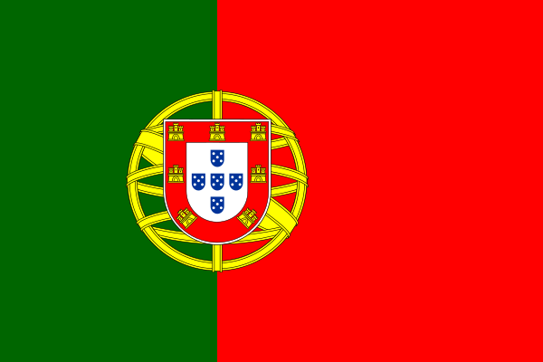
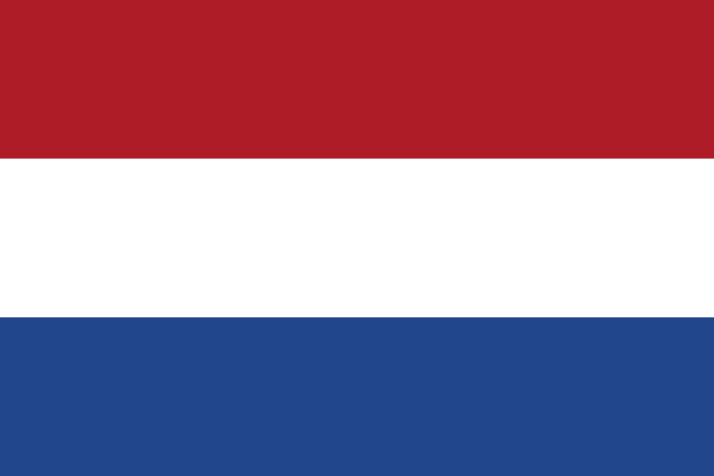
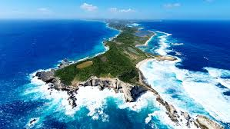
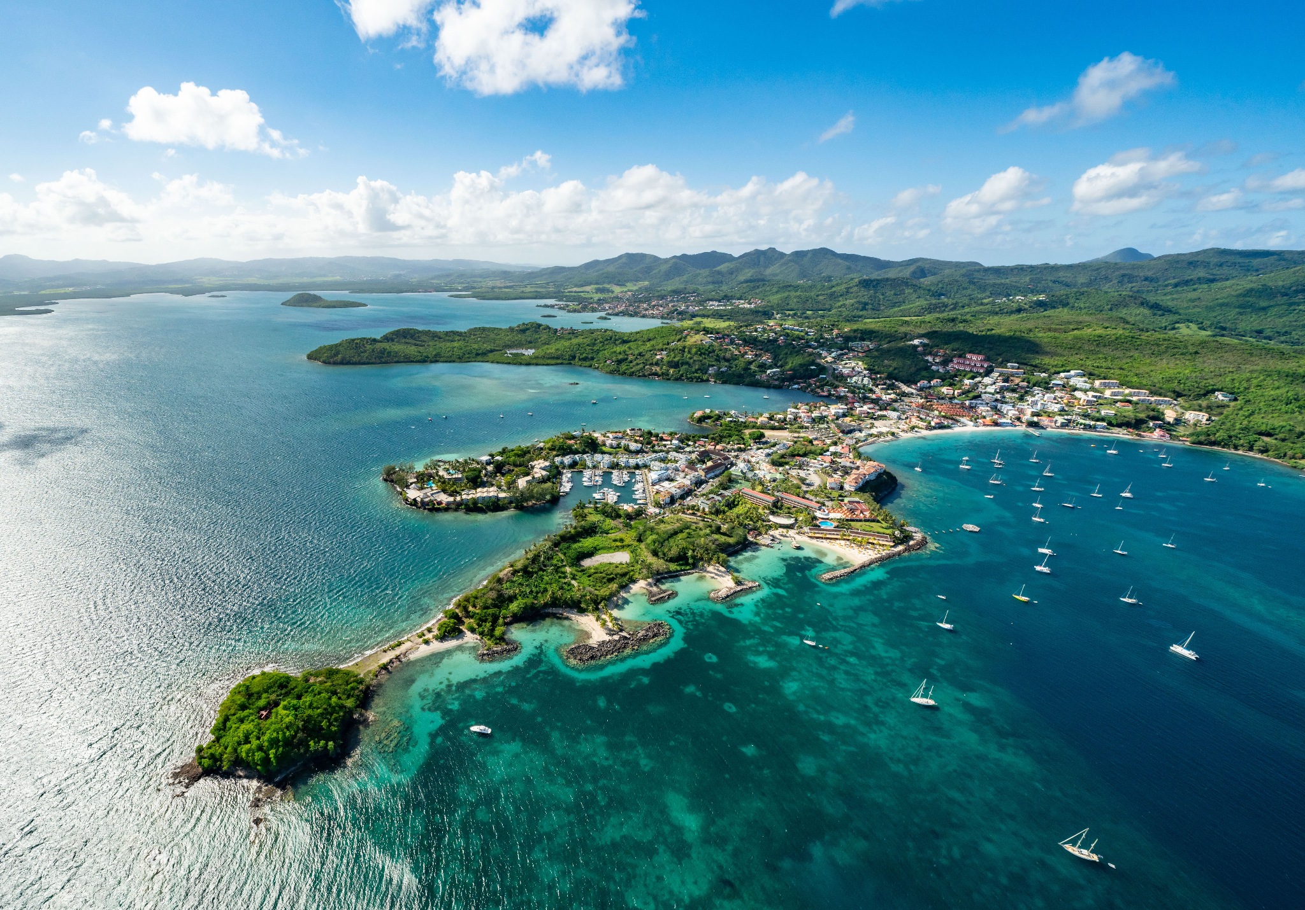
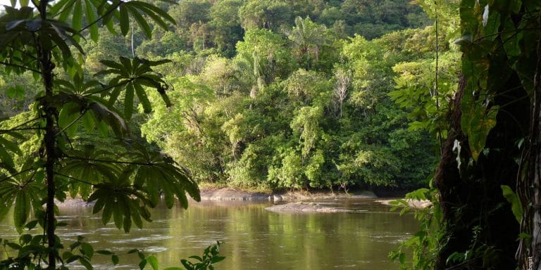
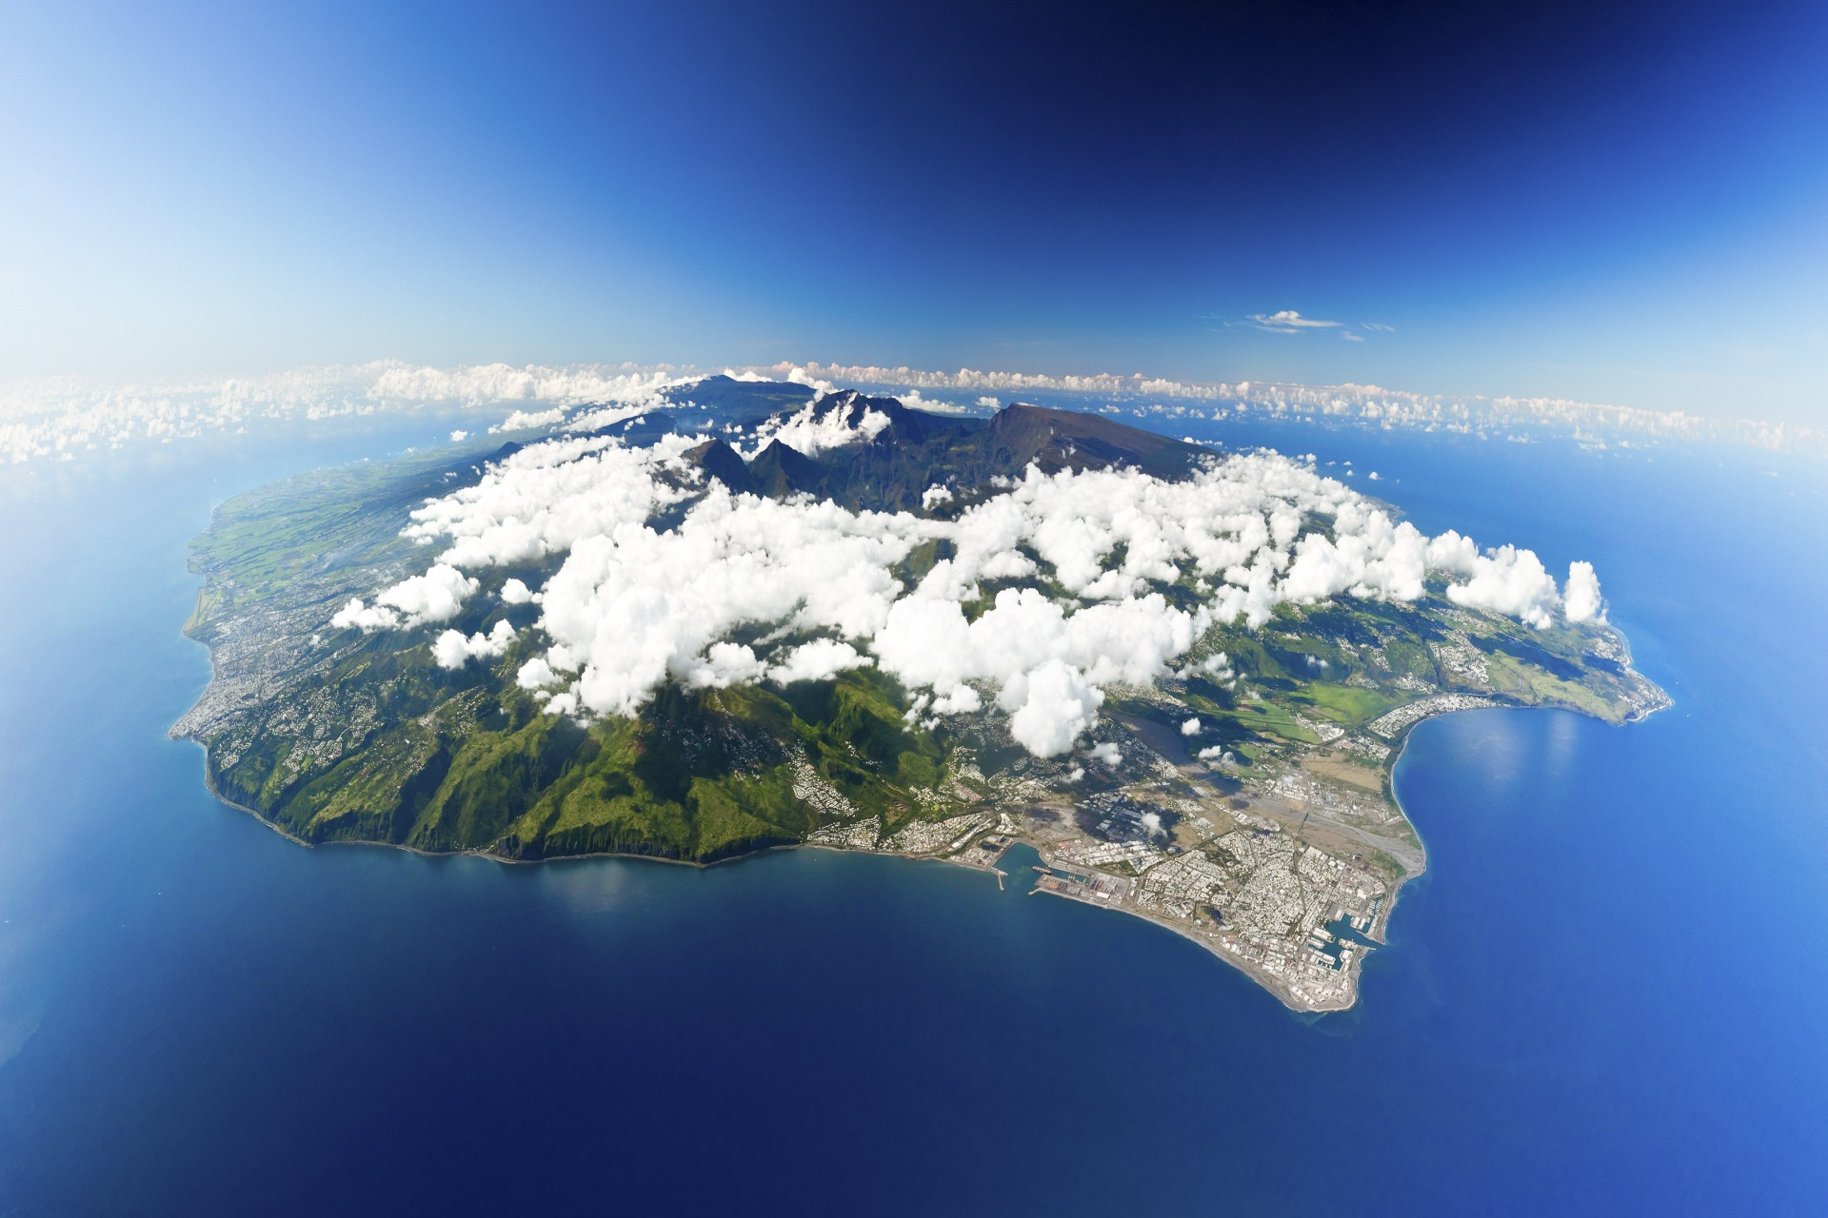
1 en France | 2 en Belgique | 3 en Suisse | 4 en Angleterre
5 en Allemagne | 6 en Espagne | 7 au Portugal | 8 aux Pays-Bas
9 en Guadeloupe | 10 en Martinique | 11 en Guyane | 12 à la Réunion
13 au Canada | 14 au Sénégal | 15 en Tunisie | 16 en Côte d’Ivoire

