Slide 1

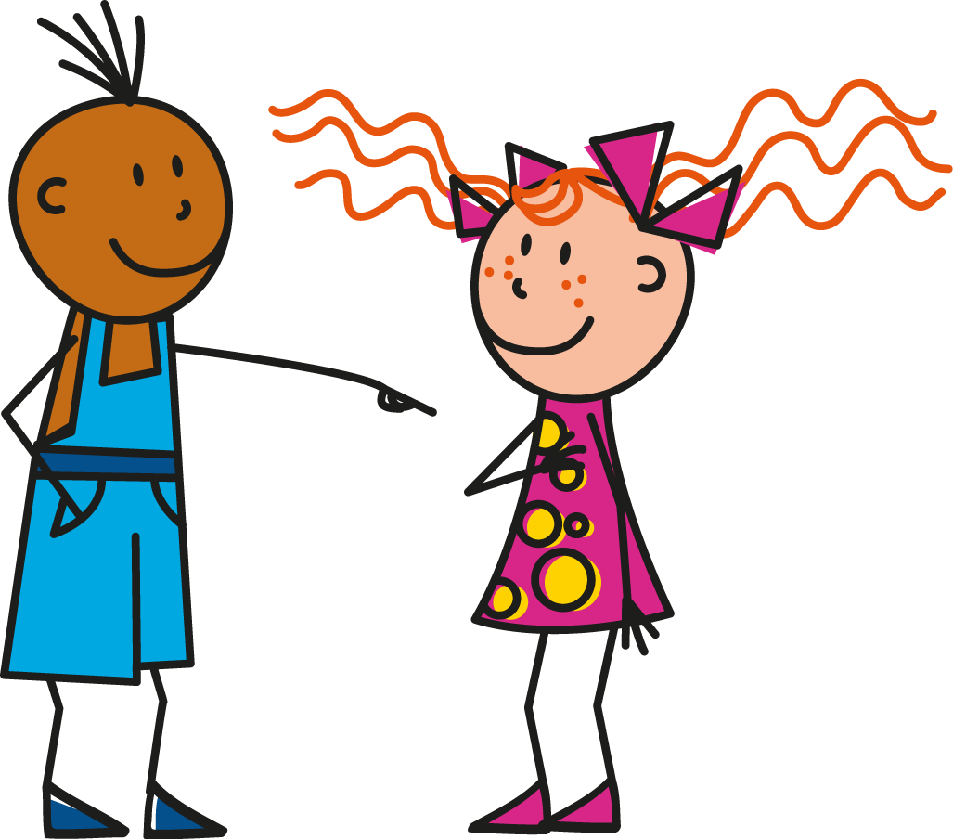
u
tu
Notes:
Timing: 1 minute
Aim: To introduce SSC [u]
Procedure:
1. Present the letter(s) and say the [u] sound first, on its own. Students repeat it with you.
2. Bring up the word ”tu” on its own, say it, students repeat it, so that they have the opportunity to focus all of their attention on the connection between the written word and its sound.
3. A possible gesture for this would be to point to someone else as though addressing him/her ‘you’.
4. Roll back the animations and work through 1-3 again, but this time, dropping your voice completely to listen carefully to the students saying the [u] sound, pronouncing ”tu” and, if using, doing the gesture.
Word frequency (1 is the most frequent word in French):
tu [112]
Source: Londsale, D., & Le Bras, Y. (2009). A Frequency Dictionary of French: Core vocabulary for learners London: Routledge.

Slide 2




u
Salut !
vue
amusant
tu
utiliser
[to use]
sur
[on]
Notes:
Timing: 2 minutes
Aim: To introduce SSC [u]
Procedure:
1. Introduce and elicit the pronunciation of the individual SSC [u] and then the source word again ‘tu’ (with gesture, if using).
2. Then present and elicit the pronunciation of the five cluster words.
The cluster words have been chosen for their high-frequency, from a range of word classes, with the SSC (where possible) positioned within a variety of syllables within the words (e.g. initial, 2nd, final etc.). Additionally, we have tried to use words that build cumulatively on previously taught SSCs (see the Phonics Teaching Sequence document) and do not include new SSCs. Where new SSCs are used, they are often consonants which have a similar symbol-sound correspondence in English.
Word frequency (1 is the most frequent word in French):
tu [112]; salut ! [2205] vue [191]; sur [16]; amusant [4695]; utiliser [345].
Source: Londsale, D., & Le Bras, Y. (2009). A Frequency Dictionary of French: Core vocabulary for learners London: Routledge.

Slide 3
u
Salut !
vue
amusant
tu
utiliser
sur
Notes:
With sound and no pictures to focus all attention on the sound-symbol correspondence.

Slide 4
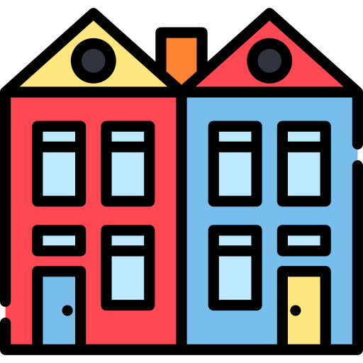
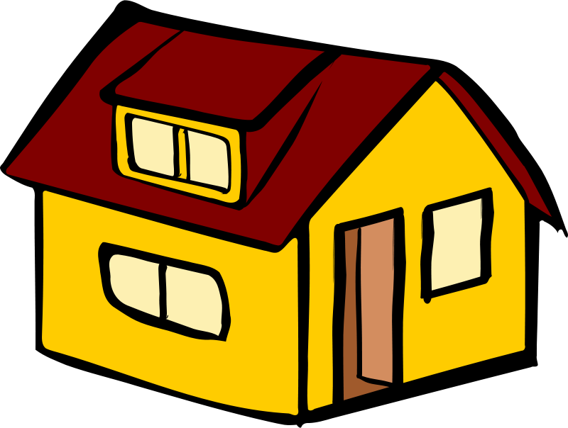
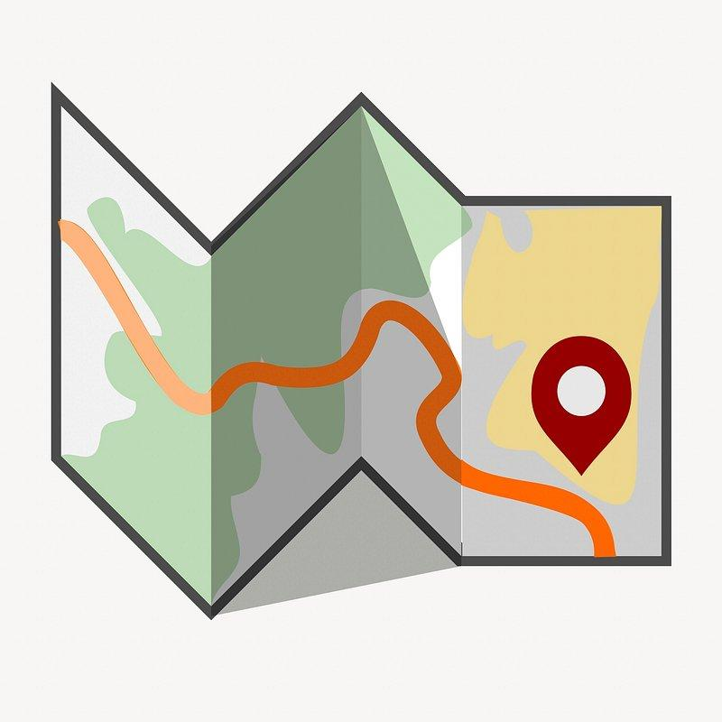
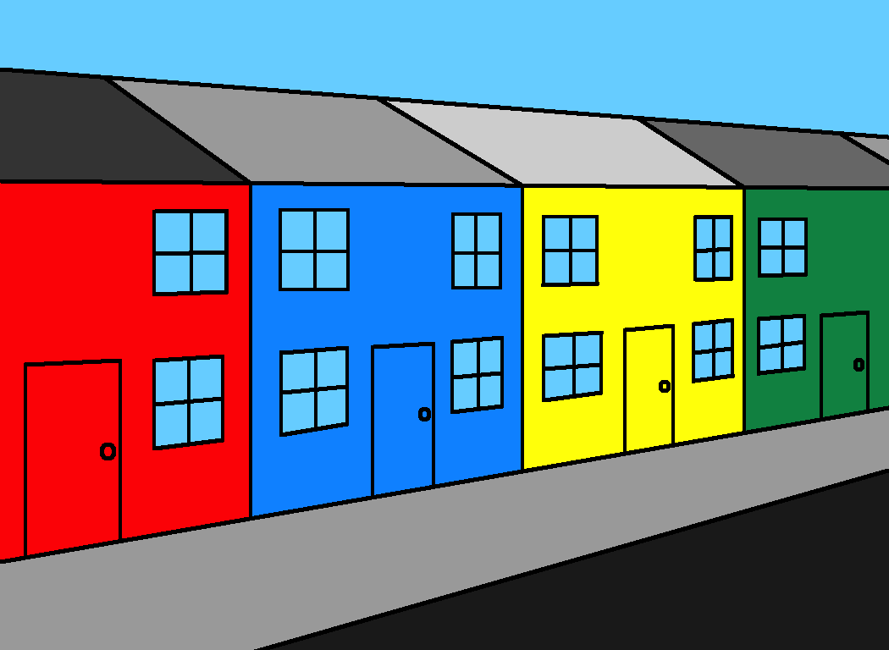

Où habites-tu exactement?
exactly

Slide 5

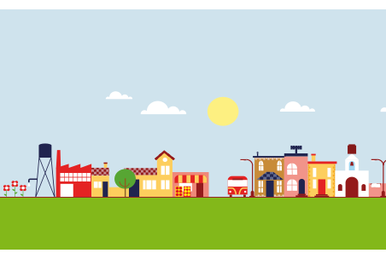
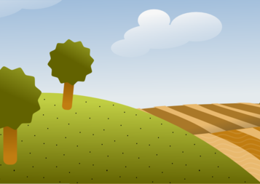

J’habite …
dans un village
dans une ville
à la campagne
à la montagne

Slide 6
J’habite
à
Glenridding
Penrith
Keswick
Patterdale
Bridgend

Slide 7
J’habite dans | une grande maison | mitoyenne jumelée individuelle | à Keswick à Penrith à Patterdale à Glenridding | dans un village
 | une petite maison |  |  | dans une ville
 | un grand | appartement cottage |  | à la campagne
 | un petit |  |  | à la montagne

Slide 8

J’habite dans une grande maison
Ma maison est et j’habite
Mon cousin habite dans un
individuelle.
jumelée.
mitoyenne.
à la campagne
à la montagne
dans un village
à Keswick.
à Penrith.
à Carlisle.
petit cottage.
grand cottage.
petit appartement.
Encore une fois!

