Slide 1


eu
deux
Notes:
Timing: 1 minute
Aim: To introduce SSC [eu]
Procedure:
1. Present the letter(s) and say the [eu] sound first, on its own. Students repeat it with you.
2. Bring up the word ”deux” on its own, say it, students repeat it, so that they have the opportunity to focus all of their attention on the connection between the written word and its sound.
3. A possible gesture for this would be to hold up two fingers (N.B. palm of the hand facing the class!).
4. Roll back the animations and work through 1-3 again, but this time, dropping your voice completely to listen carefully to the students saying the [eu] sound, pronouncing ”deux” and, if using, doing the gesture.
Word frequency (1 is the most frequent word in French):
deux [41].
Source: Londsale, D., & Le Bras, Y. (2009). A Frequency Dictionary of French: Core vocabulary for learners London: Routledge.

Slide 2




eu
jeudi
lieu
[place]
deux
feu
jeu
un peu
[a little]
Notes:
Timing: 2 minutes
Aim: To introduce SSC [eu]
Procedure:
1. Introduce and elicit the pronunciation of the individual SSC [eu] and then the source word again ‘deux’ (with gesture, if using).
2. Then present and elicit the pronunciation of the five cluster words.
The cluster words have been chosen for their high-frequency, from a range of word classes, with the SSC (where possible) positioned within a variety of syllables within the words (e.g. initial, 2nd, final etc.). Additionally, we have tried to use words that build cumulatively on previously taught SSCs (see the Phonics Teaching Sequence document) and do not include new SSCs. Where new SSCs are used, they are often consonants which have a similar symbol-sound correspondence in English.
Word frequency (1 is the most frequent word in French):
deux {41]; jeudi[1112]; lieu [117] feu [786]; un peu [138/91]; jeu [291].
Source: Londsale, D., & Le Bras, Y. (2009). A Frequency Dictionary of French: Core vocabulary for learners London: Routledge.

Slide 3

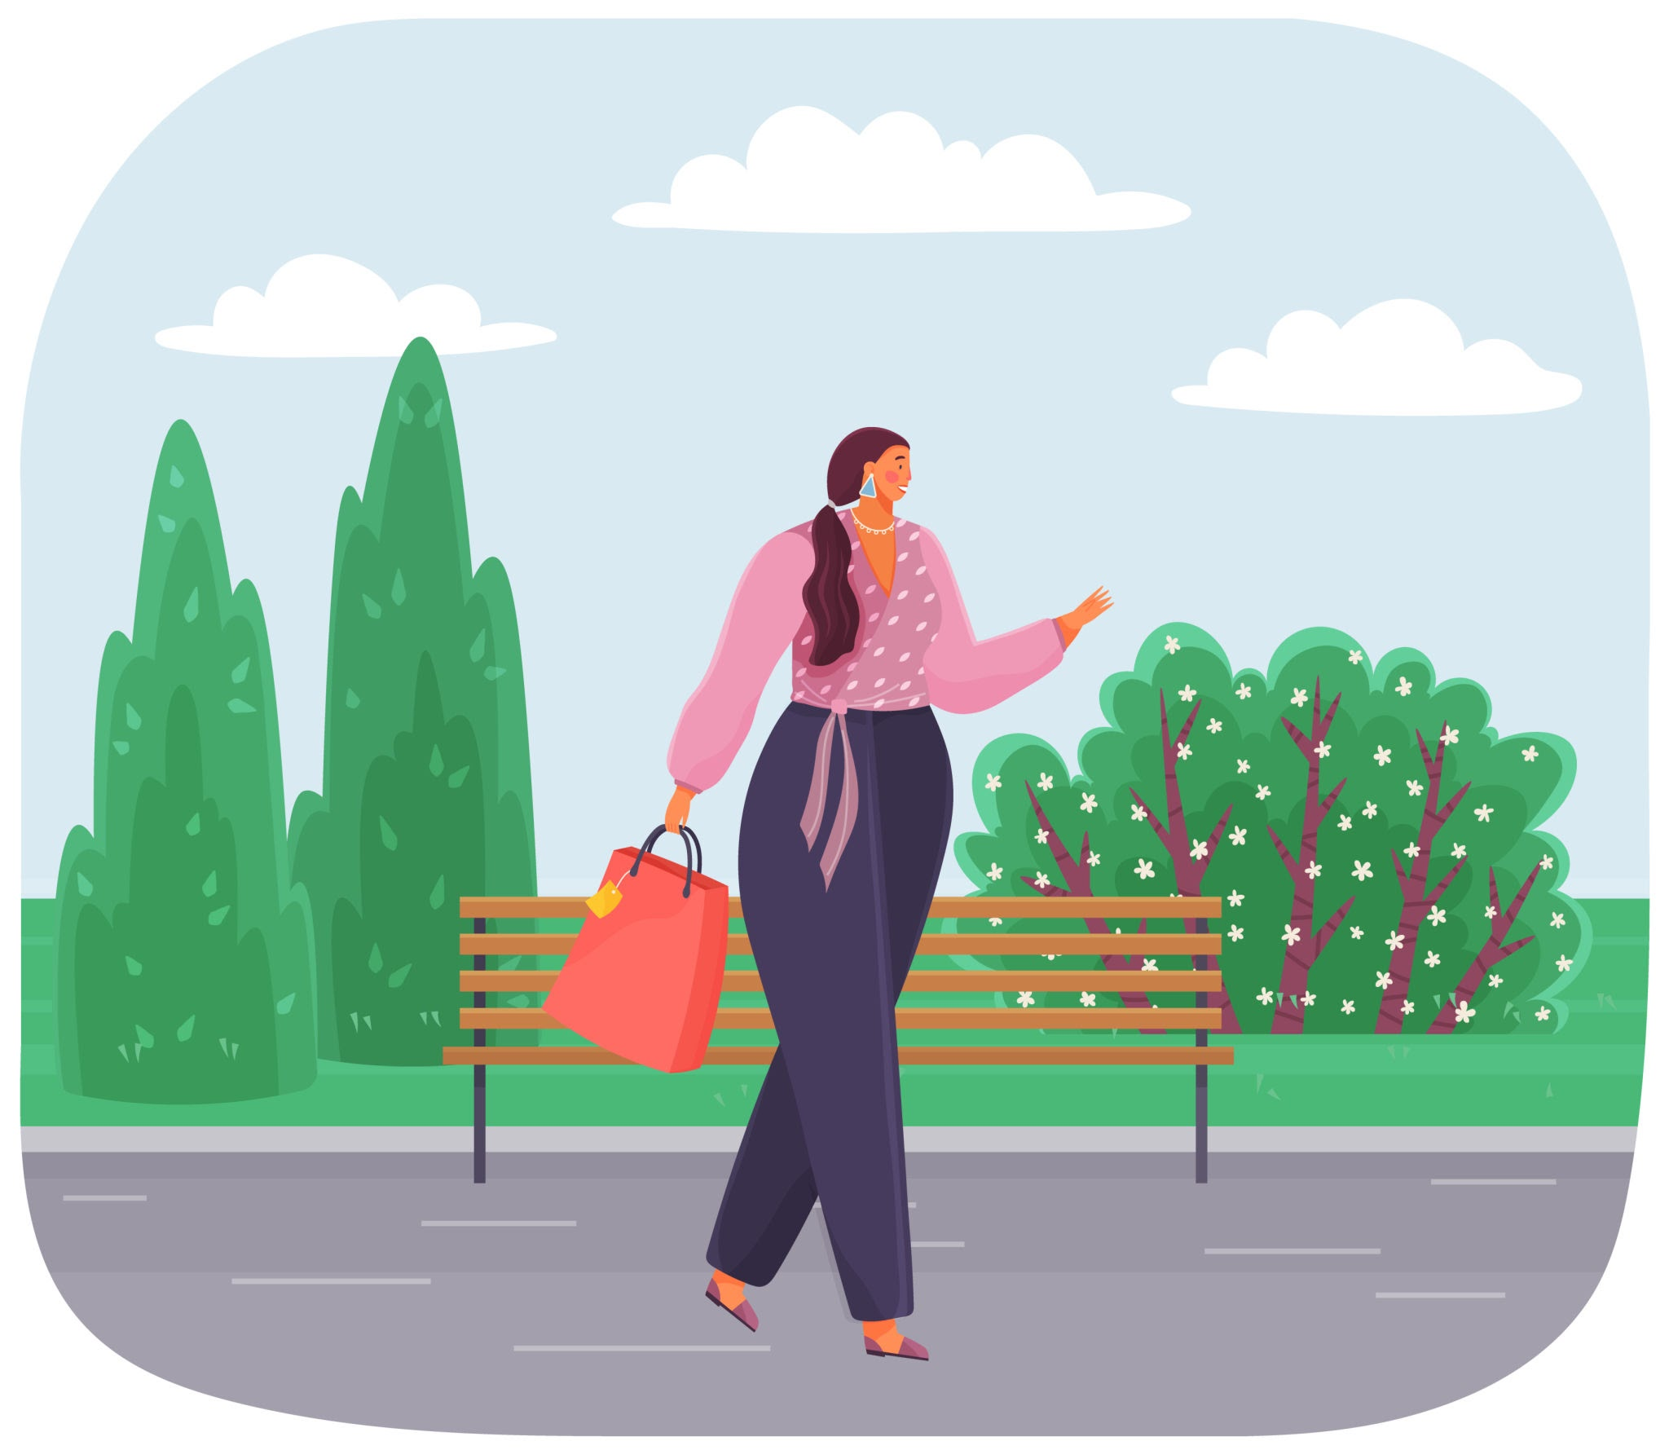
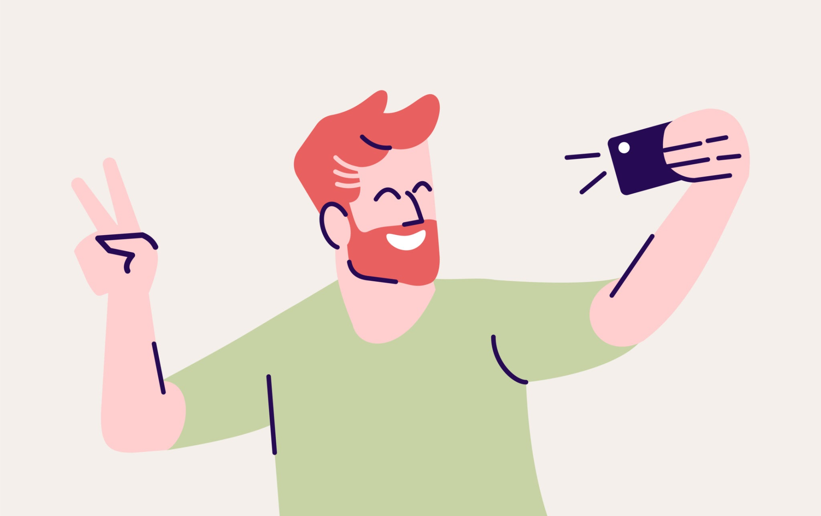


Que vas-tu faire à Paris?

Slide 4
Je vais…
visiter des monuments
pratiquer mon français
prendre des photos
flâner* dans la rue

Slide 5
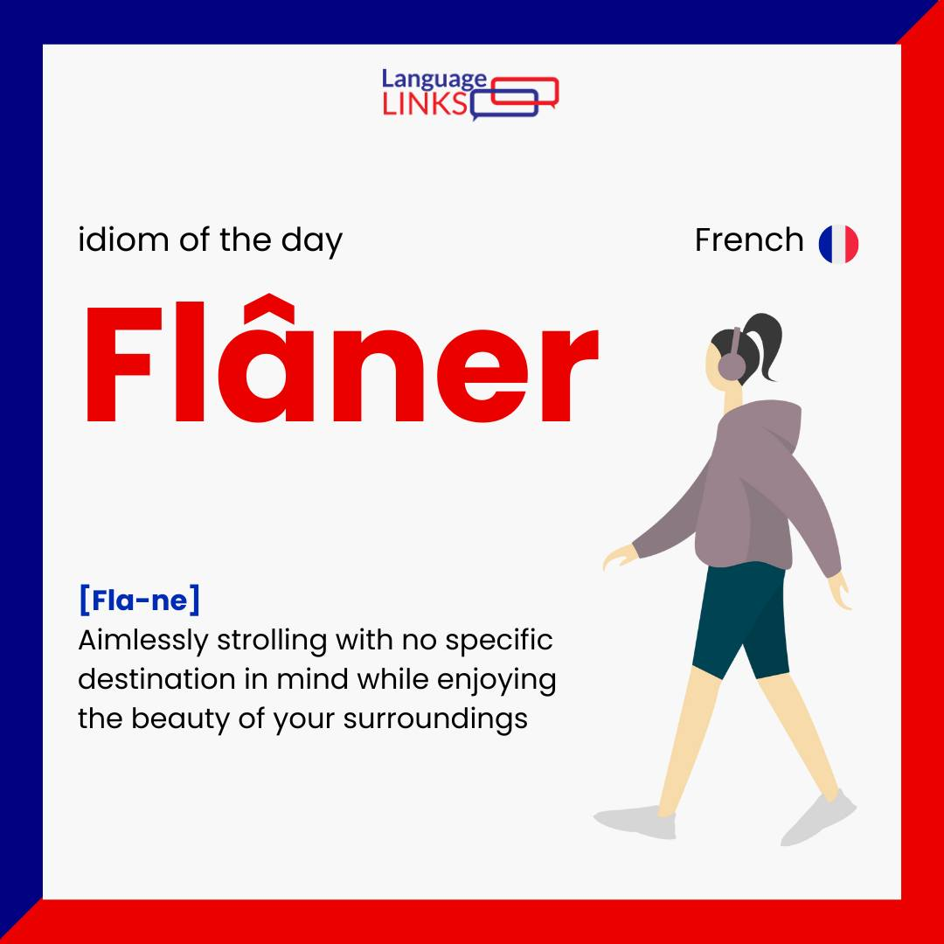
Flâner is a special French word - there is no direct translation to English!
It’s the perfect thing to do in a beautiful city like Paris!

Slide 6
Je vais…
visiter des monuments
pratiquer mon français
prendre des photos
flâner* dans la rue

Slide 7



visiter des monuments
visiter la tour Eiffel
prendre des photos
pratiquer mon français
visiter le Louvre
flâner dans la rue
 | Je vais | Mon cousin va | Mon frère va | Ma cousine va | Ma soeur va | Mes parents vont
raté!
touché!
coulé!

Slide 8
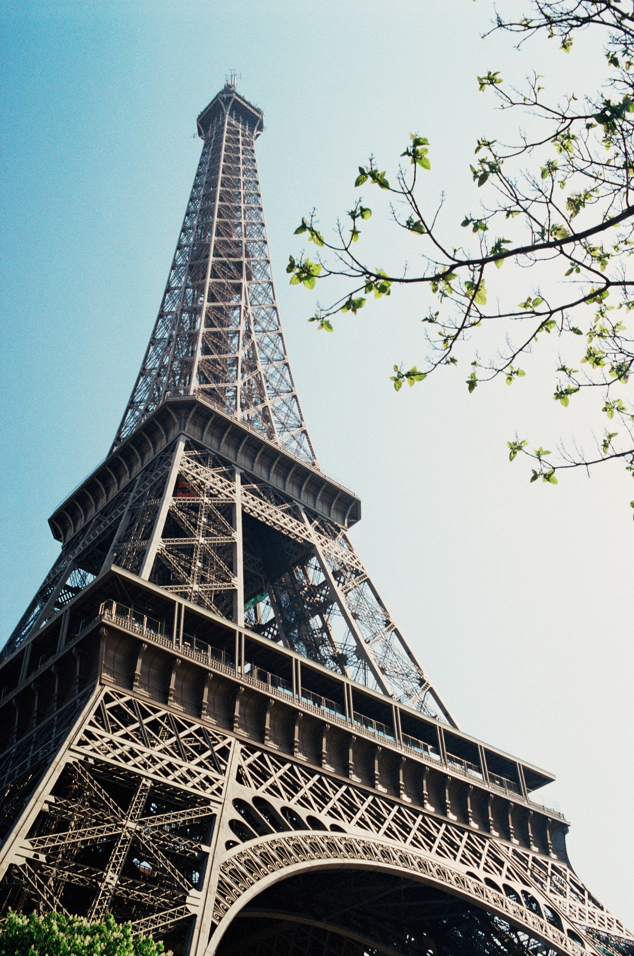
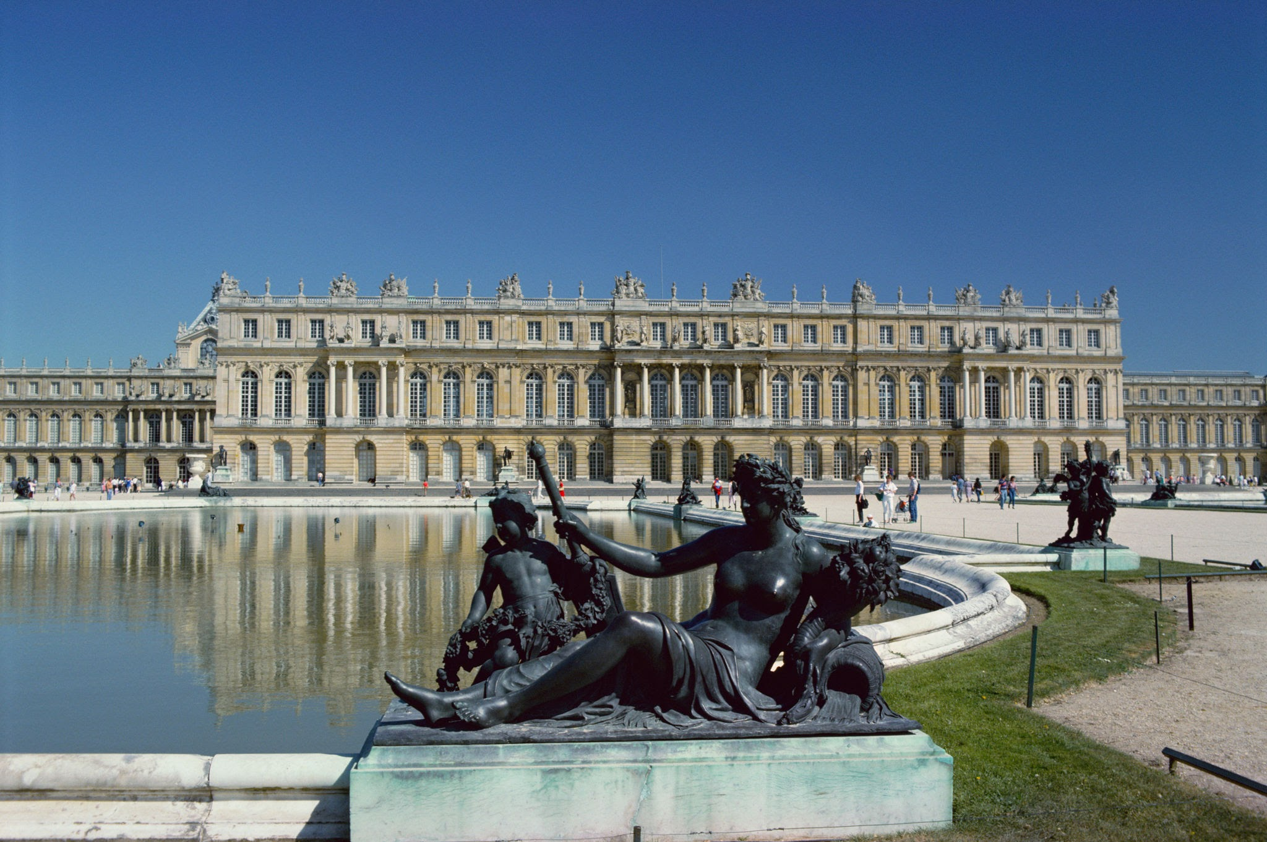
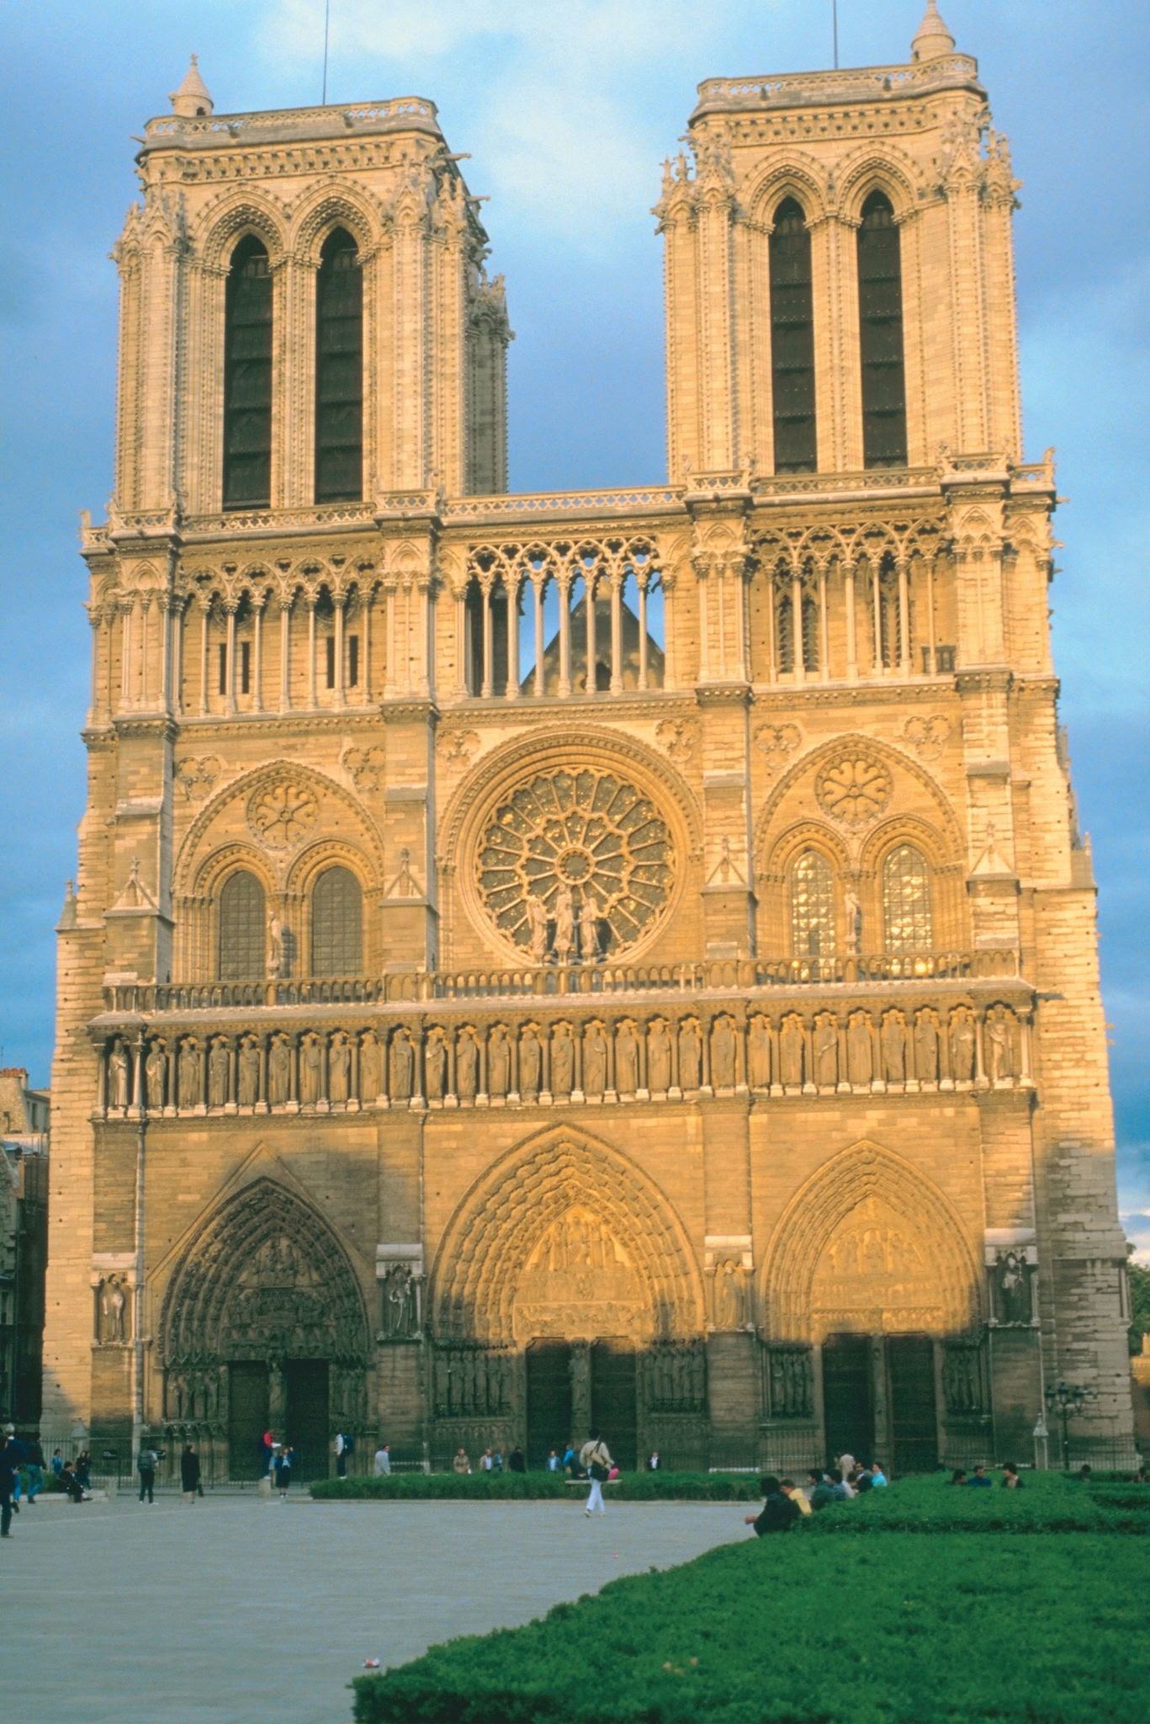
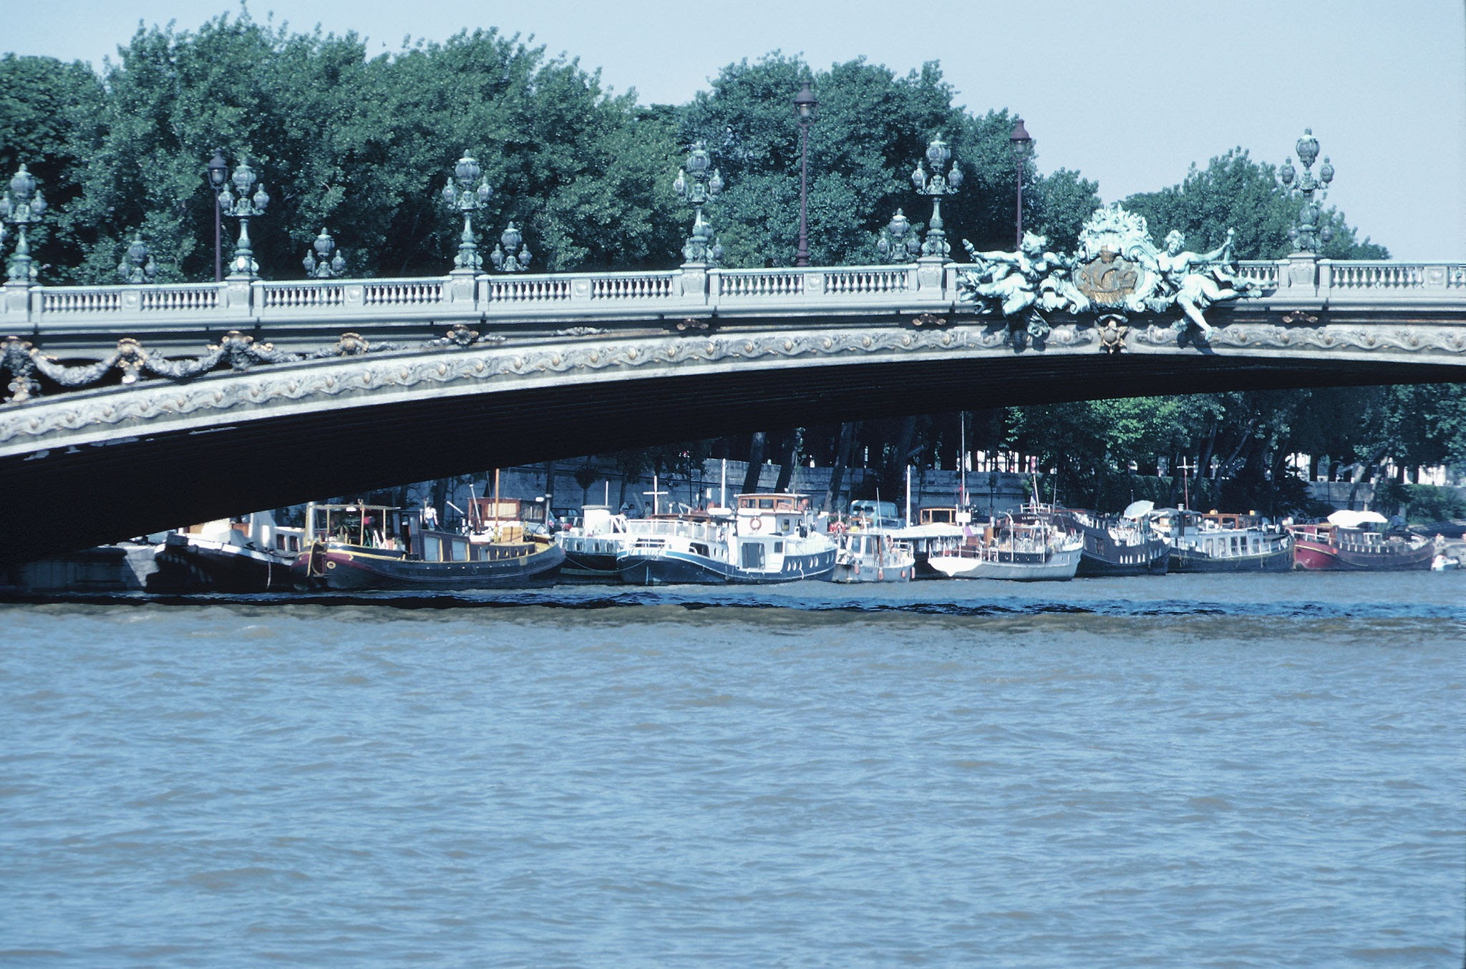
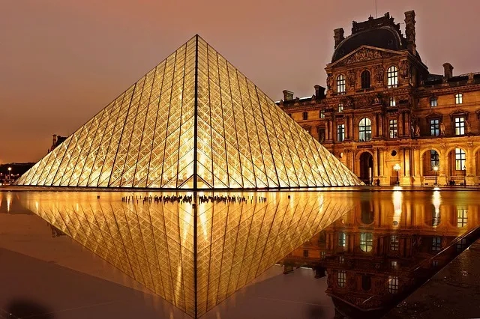
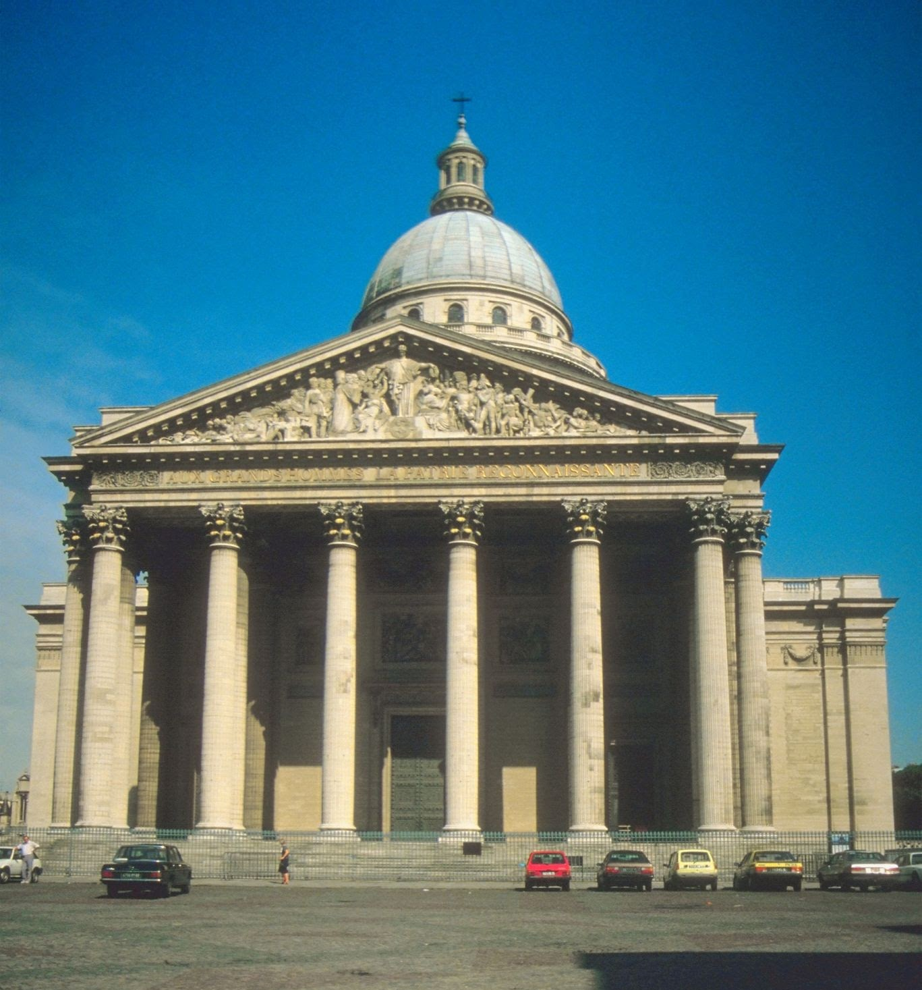
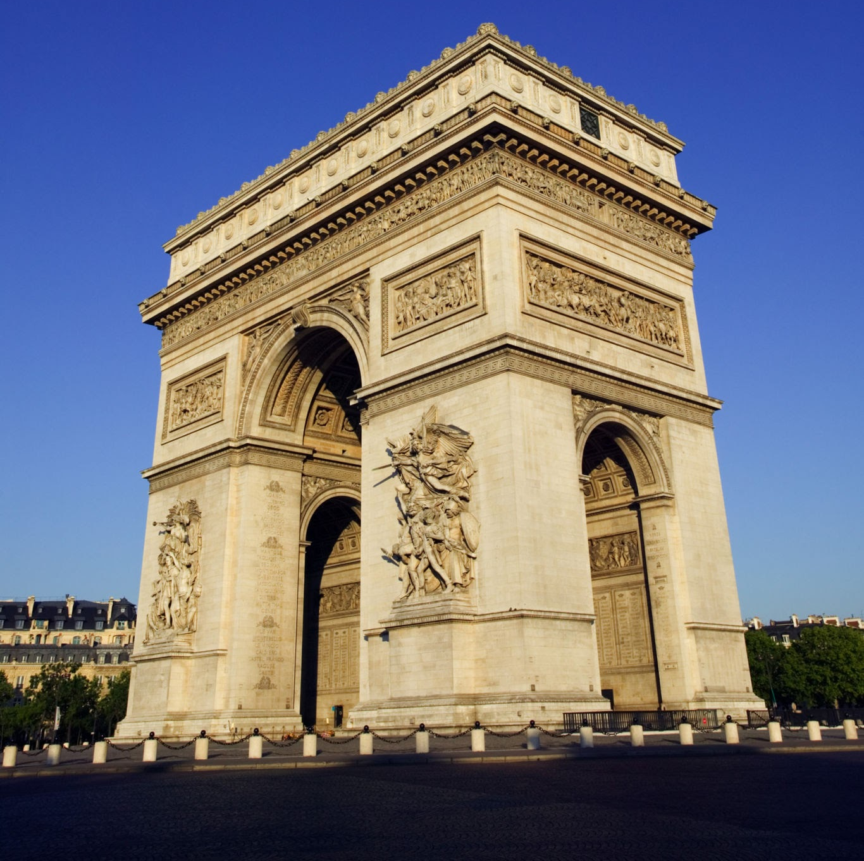
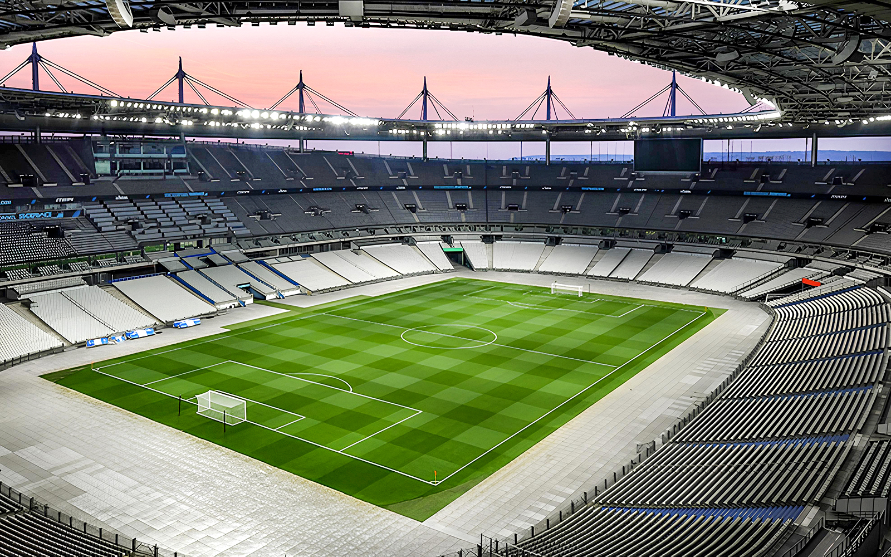

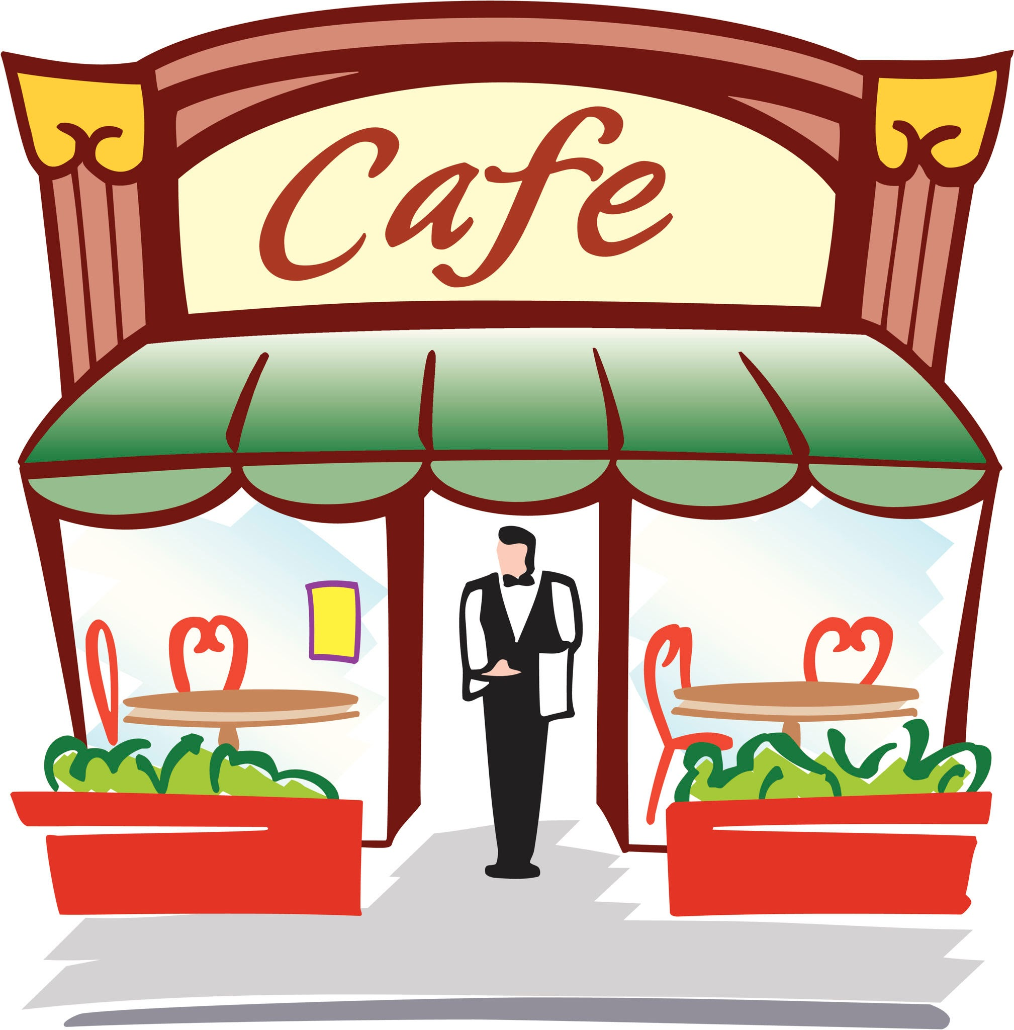
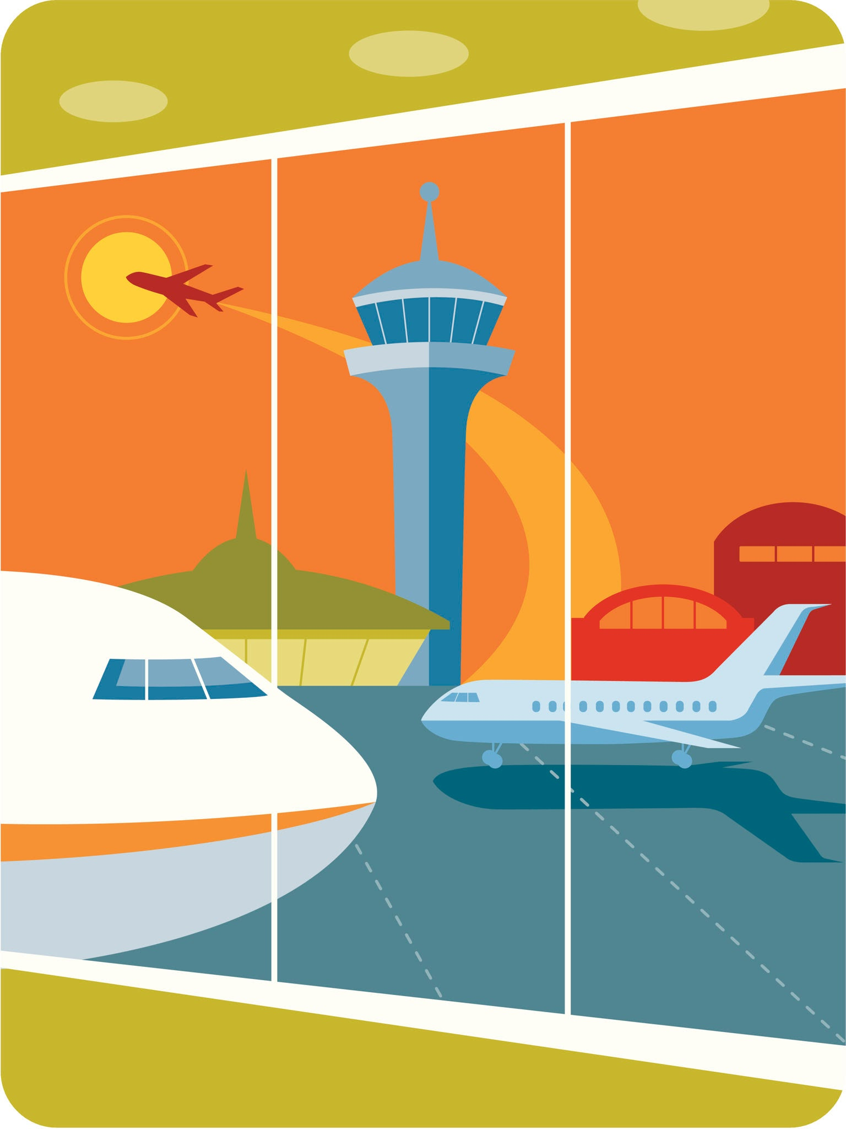
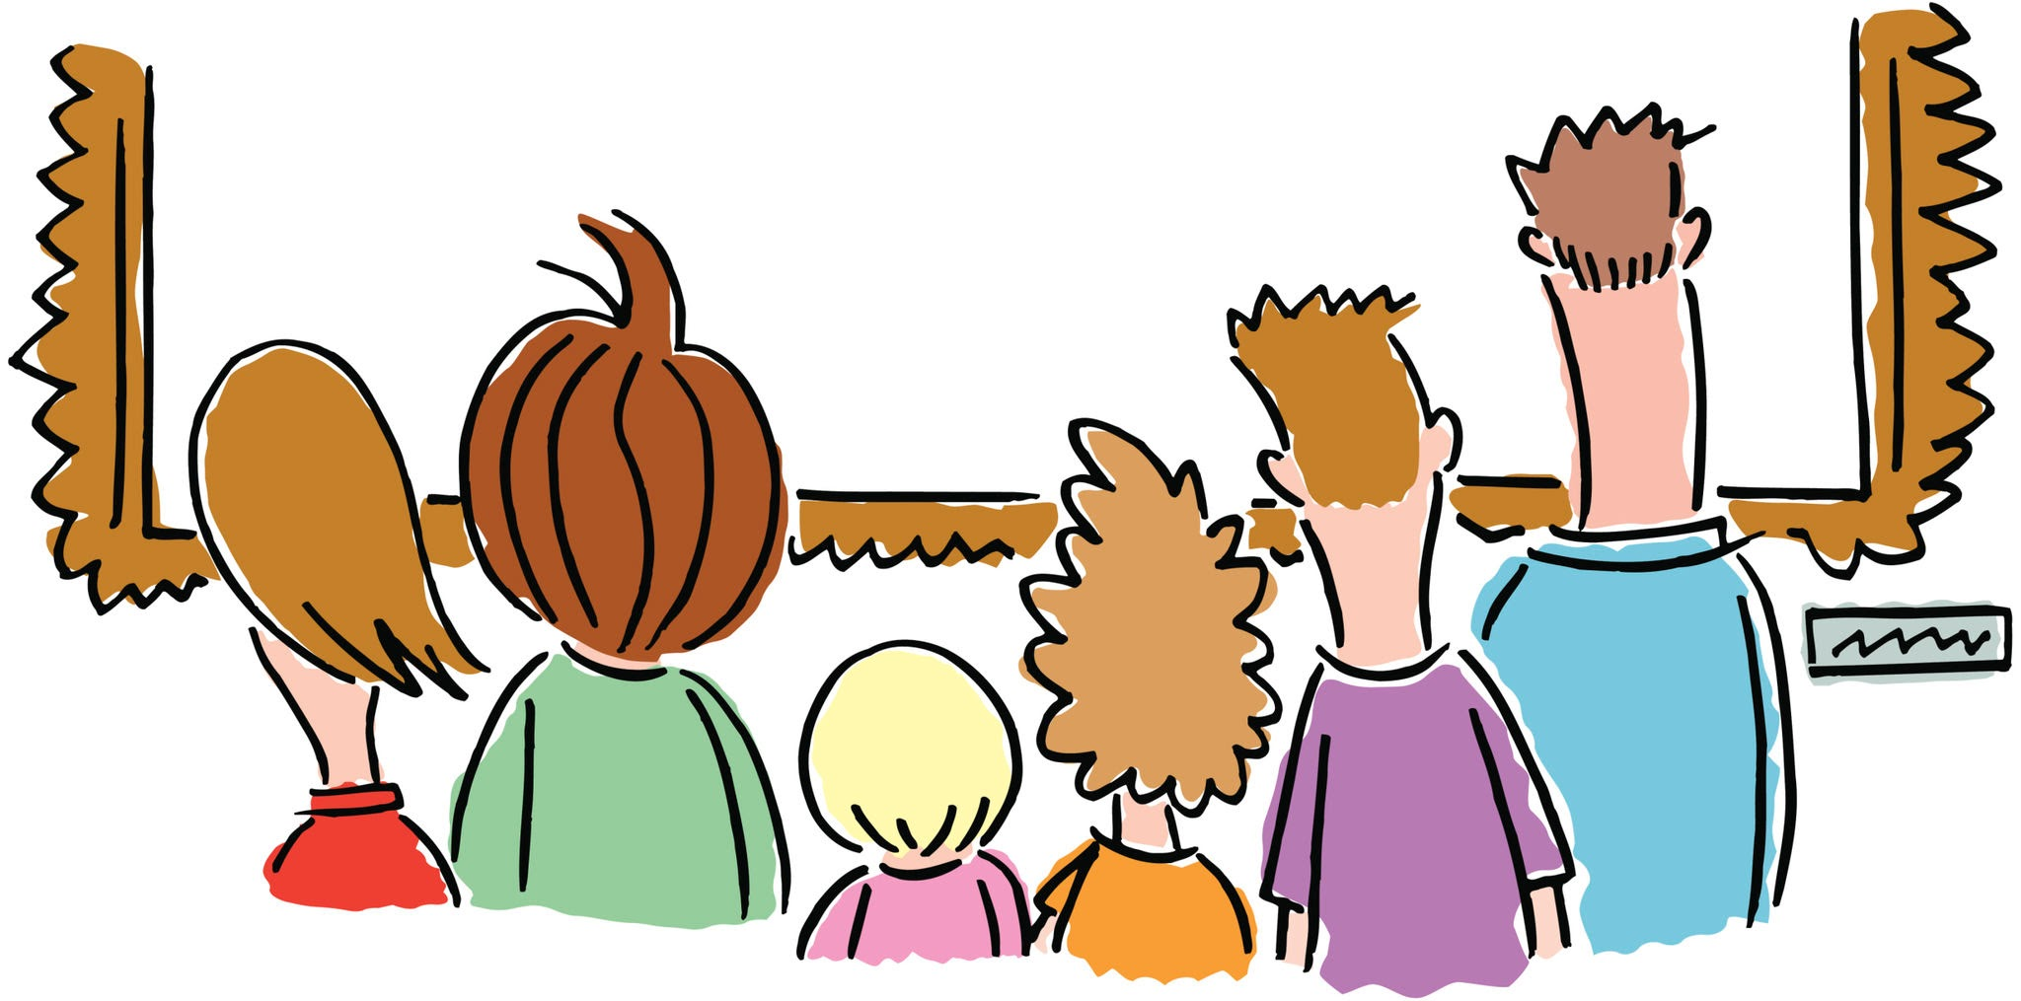
1 Je visite la tour Eiffel | 2 Je visite Versailles | 3 Je visite Notre Dame | 4 Je visite la Seine
5 Je visite la Stade de France | 6 Je visite le Louvre | 7 Je visite le Panthéon | 8 Je visite l’Arc de Triomphe
9 Je vais au musée | 10 Je vais à la cathédrale | 11 Je vais aux cafés | 12 Je vais à l’aéroport
13 Je vais visiter des monuments | 14 Je vais prendre des photos | 15 Je vais pratiquer mon français | 16 Je vais flâner dans la rue

Slide 9
1 | 2 | 3 | 4
5 | 6 | 7 | 8
9 | 10 | 11 | 12
13 | 14 | 15 | 16

Slide 10
1 Je visite la tour Eiffel | 2 Je visite Versailles | 3 Je visite Notre Dame | 4 Je visite la Seine
5 Je visite la Stade de France | 6 Je visite le Louvre | 7 Je visite le Panthéon | 8 Je visite l’Arc de Triomphe
9 Je vais au musée | 10 Je vais à la cathédrale | 11 Je vais aux cafés | 12 Je vais à l’aéroport
13 Je vais visiter des monuments | 14 Je vais prendre des photos | 15 Je vais pratiquer mon français | 16 Je vais flâner dans la rue

