Slide 1


ien
bien
Notes:
Timing: 1 minute
Aim: To introduce SSC [ien]
Procedure:
1. Present the letter(s) and say the [ien] sound first, on its own. Students repeat it with you.
2. Bring up the word ”bien” on its own, say it, students repeat it, so that they have the opportunity to focus all of their attention on the connection between the written word and its sound.
3. A possible gesture for this would be to give a thumbs up sign.
4. Roll back the animations and work through 1-3 again, but this time, dropping your voice completely to listen carefully to the students saying the [ien] sound, pronouncing ”bien” and, if using, doing the gesture.
Word frequency (1 is the most frequent word in French):
bien [47]
Source: Londsale, D., & Le Bras, Y. (2009). A Frequency Dictionary of French: Core vocabulary for learners London: Routledge.

Slide 2

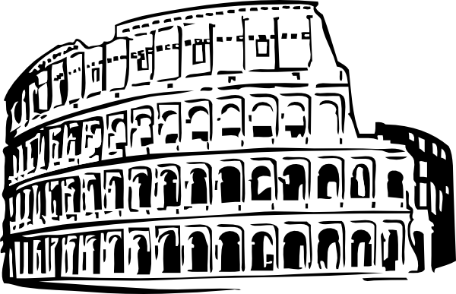


ien
ancien
chien
rien
bien
combien ?
[nothing]
bientôt
€ ?
[soon]
Notes:
Timing: 2 minutes
Aim: To introduce SSC [ien]
Procedure:
1. Introduce and elicit the pronunciation of the individual SSC [ien] and then the source word again ‘bien’ (with gesture, if using).
2. Then present and elicit the pronunciation of the five cluster words.
The cluster words have been chosen for their high-frequency, from a range of word classes, with the SSC (where possible) positioned within a variety of syllables within the words (e.g. initial, 2nd, final etc.). Additionally, we have tried to use words that build cumulatively on previously taught SSCs (see the Phonics Teaching Sequence document) and do not include new SSCs. Where new SSCs are used, they are often consonants which have a similar symbol-sound correspondence in English.
Word frequency (1 is the most frequent word in French):
chien [1744]; rien [168] bientôt [1208]; ancien [392]; combien? [800]; bien [47].
Source: Londsale, D., & Le Bras, Y. (2009). A Frequency Dictionary of French: Core vocabulary for learners London: Routledge.

Slide 3
ien
ancien
chien
rien
bien
combien ?
[nothing]
bientôt
Notes:
Timing: 2 minutes
Aim: To introduce SSC [ien]
Procedure:
1. Introduce and elicit the pronunciation of the individual SSC [ien] and then the source word again ‘bien’ (with gesture, if using).
2. Then present and elicit the pronunciation of the five cluster words.
The cluster words have been chosen for their high-frequency, from a range of word classes, with the SSC (where possible) positioned within a variety of syllables within the words (e.g. initial, 2nd, final etc.). Additionally, we have tried to use words that build cumulatively on previously taught SSCs (see the Phonics Teaching Sequence document) and do not include new SSCs. Where new SSCs are used, they are often consonants which have a similar symbol-sound correspondence in English.
Word frequency (1 is the most frequent word in French):
chien [1744]; rien [168] bientôt [1208]; ancien [392]; combien? [800]; bien [47].
Source: Londsale, D., & Le Bras, Y. (2009). A Frequency Dictionary of French: Core vocabulary for learners London: Routledge.

Slide 4
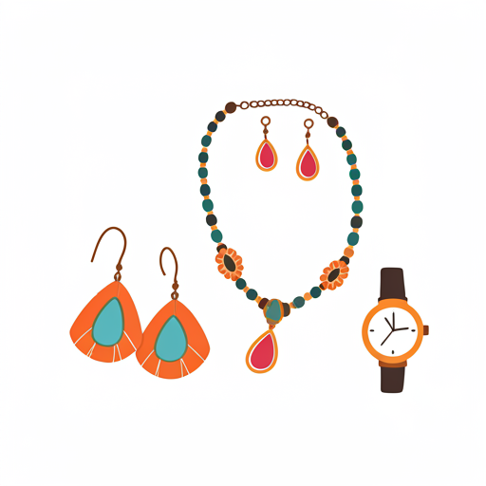

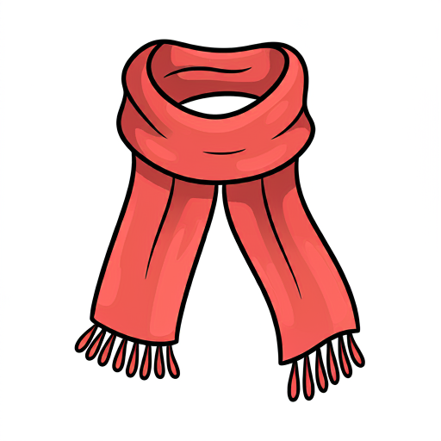

Quels accessoires portes-tu?

Slide 5
Je porte…
un chapeau
des gants
une écharpe
des bijoux

Slide 6



et un chapeau
et une écharpe
et des gants
et des bijoux
et des chaussures
et des bottes
 | Je porte une veste | Je porte un manteau | Je porte un pull | Je porte une chemise | Je porte une robe | Je porte des baskets
raté!
touché!
coulé!

Slide 7
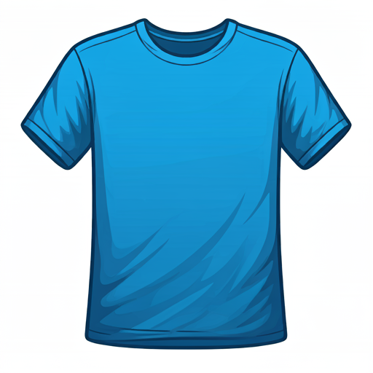
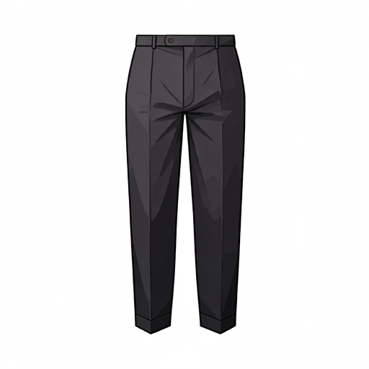
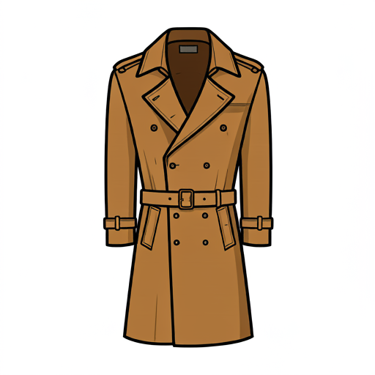
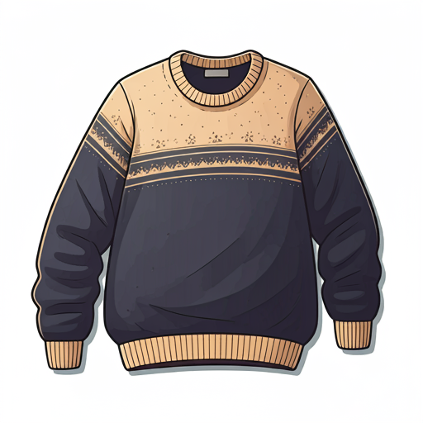
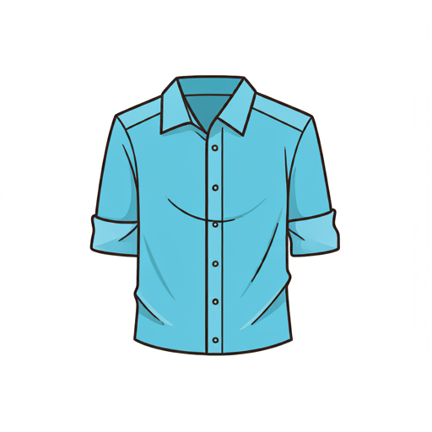

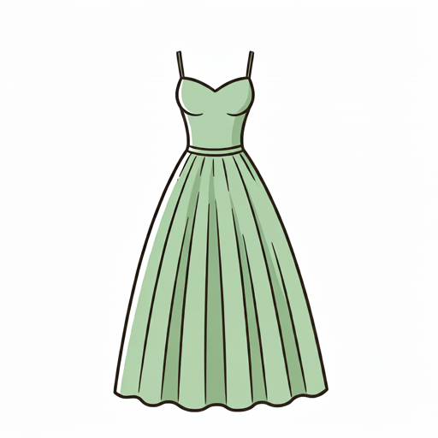
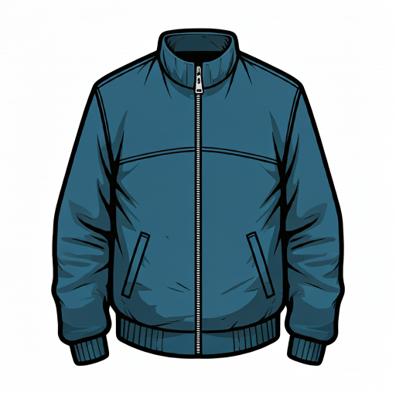
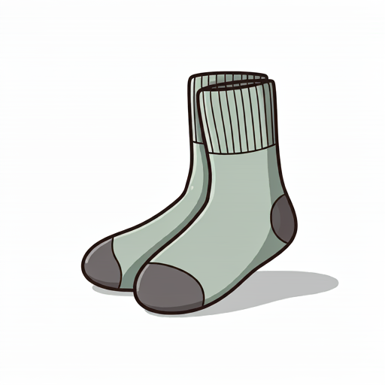
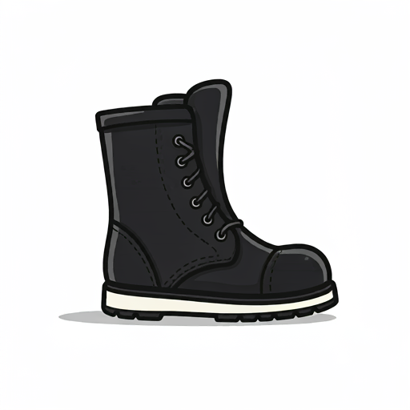
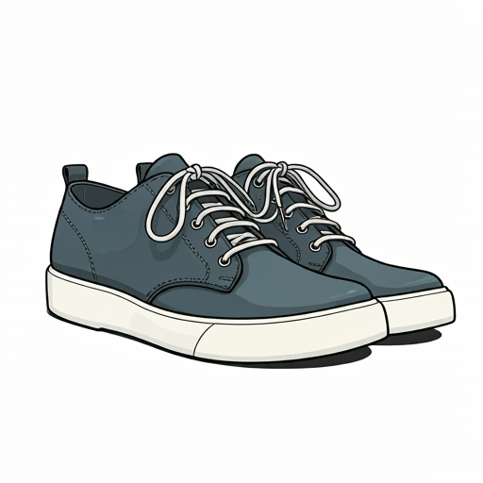
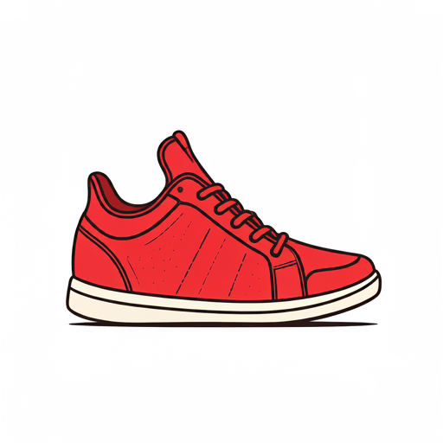
1 Je porte un t-shirt | 2 Je porte un pantalon | 3 Je porte un manteau | 4 Je porte un pull
5 Je porte une chemise | 6 Je porte une jupe | 7 Je porte une robe | 8 Je porte une veste
9 Je porte des chaussures | 10 Je porte des chaussettes | 11 Je porte des bottes | 12 Je porte des baskets
13 Je porte un chapeau | 14 Je porte une écharpe | 15 Je porte des gants | 16 Je porte des bijoux

Slide 8
1 | 2 | 3 | 4
5 | 6 | 7 | 8
9 | 10 | 11 | 12
13 | 14 | 15 | 16

