Slide 1


eu
deux
Notes:
Timing: 1 minute
Aim: To introduce SSC [eu]
Procedure:
1. Present the letter(s) and say the [eu] sound first, on its own. Students repeat it with you.
2. Bring up the word ”deux” on its own, say it, students repeat it, so that they have the opportunity to focus all of their attention on the connection between the written word and its sound.
3. A possible gesture for this would be to hold up two fingers (N.B. palm of the hand facing the class!).
4. Roll back the animations and work through 1-3 again, but this time, dropping your voice completely to listen carefully to the students saying the [eu] sound, pronouncing ”deux” and, if using, doing the gesture.
Word frequency (1 is the most frequent word in French):
deux [41].
Source: Londsale, D., & Le Bras, Y. (2009). A Frequency Dictionary of French: Core vocabulary for learners London: Routledge.

Slide 2



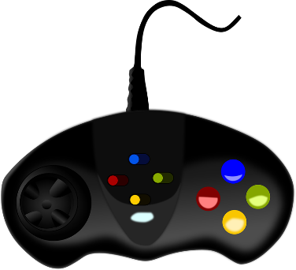
eu
jeudi
lieu
[place]
deux
feu
jeu
un peu
[a little]
Notes:
Timing: 2 minutes
Aim: To introduce SSC [eu]
Procedure:
1. Introduce and elicit the pronunciation of the individual SSC [eu] and then the source word again ‘deux’ (with gesture, if using).
2. Then present and elicit the pronunciation of the five cluster words.
The cluster words have been chosen for their high-frequency, from a range of word classes, with the SSC (where possible) positioned within a variety of syllables within the words (e.g. initial, 2nd, final etc.). Additionally, we have tried to use words that build cumulatively on previously taught SSCs (see the Phonics Teaching Sequence document) and do not include new SSCs. Where new SSCs are used, they are often consonants which have a similar symbol-sound correspondence in English.
Word frequency (1 is the most frequent word in French):
deux {41]; jeudi[1112]; lieu [117] feu [786]; un peu [138/91]; jeu [291].
Source: Londsale, D., & Le Bras, Y. (2009). A Frequency Dictionary of French: Core vocabulary for learners London: Routledge.

Slide 3
eu
jeudi
lieu
deux
feu
jeu
un peu
Notes:
Without sound to elicit pronunciation (without first hearing the teacher).
Teacher to elicit pronunciation by asking “Comment dit-on …"

Slide 4





Je joue…
au foot
au rugby
au handball
au tennis

Slide 5

Tu joues au hockey?

Slide 6

Quelle est la différence?
Je joue au hockey sur gazon
Je joue au hockey sur glace
Field hockey
Ice hockey

Slide 7


Je joue…
au hockey
à la pétanque
au volley
aux boules

Slide 8



au hockey sur glace
au volley
aux boules
au foot
au handball
au tennis
 | Je joue | Mon cousin joue | Mon frère joue | Ma cousine joue | Ma soeur joue | Mes parents jouent
raté!
touché!
coulé!

Slide 9








1 Je joue au foot | 2 Je joue au hockey | 3 Je joue au volley | 4 Je joue au tennis
5 Je joue au rugby | 6 Je joue au handball | 7 Je joue aux boules | 8 Je joue à la pétanque
9 Je fais du cyclisme | 10 Je fais de la voile | 11 Je fais de la gymnastique | 12 Je fais de l’équitation
13 Je fais du judo | 14 Je fais de l’athlétisme | 15 Je fais de l’escalade | 16 Je fais de la natation

Slide 10
1 | 2 | 3 | 4
5 | 6 | 7 | 8
9 | 10 | 11 | 12
13 | 14 | 15 | 16

