Slide 1

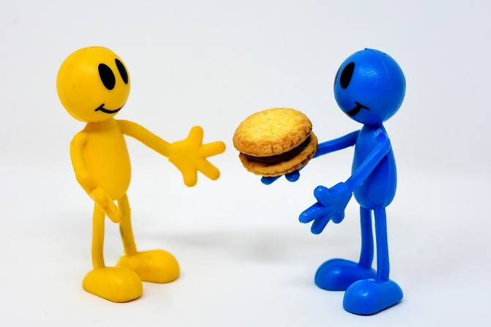
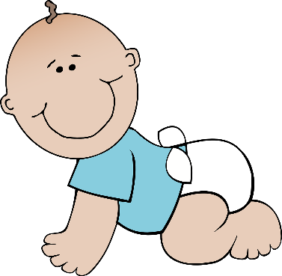


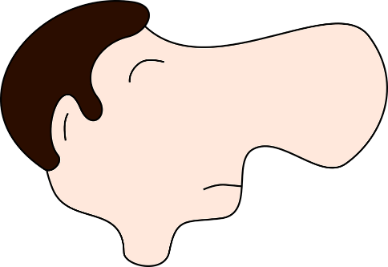
é/-er/-ez
bébé
donner
nez
parler
écrire
compliqué
[complicated]
Notes:
Timing: 2 minutes
Aim: To introduce SSC [é]
Procedure:
1. Introduce and elicit the pronunciation of the individual SSC [é] and then the source word again ‘écrire’ (with gesture, if using).
2. Then present and elicit the pronunciation of the five cluster words.
The cluster words have been chosen for their high-frequency, from a range of word classes, with the SSC (where possible) positioned within a variety of syllables within the words (e.g. initial, 2nd, final etc.). Additionally, we have tried to use words that build cumulatively on previously taught SSCs (see the Phonics Teaching Sequence document) and do not include new SSCs. Where new SSCs are used, they are often consonants which have a similar symbol-sound correspondence in English.
Word frequency (1 is the most frequent word in French):
écrire [382]; bébé [>5000]; aller [55] donner [46]; nez [2661]; parler [106].
Source: Londsale, D., & Le Bras, Y. (2009). A Frequency Dictionary of French: Core vocabulary for learners London: Routledge.

Slide 2

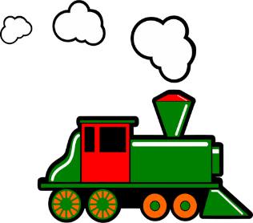


ain/in
fin
matin
[end]
vingt
train
main
maintenant
[now]
Notes:
Timing: 2 minutes
Aim: To introduce SSC [ain/in]
Procedure:
1. Introduce and elicit the pronunciation of the individual SSC [ain/in] and then the source word again ‘train’ (with gesture, if using).
2. Then present and elicit the pronunciation of the five cluster words.
The cluster words have been chosen for their high-frequency, from a range of word classes, with the SSC (where possible) positioned within a variety of syllables within the words (e.g. initial, 2nd, final etc.). Additionally, we have tried to use words that build cumulatively on previously taught SSCs (see the Phonics Teaching Sequence document) and do not include new SSCs. Where new SSCs are used, they are often consonants which have a similar symbol-sound correspondence in English.
Word frequency (1 is the most frequent word in French):
fin [111]; matin [442] vingt[1273]; maintenant [192]; main [418]; train [232].
Source: Londsale, D., & Le Bras, Y. (2009). A Frequency Dictionary of French: Core vocabulary for learners London: Routledge.

Slide 3
nom cnsiuo
ma nttea
am bllee - èrem
nmo mdie - ferèr
sem sdrgan - prntsae
mon cousin
ma tante
ma belle-mère
mon demi-frère
mes grands-parents

Slide 4
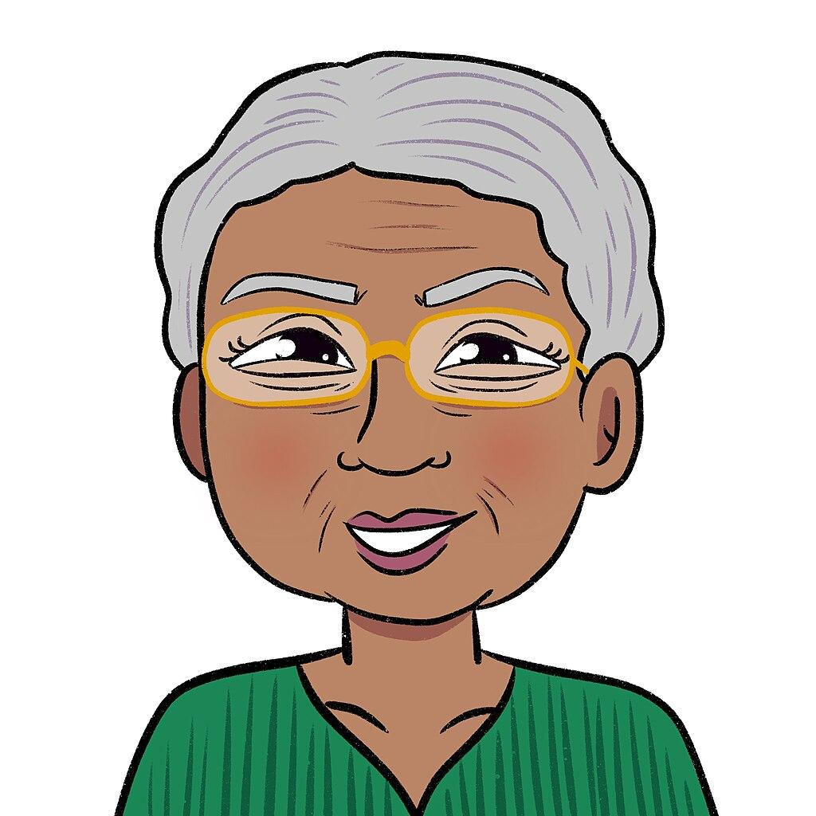

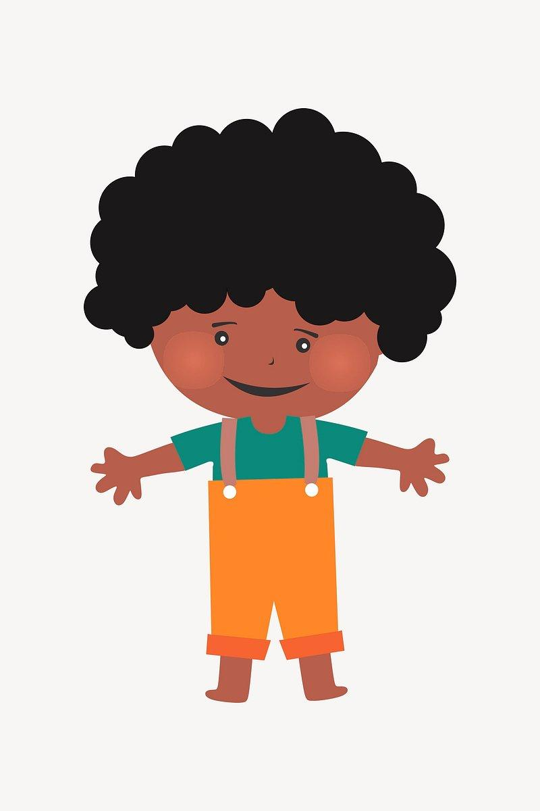
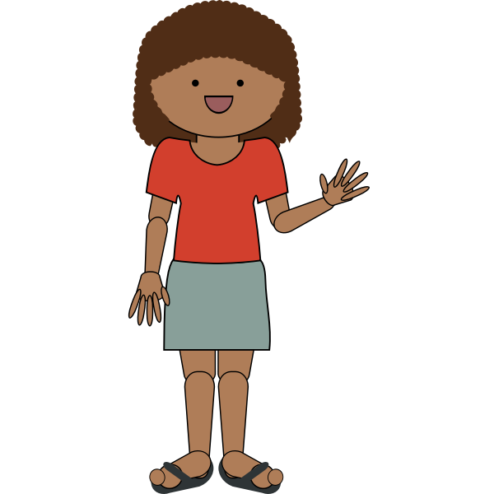


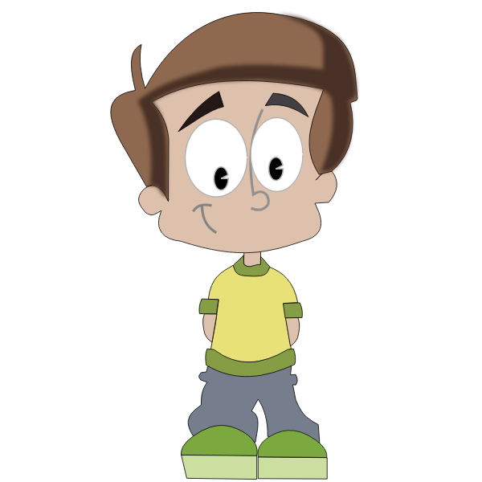


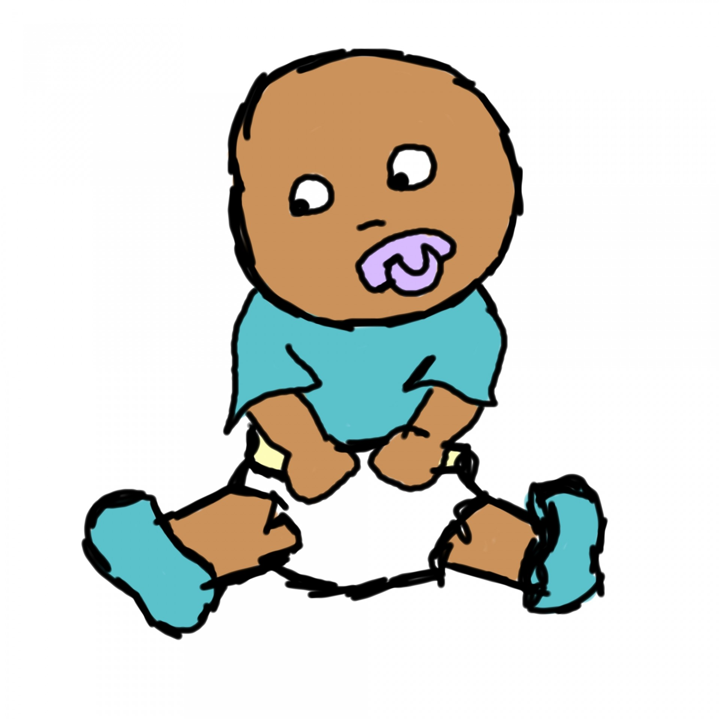
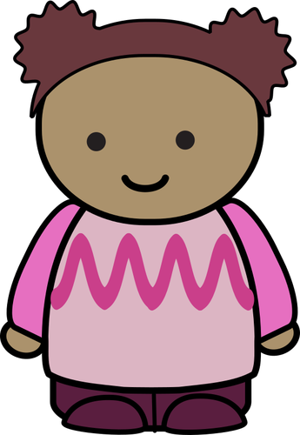
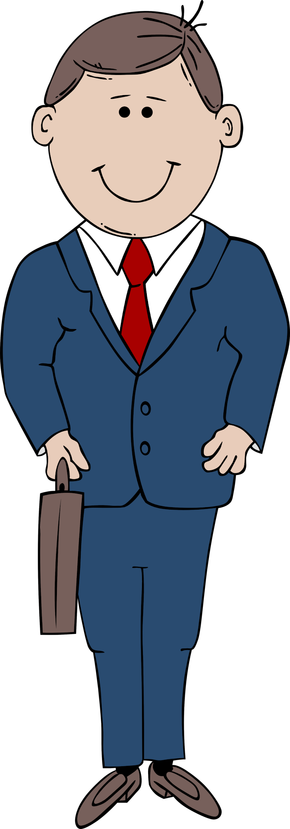

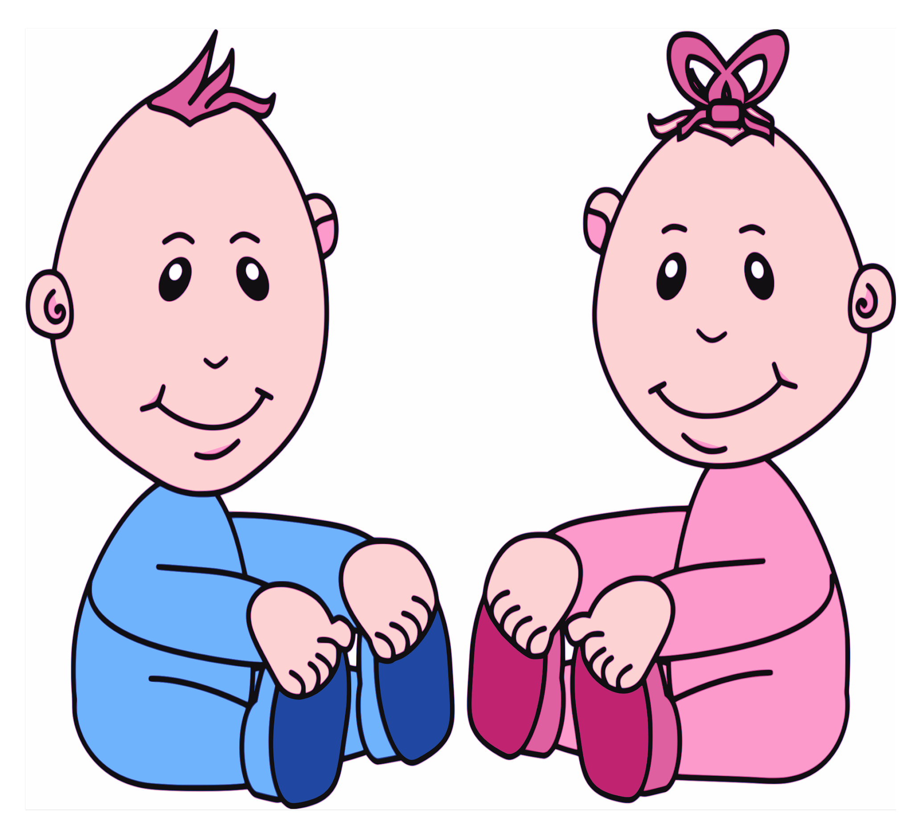
ma grand-mère
mon grand-père
moi
ma mère
mon père
ma soeur
mon frère
ma tante
mon oncle
mon cousin
ma cousine
mon demi-frère
ma demi-soeur
mon beau-père
ma belle-mère

Slide 6
m*n p^r%
m# d%m?-s*%!r
m%s c*!s?ns
m# gr#nd-m^r%
m*n *ncl%
* =
% =
^ =
# =
! =
?
o
e
è
a
u
i
mon père
ma demi-soeur
mes cousins
ma grand-mère
mon oncle

Slide 7
Voici ma famille! Voici mon père et ma belle-mère. Voici mon frère et mon beau-frère. Voici ma mère, mon beau-père et ma demi-soeur. Voici mes grands-parents et mon oncle. Et moi!

Slide 8
Voici ma famille! Voici ma mère et mon oncle. Voici ma soeur et mon cousin. Voici ma grand-mère, mon père et mon demi-frère. Voici mes tantes et ma cousine. Et moi!

