Slide 1
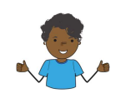
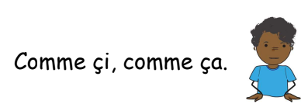
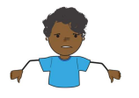
Guten Morgen / Guten Tag Wie geht’s?
Mir geht’s gut
Mir geht’s prima
Mir geht’s okay
Mir geht’s nicht gut
Notes:
Greet 5 people in the class and ask them how they are

Slide 2


eu
Deutschland
Notes:
Timing: 1 minute
Aim: To introduce/consolidate SSC [eu]
Procedure:
1. Present the letter(s) and say the [eu] sound first, on its own. Students repeat it with you.
2. Bring up the word ”Deutschland” on its own, say it, students repeat it, so that they have the opportunity to focus all of their attention on the connection between the written word and its sound.
3. A possible gesture for this would be to act as though you are addressing Germany, saying ‘Oy! Deutschland!’ and jabbing your finger into the air (joyfully) twice, once on ‘Oy!’ and once on the first syllable of Deutschland.
4. Roll back the animations and work through 1-3 again, but this time, dropping your voice completely to listen carefully to the students saying the [eu] sound, pronouncing ”Deutschland” and, if using, doing the gesture.
Word frequency (1 is the most frequent word in German):
Deutschland [N/A proper noun]
Source: Jones, R.L. & Tschirner, E. (2006). A frequency dictionary of German: core vocabulary for learners. Routledge

Slide 3
eu
Deutschland
Notes:
With sound and no pictures to focus all attention on the sound-symbol correspondence.

Slide 4
eu
Deutschland
Notes:
Without sound to elicit pronunciation (without first hearing the teacher).
Teacher to elicit pronunciation by asking “Wie sagt man…”

Slide 5
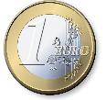



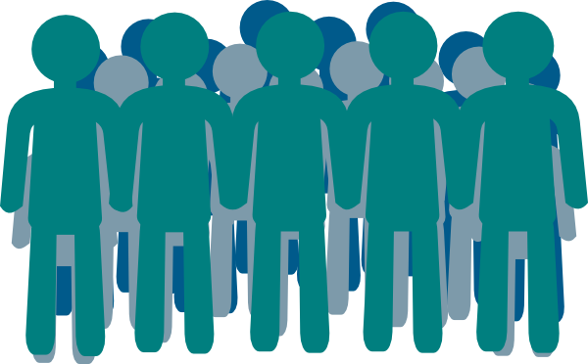
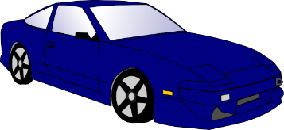

eu
Euro
heute
[today]
Deutschland
Freund
Leute
neu
Notes:
Timing: 2 minutes
Aim: To introduce/consolidate SSC [eu]
Procedure:
Introduce and elicit the pronunciation of the individual SSC [eu] and then the source word again ‘Deutschland’ (with gesture, if using).
Then present and elicit the pronunciation of the five cluster words.
The cluster words have been chosen for their high-frequency, from a range of word classes, with the SSC (where possible) positioned within a variety of syllables within the words (e.g. initial, 2nd, final etc.). Additionally, we have tried to use words that build cumulatively on previously taught SSCs (see the Phonics Teaching Sequence document) and do not include new SSCs. Where new SSCs are used, they are often consonants which have a similar symbol-sound correspondence in English.
Word frequency (1 is the most frequent word in German):
Deutschland [N/A proper noun]; Euro [333] heute [121]; Freund [327]; neu [80]; Leute[163].
Source: Jones, R.L. & Tschirner, E. (2006). A frequency dictionary of German: core vocabulary for learners. Routledge

Slide 6
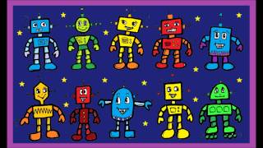

Slide 7
Eins, zwei, drei, vier fünf kleine Roboter
sechs, sieben, acht, neun, zehn kleine Roboter
Eins, zwei, drei, vier fünf kleine Roboter
sechs, sieben, acht, neun, zehn.
Eins, zwei, drei, vier fünf Krokodile
sechs, sieben, acht, neun, zehn Krokodile
Eins, zwei, drei, vier fünf Krokodile
sechs, sieben, acht, neun, zehn.
Eins, zwei, drei, vier fünf Dinosaurier
sechs, sieben, acht, neun, zehn Dinosaurier
Eins, zwei, drei, vier fünf kleine Dinosaurier
sechs, sieben, acht, neun, zehn.

Slide 8
1 | 2 | 3 | 4 | 5 | 6
7 | 8 | 9 | 10 | 11 | Die Zahlen
e
eins
z
zwei
d
drei
v
vier
f
fünf
s
sechs
s
sieben
a
acht
n
neun
z
zehn
e
elf

Slide 9
1 | 2 | 3 | 4 | 5 | 6
7 | 8 | 9 | 10 | 11 | Die Zahlen
e
eins
z
zwei
d
drei
v
vier
f
fünf
s
sechs
s
sieben
a
acht
n
neun
z
zehn
e
elf
Notes:
To print and cut up for thosse that need it for the lotto game

Slide 10
Lotto!
Notes:
Demo how they pick 4 numbers

Slide 11


Wie alt bist du?
Ich bin
neun

Slide 12
Wie alt bist du?
Ich bin
sieben

Slide 13
Wie alt bist du?
Ich bin eins, zwei, drei, vier, fünf, sechs, sieben, acht, neun, zehn, elf

Slide 14
Wie geht’s?
Mir geht’s [gut]
Wie heißt du?
Ich heiße [Heidi]
Wo wohnst du?
Ich wohne in [Wigton]
Ich bin [zehn]
Wie alt bist du?
Tschüss!
Auf Wiedersehen!

