Slide 1


é/-er/-ez
écrire
Notes:
Timing: 1 minute
Aim: To introduce SSC [é]
Procedure:
1. Present the letter(s) and say the [é] sound first, on its own. Students repeat it with you.
2. Bring up the word ”écrire” on its own, say it, students repeat it, so that they have the opportunity to focus all of their attention on the connection between the written word and its sound.
3. A possible gesture for this would be to mime the act of writing (onto the palm of the other hand perhaps).
4. Roll back the animations and work through 1-3 again, but this time, dropping your voice completely to listen carefully to the students saying the [é] sound, pronouncing ”écrire” and, if using, doing the gesture.
Word frequency (1 is the most frequent word in French):
écrire [382]
Source: Londsale, D., & Le Bras, Y. (2009). A Frequency Dictionary of French: Core vocabulary for learners London: Routledge.

Slide 2
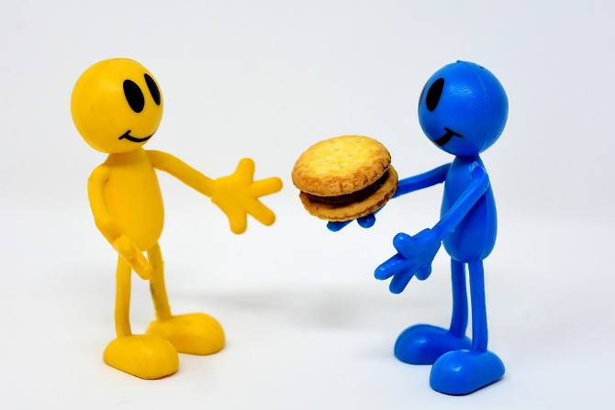
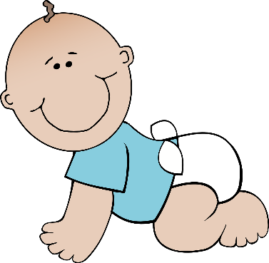


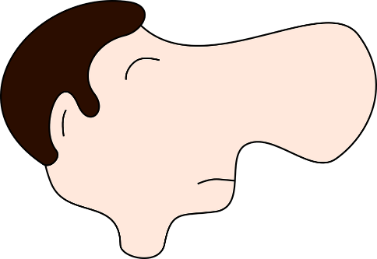
é/-er/-ez
donner
bébé
nez
parler
écrire
compliqué
[complicated]
Notes:
Timing: 2 minutes
Aim: To introduce SSC [é]
Procedure:
1. Introduce and elicit the pronunciation of the individual SSC [é] and then the source word again ‘écrire’ (with gesture, if using).
2. Then present and elicit the pronunciation of the five cluster words.
The cluster words have been chosen for their high-frequency, from a range of word classes, with the SSC (where possible) positioned within a variety of syllables within the words (e.g. initial, 2nd, final etc.). Additionally, we have tried to use words that build cumulatively on previously taught SSCs (see the Phonics Teaching Sequence document) and do not include new SSCs. Where new SSCs are used, they are often consonants which have a similar symbol-sound correspondence in English.
Word frequency (1 is the most frequent word in French):
écrire [382]; bébé [>5000]; aller [55] donner [46]; nez [2661]; parler [106].
Source: Londsale, D., & Le Bras, Y. (2009). A Frequency Dictionary of French: Core vocabulary for learners London: Routledge.

Slide 3
é/-er/-ez
donner
bébé
nez
parler
écrire
compliqué
Notes:
Timing: 2 minutes
Aim: To introduce SSC [é]
Procedure:
1. Introduce and elicit the pronunciation of the individual SSC [é] and then the source word again ‘écrire’ (with gesture, if using).
2. Then present and elicit the pronunciation of the five cluster words.
The cluster words have been chosen for their high-frequency, from a range of word classes, with the SSC (where possible) positioned within a variety of syllables within the words (e.g. initial, 2nd, final etc.). Additionally, we have tried to use words that build cumulatively on previously taught SSCs (see the Phonics Teaching Sequence document) and do not include new SSCs. Where new SSCs are used, they are often consonants which have a similar symbol-sound correspondence in English.
Word frequency (1 is the most frequent word in French):
écrire [382]; bébé [>5000]; aller [55] donner [46]; nez [2661]; parler [106].
Source: Londsale, D., & Le Bras, Y. (2009). A Frequency Dictionary of French: Core vocabulary for learners London: Routledge.

Slide 4
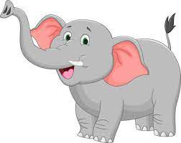
é/-er/-ez
Un éléphant est très grand.
Un éléphant est très grand.
Un éléphant est très grand.
/é/-/é/-/é/-/é/-/é/

Slide 5
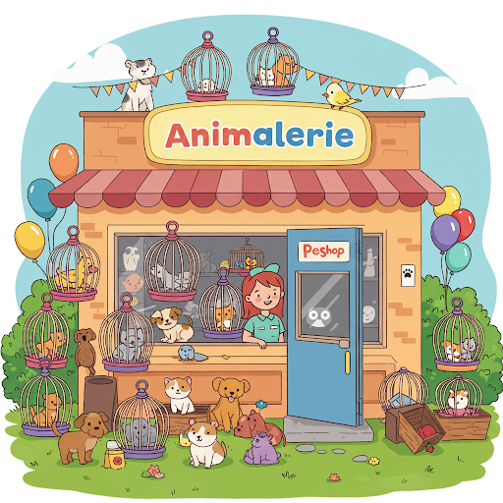
Chez l'animalerie

Slide 6
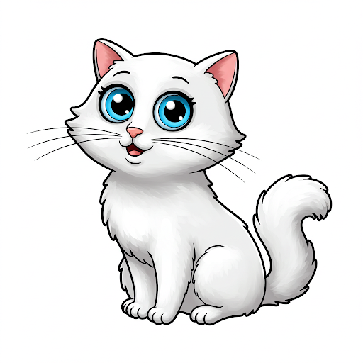
il est noir
il est brun
il est blanc
il est orange
il est gris
J’ai un chien.
J’ai un chat.
J’ai un cheval.
J’ai un poisson.
J’ai un lapin.
J’ai un serpent.
J’ai un oiseau.
J’ai un hamster.
il est grand
il est petit
il est adorable
il est mignon

Slide 7

il est noir
il est brun
il est blanc
il est orange
il est gris
J’ai un chien.
J’ai un chat.
J’ai un cheval.
J’ai un poisson.
J’ai un lapin.
J’ai un serpent.
J’ai un oiseau.
J’ai un hamster.
il est grand
il est petit
il est adorable
il est mignon

Slide 8
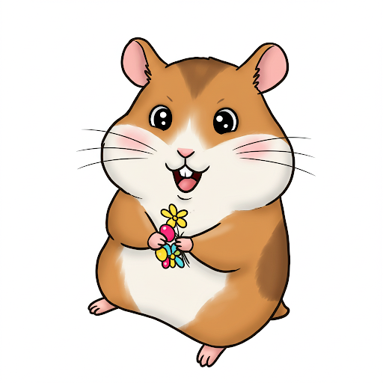
il est noir
il est brun
il est blanc
il est orange
il est gris
J’ai un chien.
J’ai un chat.
J’ai un cheval.
J’ai un poisson.
J’ai un lapin.
J’ai un serpent.
J’ai un oiseau.
J’ai un hamster.
il est grand
il est petit
il est adorable
il est mignon
et = and

Slide 9
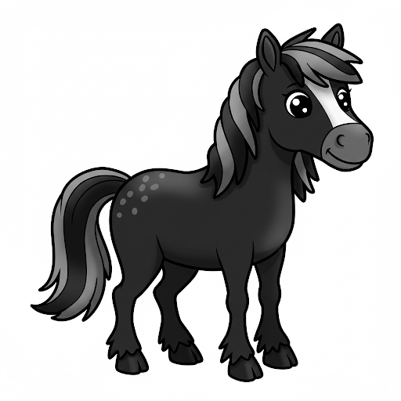
il est noir
il est brun
il est blanc
il est orange
il est gris
J’ai un chien.
J’ai un chat.
J’ai un cheval.
J’ai un poisson.
J’ai un lapin.
J’ai un serpent.
J’ai un oiseau.
J’ai un hamster.
il est grand
il est petit
il est adorable
il est mignon
et = and

Slide 10
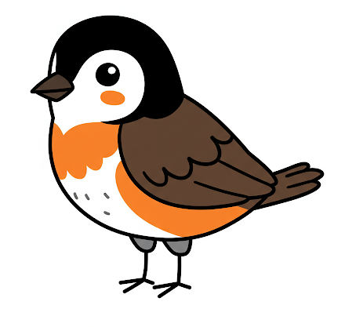
il est noir
il est brun
il est blanc
il est orange
il est gris
J’ai un chien.
J’ai un chat.
J’ai un cheval.
J’ai un poisson.
J’ai un lapin.
J’ai un serpent.
J’ai un oiseau.
J’ai un hamster.
il est grand
il est petit
il est adorable
il est mignon
et = and

Slide 11
Chez l'animalerie

