Slide 1


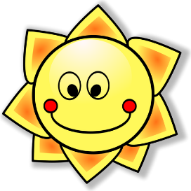

j/soft g
j’ai
génial
[I have]
X
jour
sujet
jamais
[subject]
[never]
déjà
[already]
Notes:
Timing: 2 minutes
Aim: To introduce SSC [j/soft g]
Procedure:
1. Introduce and elicit the pronunciation of the individual SSC [j/soft g] and then the source word again ‘jour’ (with gesture, if using).
2. Then present and elicit the pronunciation of the five cluster words.
The cluster words have been chosen for their high-frequency, from a range of word classes, with the SSC (where possible) positioned within a variety of syllables within the words (e.g. initial, 2nd, final etc.). Additionally, we have tried to use words that build cumulatively on previously taught SSCs (see the Phonics Teaching Sequence document) and do not include new SSCs. Where new SSCs are used, they are often consonants which have a similar symbol-sound correspondence in English.
Word frequency (1 is the most frequent word in French):
j’ai [8 - avoir]; génial [3872] sujet [353]; déjà [58]; jamais [179]; jour [78].
Source: Londsale, D., & Le Bras, Y. (2009). A Frequency Dictionary of French: Core vocabulary for learners London: Routledge.

Slide 2

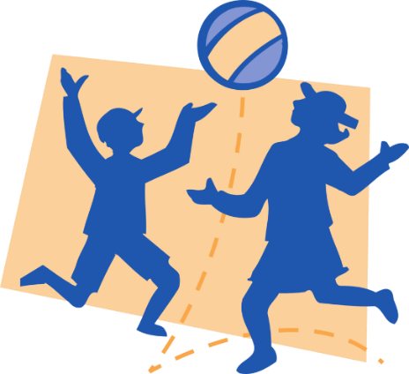



ou
Où?
jouer
[where?]
Bonjour !
nous
douze
toujours
[always; still]
Notes:
Timing: 2 minutes
Aim: To introduce SSC [ou]
Procedure:
1. Introduce and elicit the pronunciation of the individual SSC [ou] and then the source word again ‘nous’ (with gesture, if using).
2. Then present and elicit the pronunciation of the five cluster words.
The cluster words have been chosen for their high-frequency, from a range of word classes, with the SSC (where possible) positioned within a variety of syllables within the words (e.g. initial, 2nd, final etc.). Additionally, we have tried to use words that build cumulatively on previously taught SSCs (see the Phonics Teaching Sequence document) and do not include new SSCs. Where new SSCs are used, they are often consonants which have a similar symbol-sound correspondence in English.
Word frequency (1 is the most frequent word in French):
nous [31]; trouver [83] jouer [219]; bonjour [1972]; toujours [103]; douze [1664].
Source: Londsale, D., & Le Bras, Y. (2009). A Frequency Dictionary of French: Core vocabulary for learners London: Routledge.

Slide 3
Project Work
Create your own poster about where you live
This could be on paper or electronically
Your poster could be entirely fictional or factual -
You could bring in photos from home or draw fictional characters etc

Slide 4
J’habite dans (Twinkle Twinkle)
J’habite dans une grande maison
Dans une maison individuelle
Mon cousin, il habite dans
Dans une maison mitoyenne
Ma famille, elle habite dans une
Maison jumelée et grande
Ma famille, elle n’habite pas
Dans un grand appartement
Notes:
Song - to the tune of Twinkle Twinkle

