Slide 1


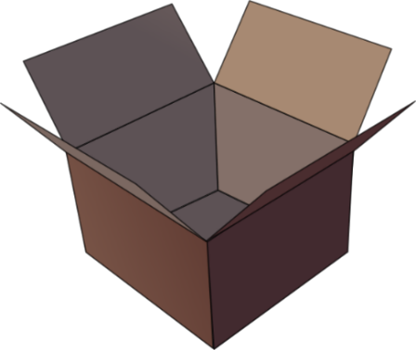
SFC
Silent final consonant
dans
X
Notes:
Timing: 1 minute
Aim: To introduce SSC [SFC]
Explanation in English, if desired: Something that makes French sounds very different from English is that some consonants at the ends of words are silent. This means you don’t pronounce/sound them out at all. As in the word ‘dans’ in French.
Procedure:
1. Present the letter(s) and say the [SFC] sound first, on its own. Students repeat it with you.
2. Bring up the word ”dans” on its own, say it, students repeat it, so that they have the opportunity to focus all of their attention on the connection between the written word and its sound.
3. A possible gesture for this would be to hold ones finger to ones lips to indicate ‘Shhhh!’.
4. Roll back the animations and work through 1-3 again, but this time, dropping your voice completely to listen carefully to the students saying the [SFC] sound, pronouncing ”dans” and, if using, doing the gesture.
Word frequency (1 is the most frequent word in French):
dans [11]
Source: Londsale, D., & Le Bras, Y. (2009). A Frequency Dictionary of French: Core vocabulary for learners London: Routledge.

Slide 2







SFC
petit
prix
€15.95
grand
mot
dans
X
mais
[but]
Notes:
Timing: 2 minutes
Aim: To introduce SSC [SFC]
Procedure:
1. Introduce and elicit the pronunciation of the individual SSC [SFC] (in this case is SFC – silent final consonant so nothing to pronounce as an individual sound!) and then the source word again ‘dans’ (with gesture, if using).
2. Then present and elicit the pronunciation of the five cluster words.
The cluster words have been chosen for their high-frequency, from a range of word classes, with the SSC (where possible) positioned within a variety of syllables within the words (e.g. initial, 2nd, final etc.). Additionally, we have tried to use words that build cumulatively on previously taught SSCs (see the Phonics Teaching Sequence document) and do not include new SSCs. Where new SSCs are used, they are often consonants which have a similar symbol-sound correspondence in English.
Word frequency (1 is the most frequent word in French):
dans [11]; petit [138] prix [310]; mot [220]; mais [30]; grand [59].
Source: Londsale, D., & Le Bras, Y. (2009). A Frequency Dictionary of French: Core vocabulary for learners London: Routledge.

Slide 3
SFC
petit
prix
grand
mot
dans
X
mais
Notes:
Timing: 2 minutes
Aim: To introduce SSC [SFC]
Procedure:
1. Introduce and elicit the pronunciation of the individual SSC [SFC] (in this case is SFC – silent final consonant so nothing to pronounce as an individual sound!) and then the source word again ‘dans’ (with gesture, if using).
2. Then present and elicit the pronunciation of the five cluster words.
The cluster words have been chosen for their high-frequency, from a range of word classes, with the SSC (where possible) positioned within a variety of syllables within the words (e.g. initial, 2nd, final etc.). Additionally, we have tried to use words that build cumulatively on previously taught SSCs (see the Phonics Teaching Sequence document) and do not include new SSCs. Where new SSCs are used, they are often consonants which have a similar symbol-sound correspondence in English.
Word frequency (1 is the most frequent word in French):
dans [11]; petit [138] prix [310]; mot [220]; mais [30]; grand [59].
Source: Londsale, D., & Le Bras, Y. (2009). A Frequency Dictionary of French: Core vocabulary for learners London: Routledge.

Slide 4
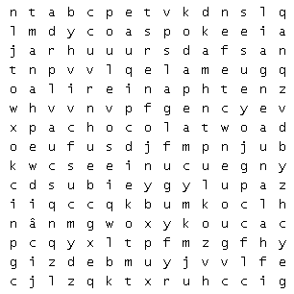
agneau |  | lapin
chasse |  | oeuf
chocolat |  | panier
cloche |  | Pâques
enfant |  | poule
joyeuses |  | poussin

Slide 5
agneau | lapin
chasse | oeuf
chocolat | panier
cloche | Pâques
enfant | poule
joyeuses | poussin
hunt
lamb
rabbit
chocolate
basket
chicken
bell
egg
child
happy
Easter
chick

Slide 6
agneau |  | lapin
chasse |  | oeuf
chocolat |  | panier
cloche |  | Pâques
enfant |  | poule
joyeuses |  | poussin
lamb
rabbit
hunt
egg
chocolate
basket
bell
Easter
child
chicken
happy
chick

Slide 7
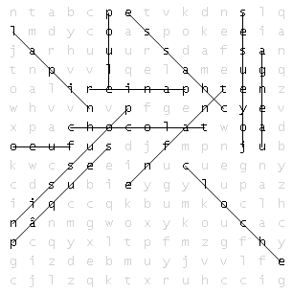
agneau |  | lapin
chasse |  | oeuf
chocolat |  | panier
cloche |  | Pâques
enfant |  | poule
joyeuses |  | poussin
lamb
rabbit
hunt
egg
chocolate
basket
bell
Easter
child
chicken
happy
chick

Slide 8
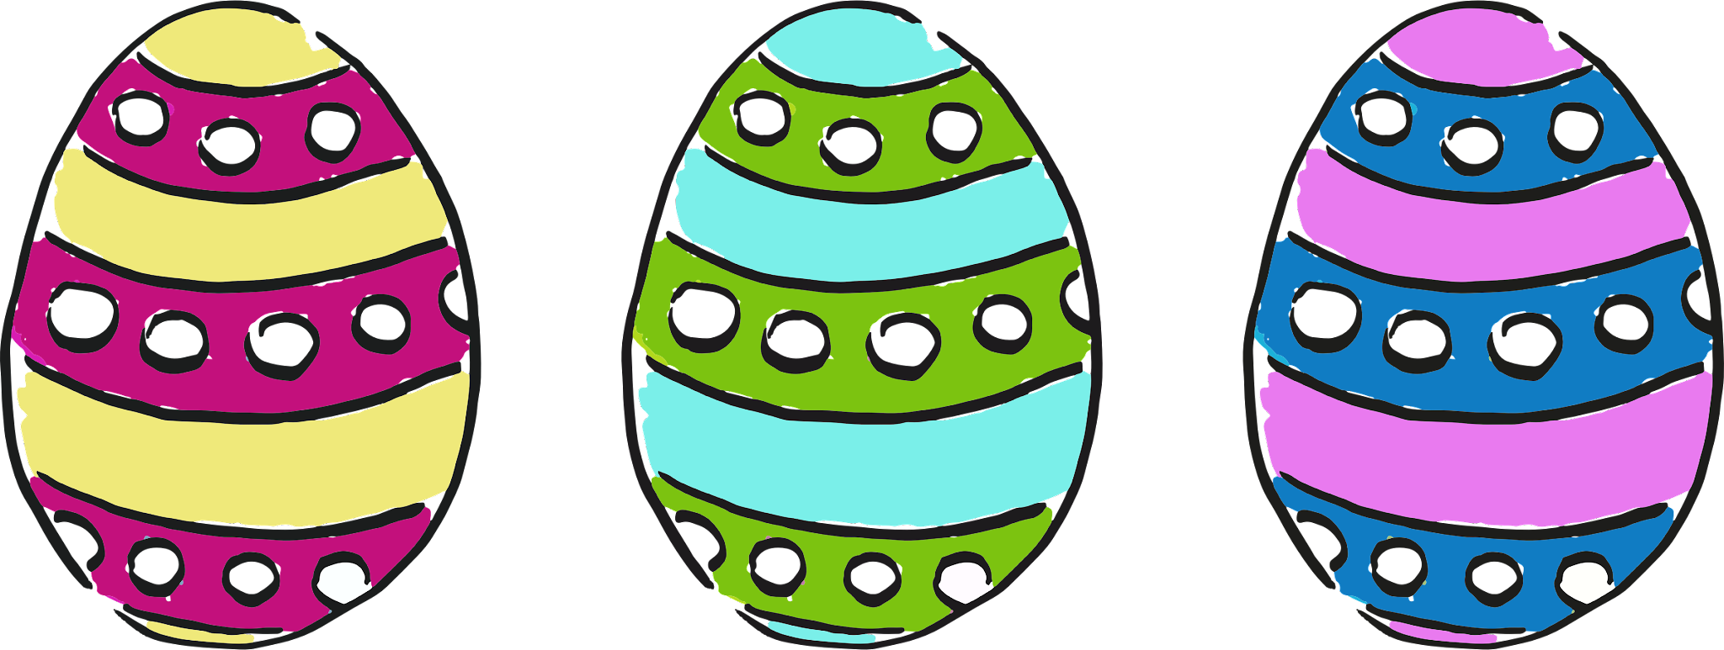
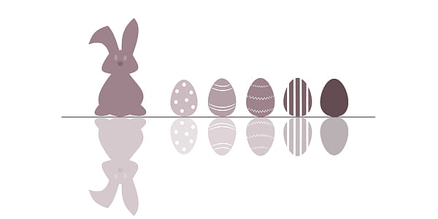
Pâques en France

Slide 9
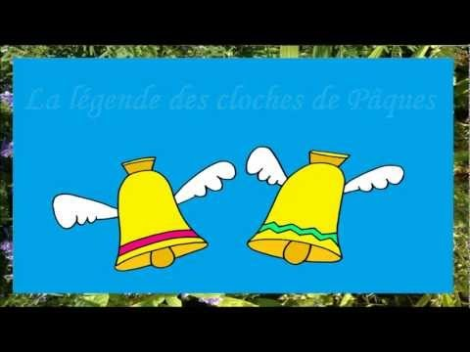

Slide 10
En France, les cloches disparaissent Vendredi Saint et retournent dimanche de Pâques. Elles sont parties à Rome, en Italie, pour rendre visite au Pape. Quand elles retournent en France, elles apportent des oeufs en chocolat aux enfants. Les enfants font la chasse des oeufs dans le jardin. Joyeuses Pâques!
In France, church bells disappear
they bring chocolate eggs to children.
The children have an Easter egg hunt in the garden.
to visit the Pope.
return on Easter Sunday.
They have gone to Rome,
Happy Easter!
on Good Friday and
When they return to France,
in Italy,
1. In France, church bells disappear
8. on Good Friday and
5. return on Easter Sunday.
6. They have gone to Rome,
10. in Italy,
4. to visit the Pope.
9. When they return to France,
2. they bring chocolate eggs to children.
3. The children have an Easter egg hunt in the garden.
7. Happy Easter!

Slide 11
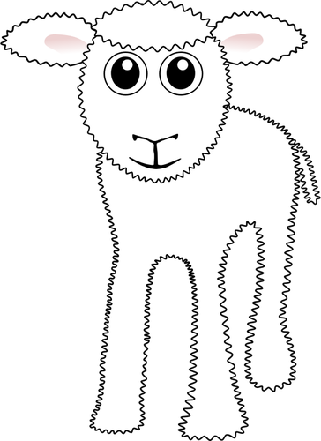
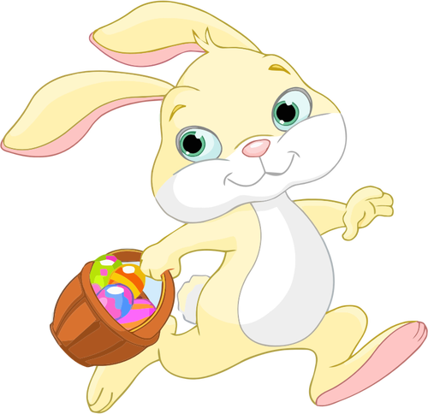
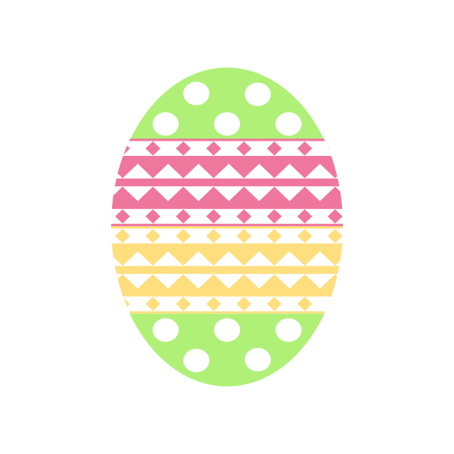

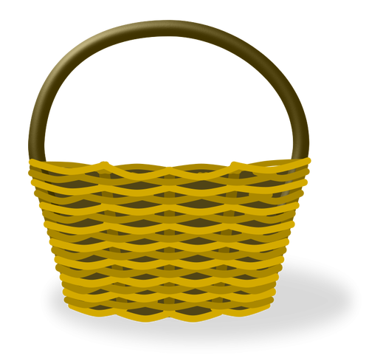
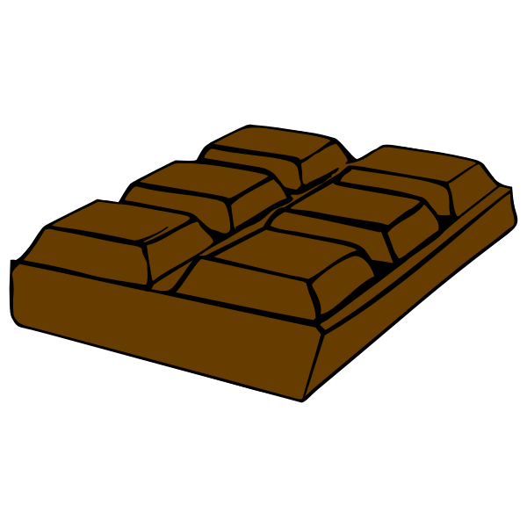
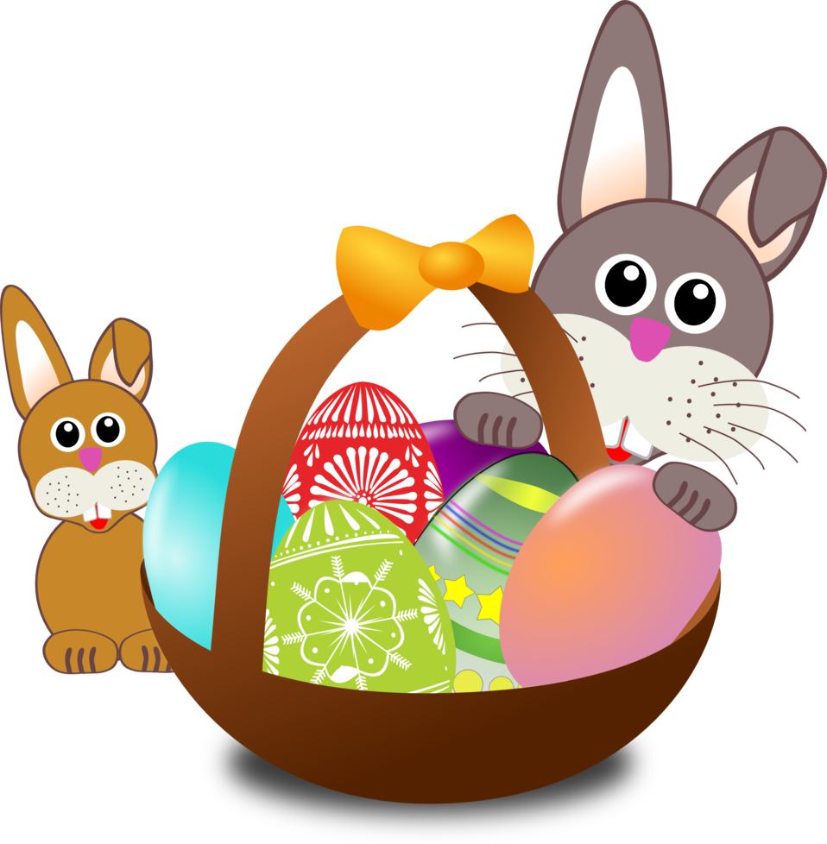

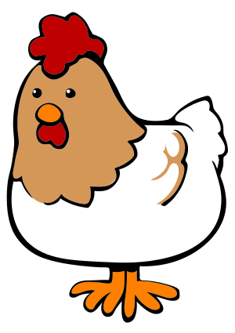
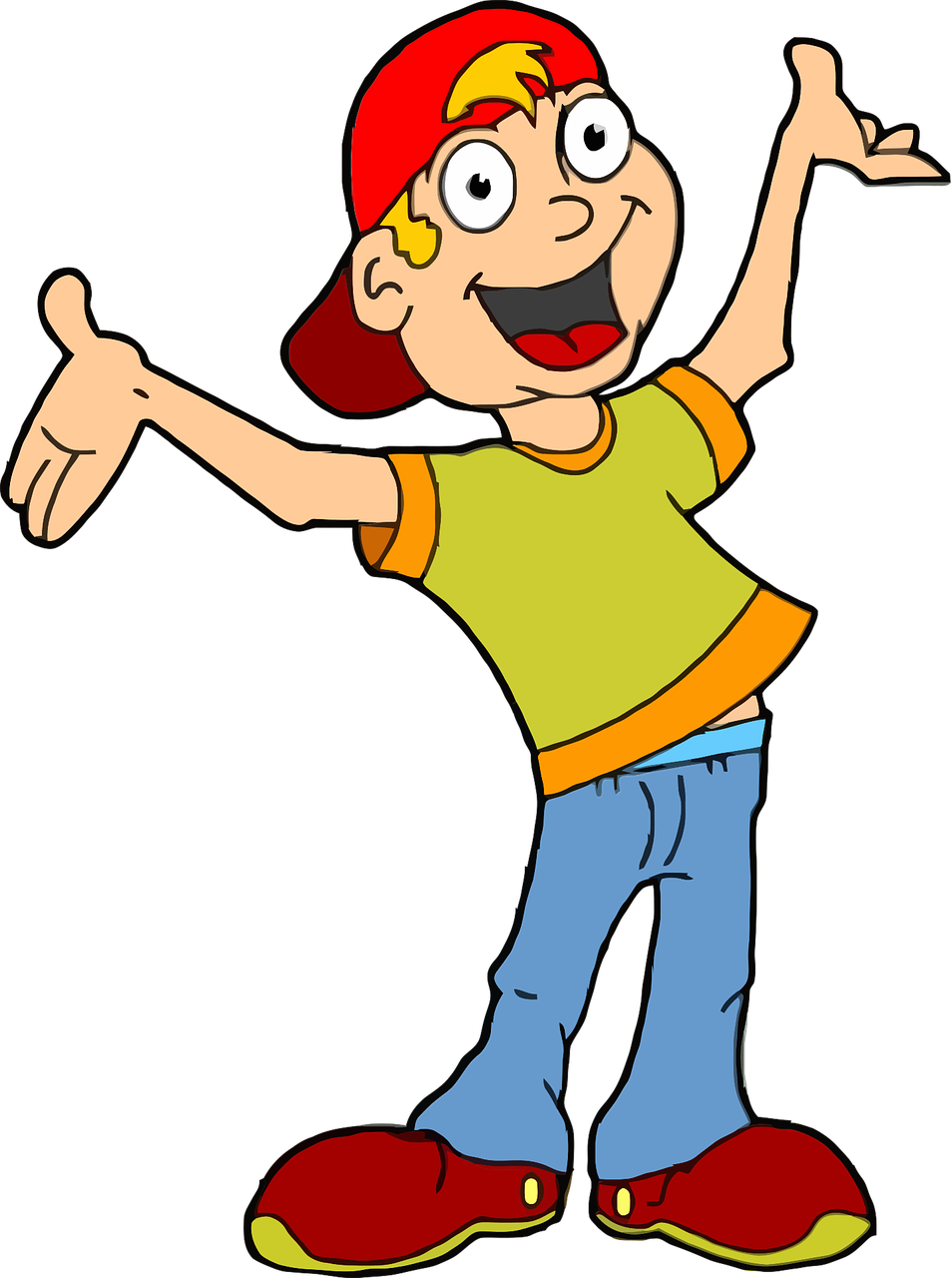

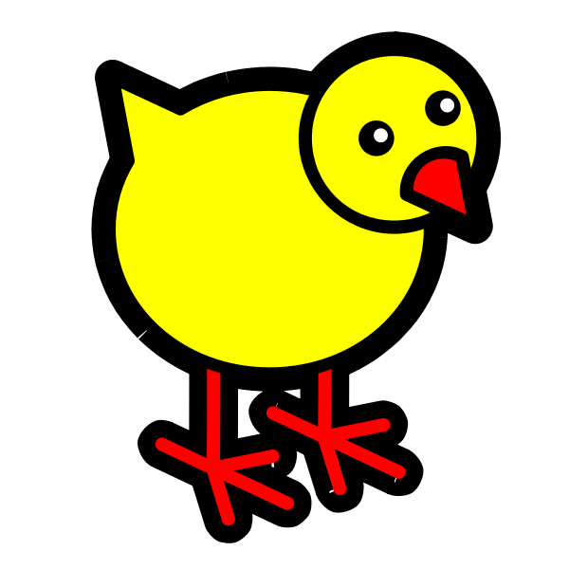
agneau |  | lapin
 | chasse |  | oeuf
chocolat |  | panier
 | cloche |  | Pâques
enfant |  | poule
 | joyeuses |  | poussin

