Slide 1

Phonetik

Slide 2


sch
schreiben
Notes:
Timing: 1 minute
Aim: To introduce/consolidate SSC [sch]
Procedure:
1. Present the letter(s) and say the [sch] sound first, on its own. Students repeat it with you.
2. Bring up the word ”schreiben” on its own, say it, students repeat it, so that they have the opportunity to focus all of their attention on the connection between the written word and its sound.
3. A possible gesture for this would be to mime writing.
4. Roll back the animations and work through 1-3 again, but this time, dropping your voice completely to listen carefully to the students saying the [sch] sound, pronouncing ”schreiben” and, if using, doing the gesture.
Word frequency (1 is the most frequent word in German):
schreiben [245]
Source: Jones, R.L. & Tschirner, E. (2006). A frequency dictionary of German: core vocabulary for learners. Routledge

Slide 3
sch
schreiben
Notes:
With sound and no pictures to focus all attention on the sound-symbol correspondence.

Slide 4
sch
schreiben
Notes:
Without sound to elicit pronunciation (without first hearing the teacher).
Teacher to elicit pronunciation by asking “Wie sagt man…”

Slide 5
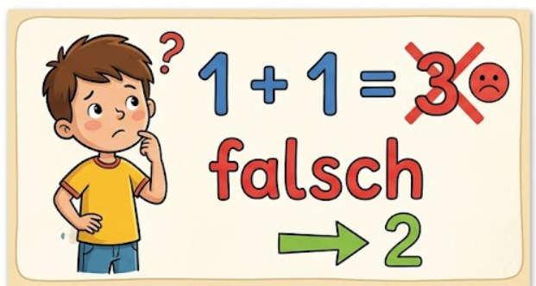
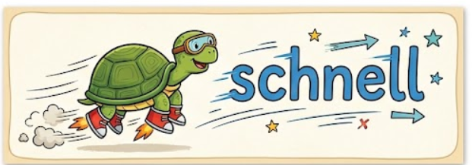
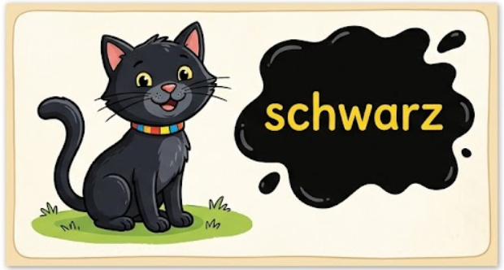
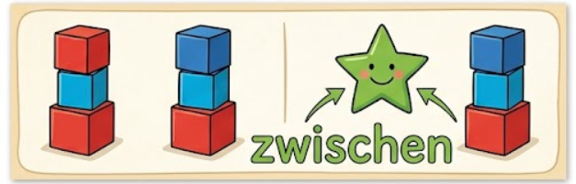
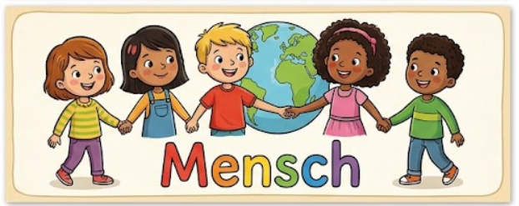
sch
falsch
schnell
[fast]
schreiben
schwarz
zwischen
Mensch
Notes:
Timing: 2 minutes
Aim: To introduce/consolidate SSC [sch]
Procedure:
Introduce and elicit the pronunciation of the individual SSC [sch] and then the source word again ‘schreiben’ (with gesture, if using).
Then present and elicit the pronunciation of the five cluster words.
The cluster words have been chosen for their high-frequency, from a range of word classes, with the SSC (where possible) positioned within a variety of syllables within the words (e.g. initial, 2nd, final etc.). Additionally, we have tried to use words that build cumulatively on previously taught SSCs (see the Phonics Teaching Sequence document) and do not include new SSCs. Where new SSCs are used, they are often consonants which have a similar symbol-sound correspondence in English.
Word frequency (1 is the most frequent word in German):
schreiben [245]; falsch [638] schnell [233]; zwischen [115]; Mensch [104]; schwarz [451].
Source: Jones, R.L. & Tschirner, E. (2006). A frequency dictionary of German: core vocabulary for learners. Routledge

Slide 6
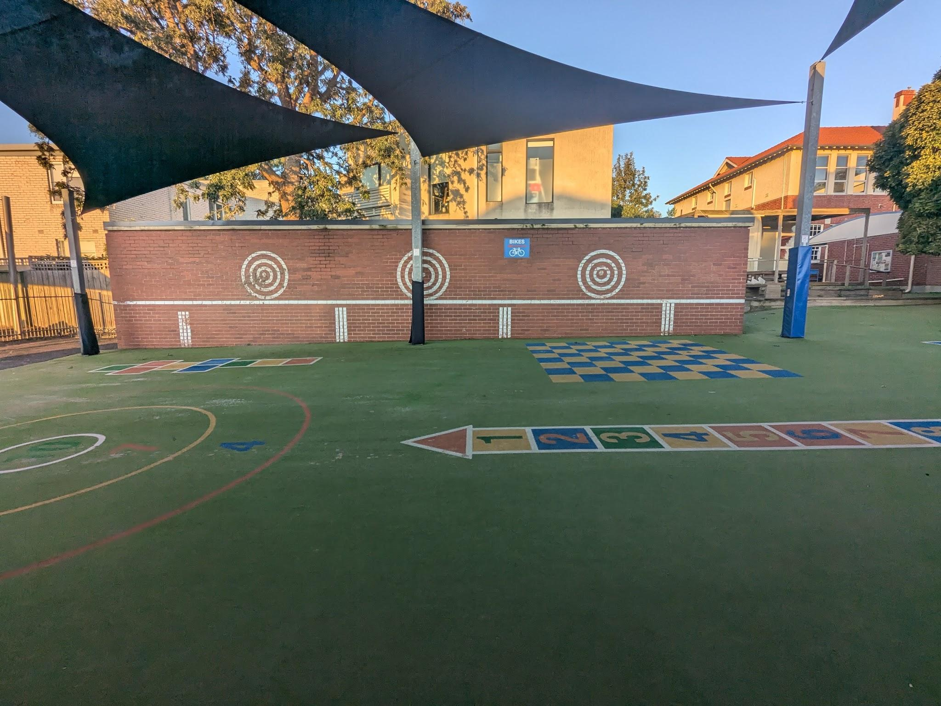
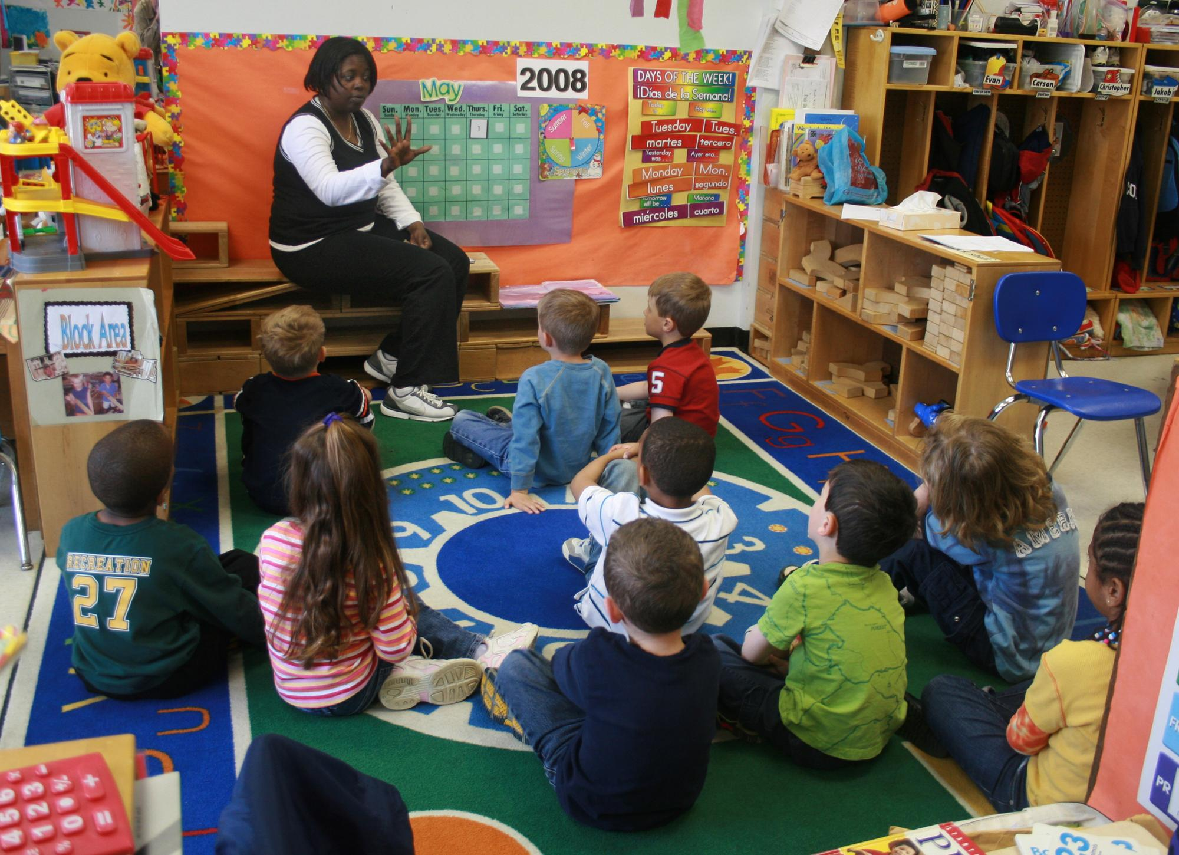
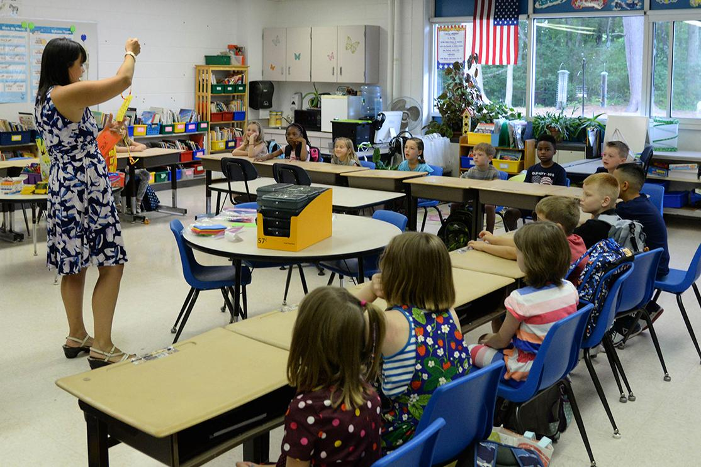
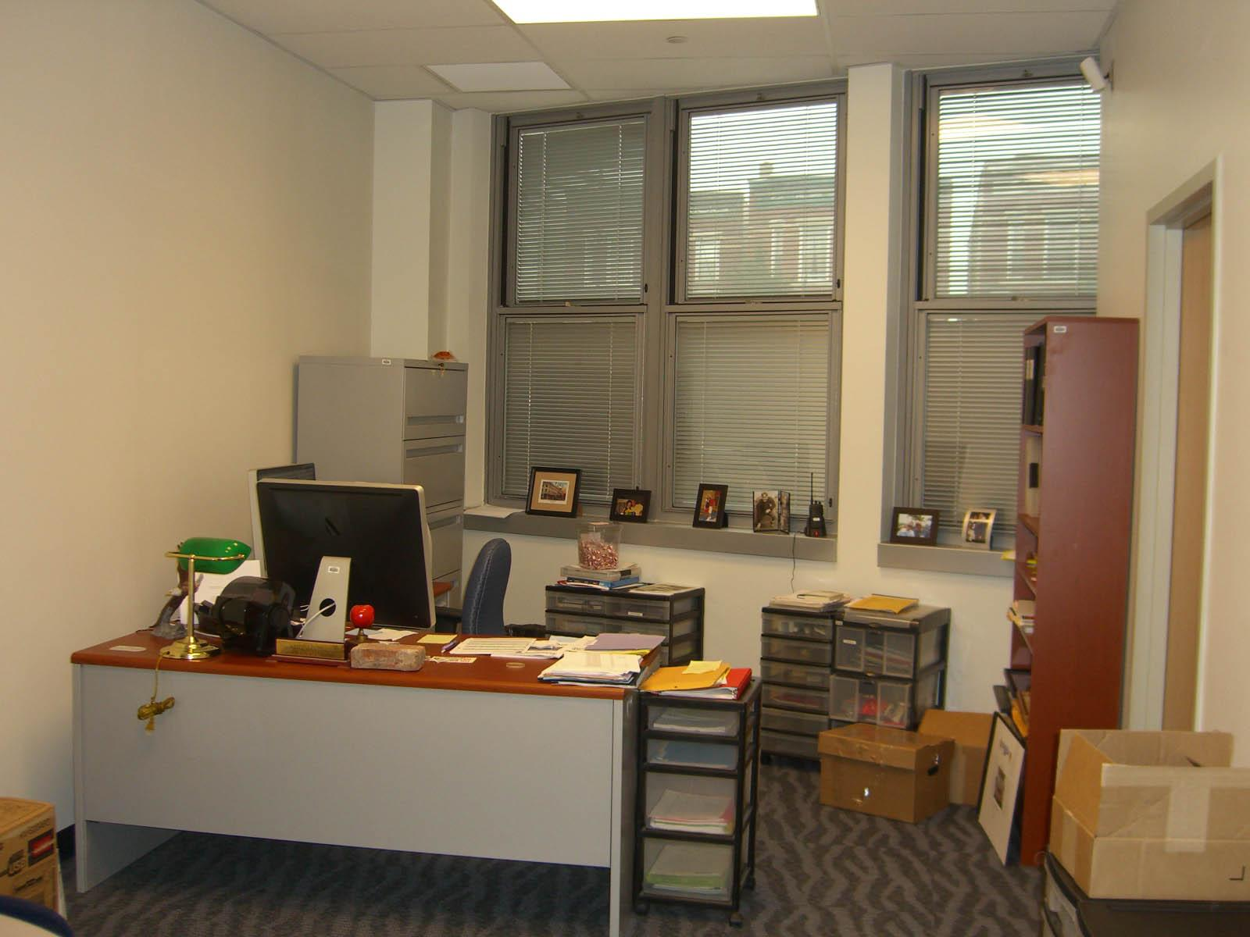
Was haben wir in unserer Schule?
Notes:
You could replace these images with photos from your school to personalise it. YOu could replace all the images on the presentation to personalise it.

Slide 7

Wir haben…..
Klassenzimmer
einen Schulhof
eine Bibliothek
ein Büro
Notes:
Intro / elicit meaning / four corners

Slide 8
Wir haben…..
1
2
3
4
Notes:
This can also be printed off for the teacher to pick random cards for the four corners activity

Slide 9
Klassenzimmer
Notes:
Slide for printing for 4 corners

Slide 10
einen Schulhof
Notes:
Slide for printing for 4 corners

Slide 11
eine Bibliothek
Notes:
Slide for printing for 4 corners

Slide 12
ein Büro
Notes:
Slide for printing for 4 corners

Slide 13
Wir haben…..
Klassenzimmer
einen Schulhof
eine Bibliothek
ein Büro
Notes:
Repetition / delayed repetition / Beat the Teacher

Slide 14
Wir haben…..
Notes:
Beat the Teacher - no words

Slide 15
Wir haben…..
Klassenzimmer
einen Schulhof
eine Bibliothek
ein Büro
Notes:
Gender awareness raising

