Slide 1

Phonetik

Slide 2
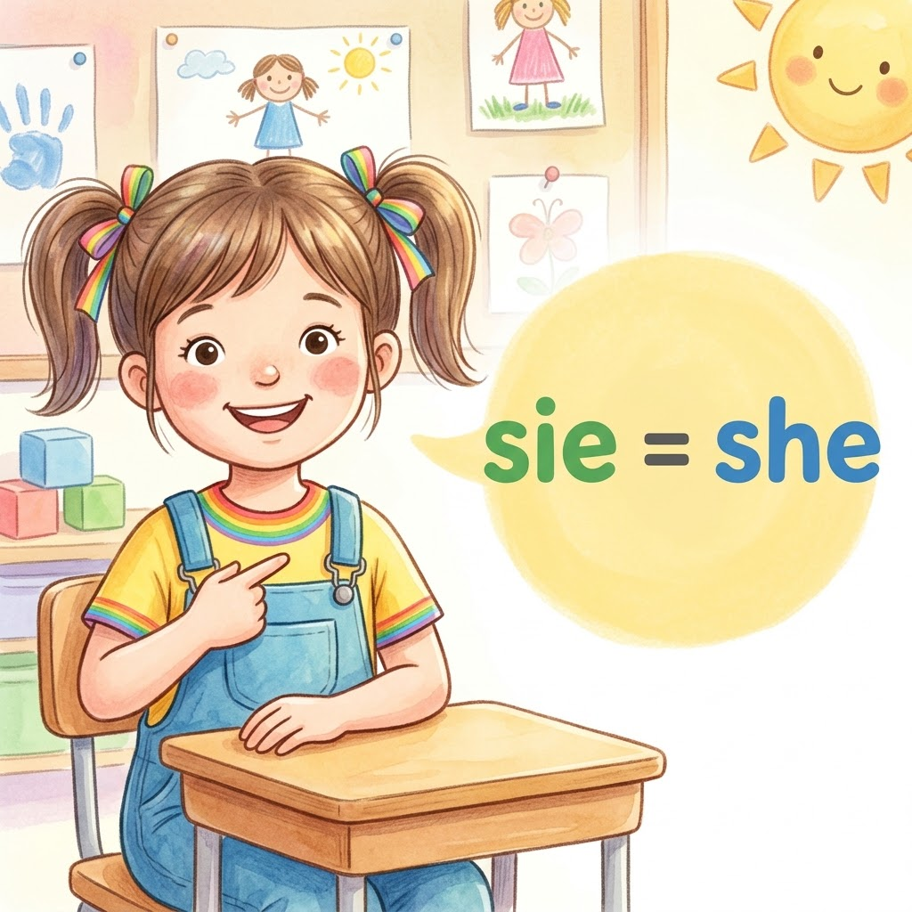

s
sie
Notes:
Timing: 1 minute
Aim: To introduce/consolidate SSC [s]
Procedure:
1. Present the letter(s) and say the [s] sound first, on its own. Students repeat it with you.
2. Bring up the word ”sollen” on its own, say it, students repeat it, so that they have the opportunity to focus all of their attention on the connection between the written word and its sound.
3. A possible gesture for this would be to mime telling someone what s/he should do, by wagging your finger, and looking serious.
4. Roll back the animations and work through 1-3 again, but this time, dropping your voice completely to listen carefully to the students saying the [s] sound, pronouncing ”sollen” and, if using, doing the gesture.
Word frequency (1 is the most frequent word in German):
sollen [63]
Source: Jones, R.L. & Tschirner, E. (2006). A frequency dictionary of German: core vocabulary for learners. Routledge

Slide 3
s
sie
Notes:
With sound and no pictures to focus all attention on the sound-symbol correspondence.

Slide 4
s
sie
Notes:
Without sound to elicit pronunciation (without first hearing the teacher).
Teacher to elicit pronunciation by asking “Wie sagt man…”

Slide 5
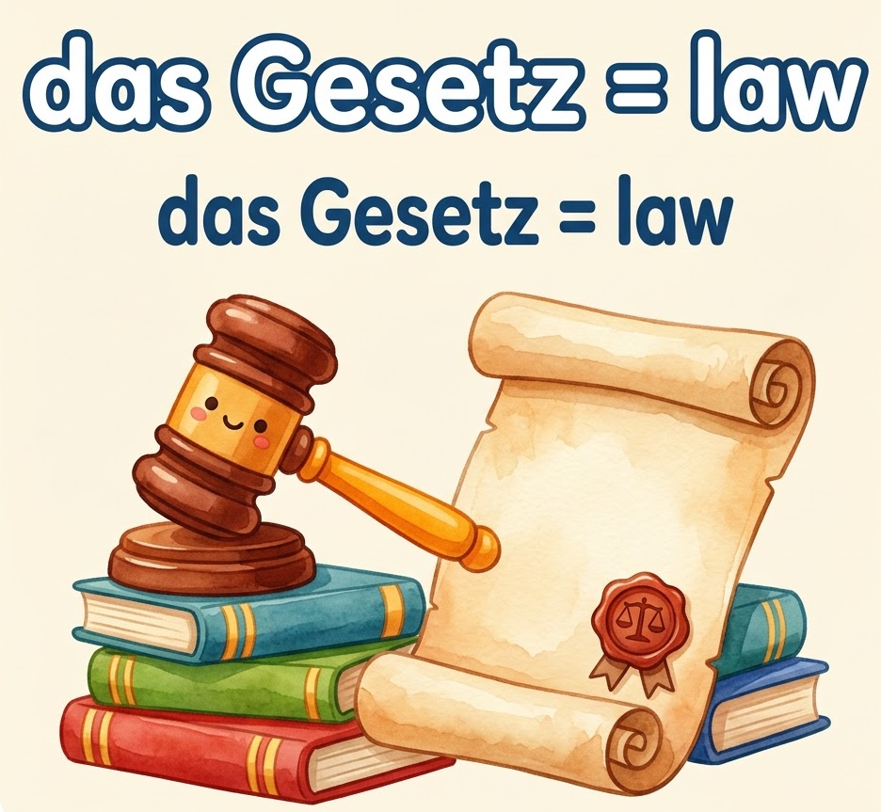
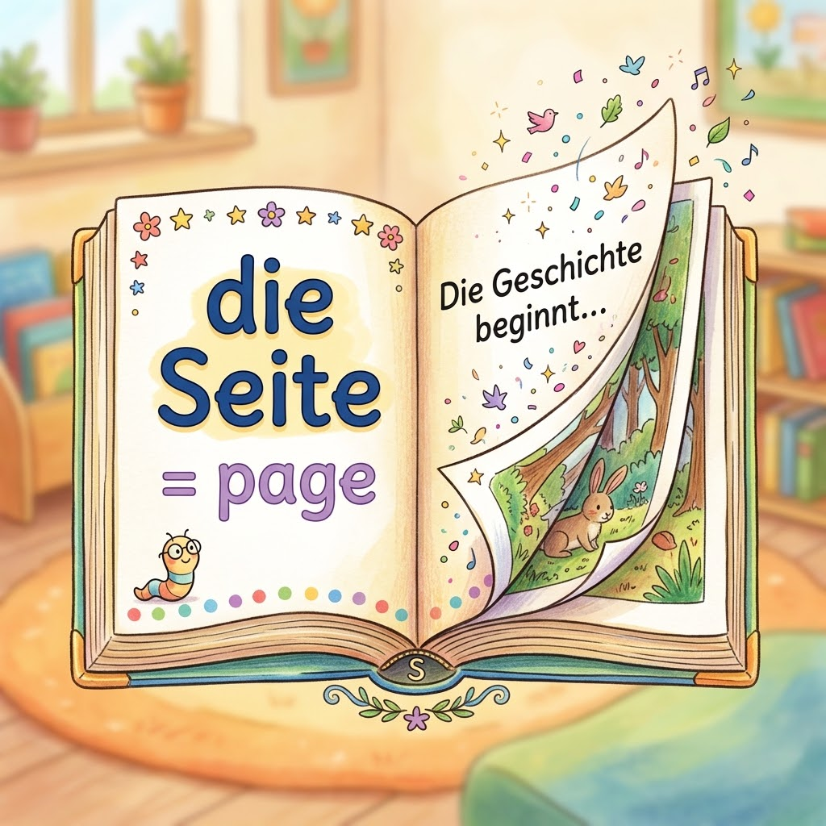
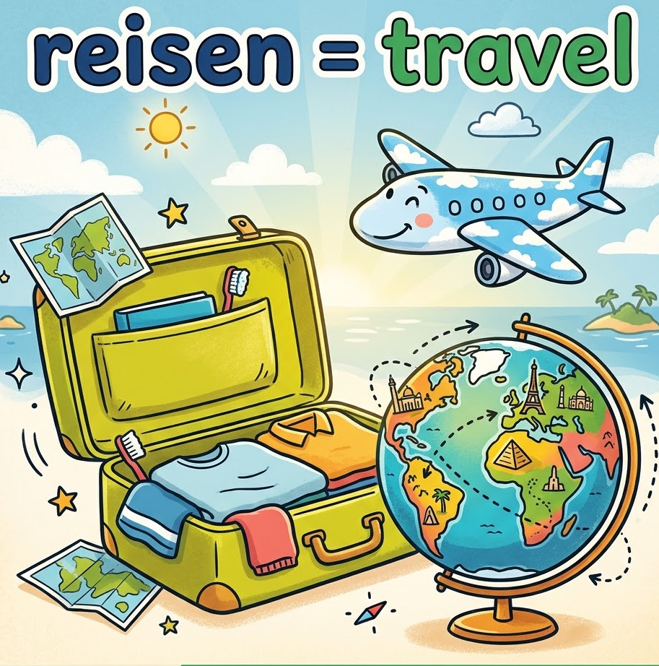
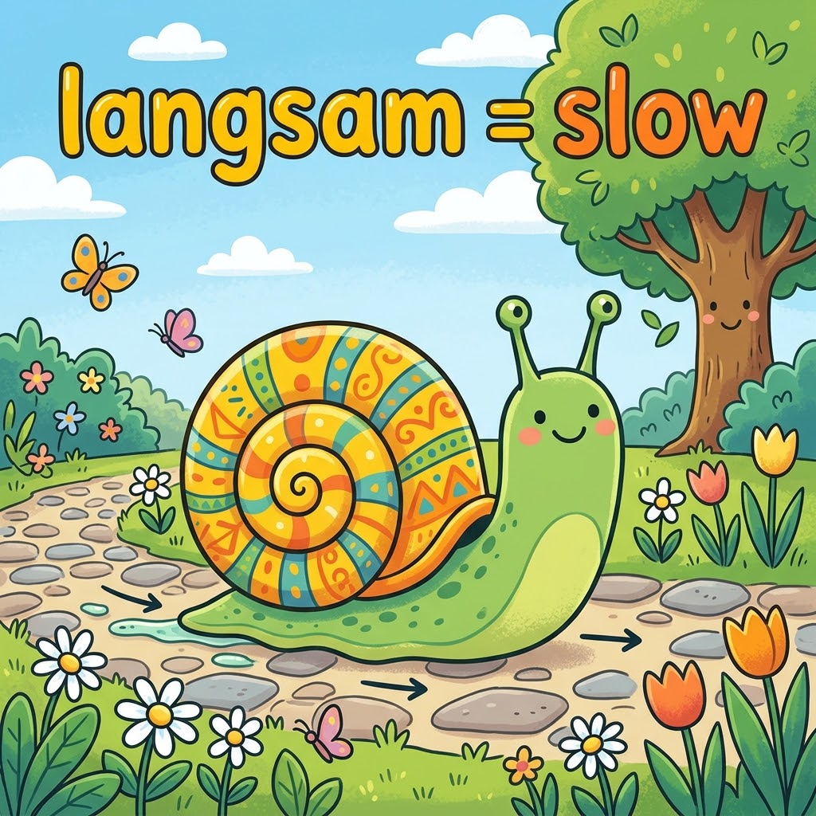
s
Gesetz
Seite
sie
reisen
langsam
Notes:
Timing: 2 minutes
Aim: To introduce/consolidate SSC [s]
Procedure:
Introduce and elicit the pronunciation of the individual SSC [s] and then the source word again ‘sollen’ (with gesture, if using).
Then present and elicit the pronunciation of the five cluster words.
The cluster words have been chosen for their high-frequency, from a range of word classes, with the SSC (where possible) positioned within a variety of syllables within the words (e.g. initial, 2nd, final etc.). Additionally, we have tried to use words that build cumulatively on previously taught SSCs (see the Phonics Teaching Sequence document) and do not include new SSCs. Where new SSCs are used, they are often consonants which have a similar symbol-sound correspondence in English.
Word frequency (1 is the most frequent word in German):
sollen [63]; Gesetz [552] Seite[217]; reisen [978]; langsam [604]; Satz [582].
Source: Jones, R.L. & Tschirner, E. (2006). A frequency dictionary of German: core vocabulary for learners. Routledge

Slide 6
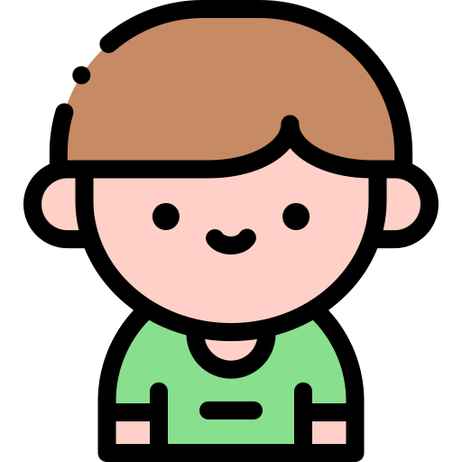
Wie heißt du?
Where do you live?
What are you called?
How old are you?

Slide 7

Wie heißt du?
Ich heiße Heidi

Slide 8
Wie heißt du?
Ich heiße Stefan

Slide 9
Wie heißen deine Freunde? [What are your friends called?]
Das ist mein Freund.
Er heißt Stefan.
This is my friend.
He is called Stefan.

Slide 10
Wie heißen deine Freunde? [What are your friends called?]
Das ist meine Freundin.
Sie heißt Heidi.
This is my friend.
She is called Heidi.

Slide 11
Wie heißen deine Freunde? [What are your friends called?]
Das ist mein Freund.
Er heißt Stefan.
Das ist meine Freundin.
Sie heißt Heidi.

Slide 12
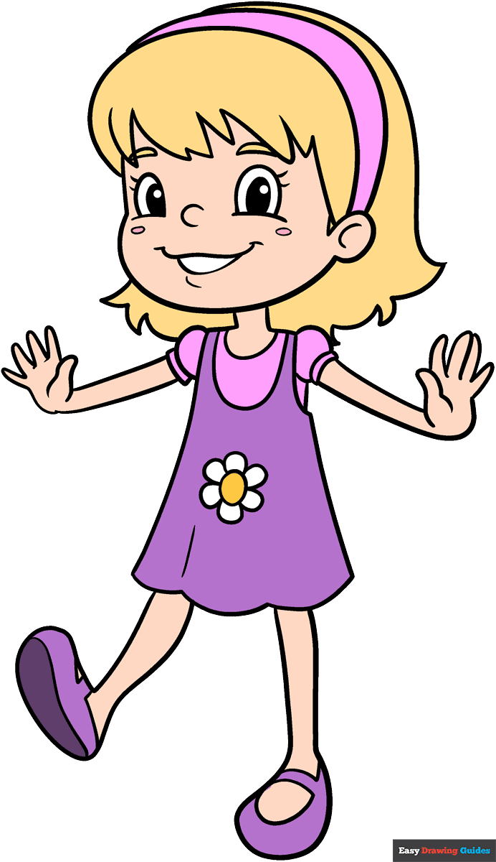
Sie
1. _________ heißt Laura.

Slide 13
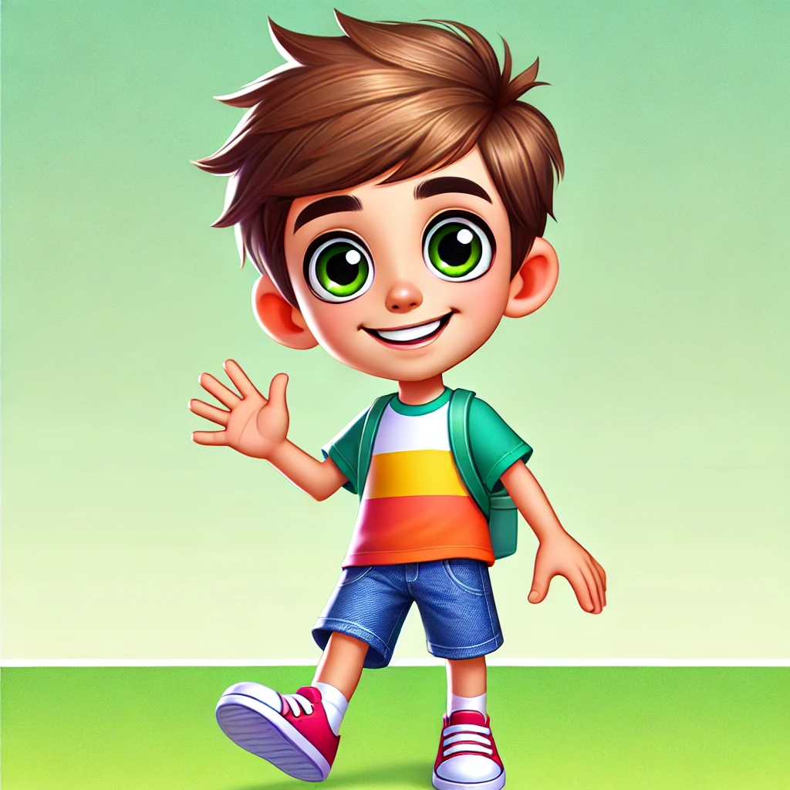
Er
2. _________ heißt Thomas.

Slide 14
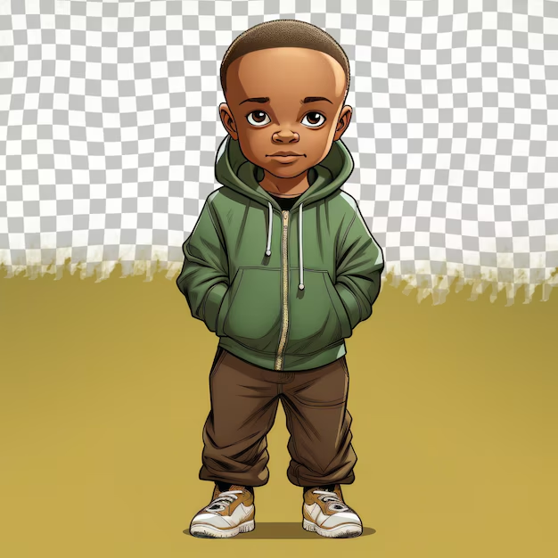
Er
3. _________ heißt Julian.

Slide 15
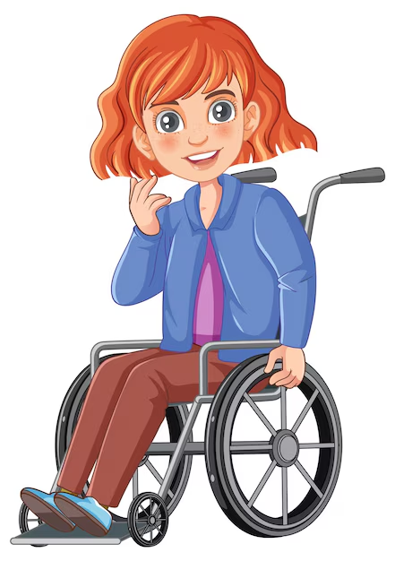
Sie
4. _________ heißt Leonie.

Slide 16
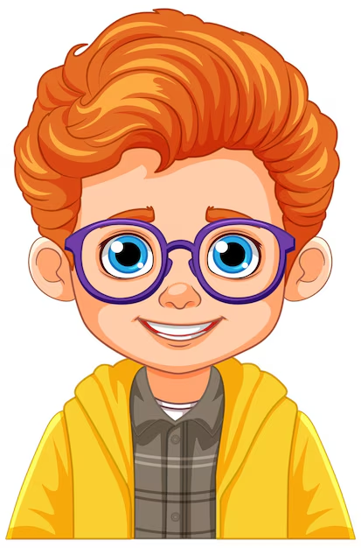
Er
5. _________ heißt Kai.

Slide 17
Wie heißen deine Freunde? [What are your friends called?]
Das ist mein Freund.
Er heißt ……….
Das ist meine Freundin.
Sie heißt ……….

