Slide 1

Phonetik

Slide 2
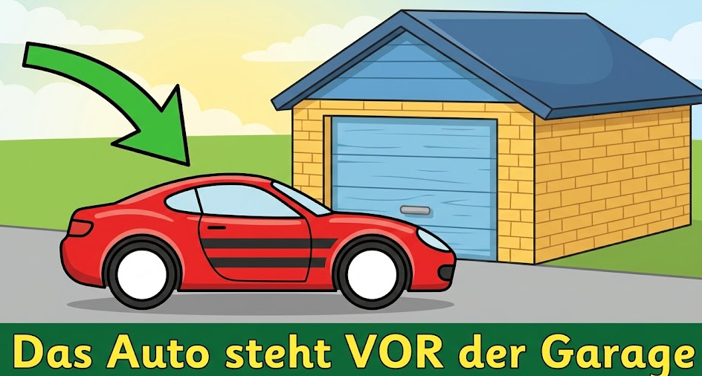

v
vor
Notes:
Timing: 1 minute
Aim: To introduce/consolidate SSC [v]
Procedure:
1. Present the letter(s) and say the [v] sound first, on its own. Students repeat it with you.
2. Bring up the word ”vor” on its own, say it, students repeat it, so that they have the opportunity to focus all of their attention on the connection between the written word and its sound.
3. A possible gesture for this would be to hold your hands, left in front of right, in front of your body, palms facing inward. Quickly move the right hand over the top of the left, as you say ‘vor’, to mime ‘in front’.
4. Roll back the animations and work through 1-3 again, but this time, dropping your voice completely to listen carefully to the students saying the [v] sound, pronouncing ”vor” and, if using, doing the gesture.
Word frequency (1 is the most frequent word in German):
vor [55]
Source: Jones, R.L. & Tschirner, E. (2006). A frequency dictionary of German: core vocabulary for learners. Routledge

Slide 3
v
vor
Notes:
With sound and no pictures to focus all attention on the sound-symbol correspondence.

Slide 4
v
vor
Notes:
Timing: 1 minute
Aim: To introduce/consolidate SSC [v]
Procedure:
1. Present the letter(s) and say the [v] sound first, on its own. Students repeat it with you.
2. Bring up the word ”vor” on its own, say it, students repeat it, so that they have the opportunity to focus all of their attention on the connection between the written word and its sound.
3. A possible gesture for this would be to hold your hands, left in front of right, in front of your body, palms facing inward. Quickly move the right hand over the top of the left, as you say ‘vor’, to mime ‘in front’.
4. Roll back the animations and work through 1-3 again, but this time, dropping your voice completely to listen carefully to the students saying the [v] sound, pronouncing ”vor” and, if using, doing the gesture.
Word frequency (1 is the most frequent word in German):
vor [55]
Source: Jones, R.L. & Tschirner, E. (2006). A frequency dictionary of German: core vocabulary for learners. Routledge

Slide 5
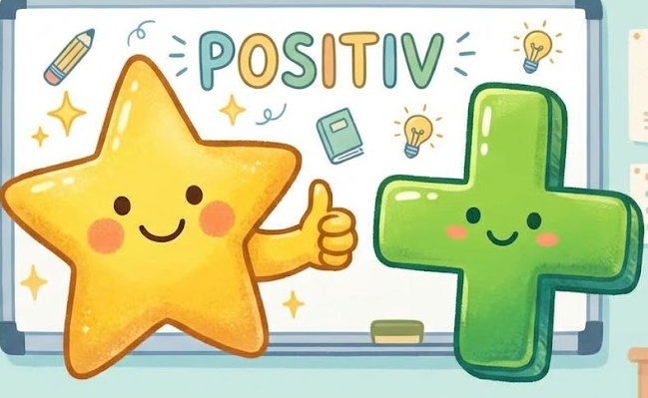
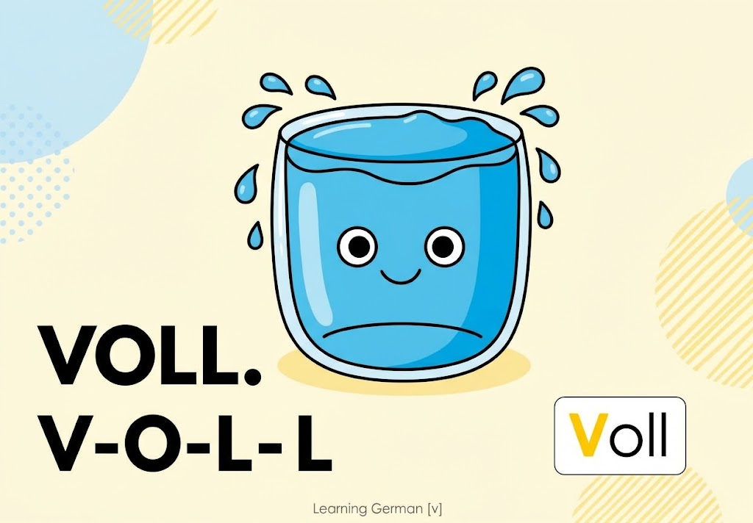

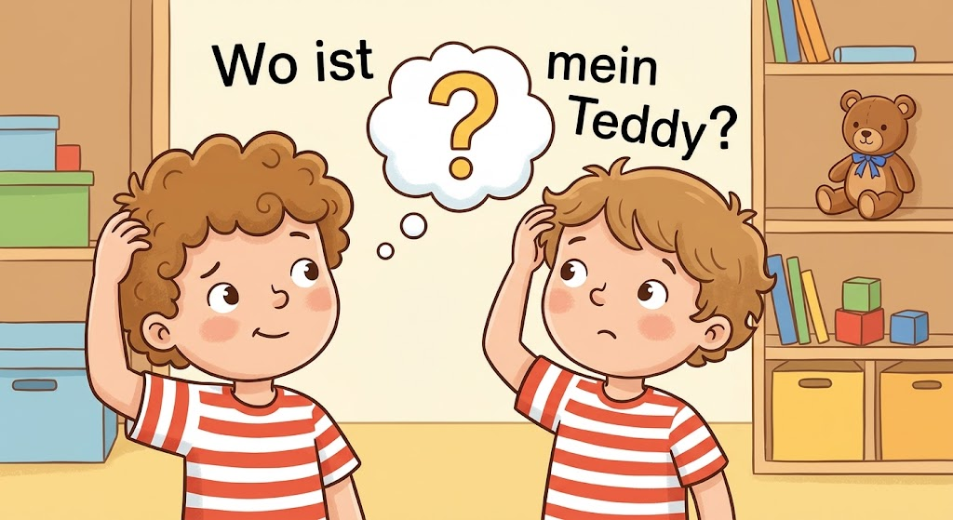
v
positiv
voll
vor
Vater
vergessen
Notes:
Timing: 2 minutes
Aim: To introduce/consolidate SSC [v]
Procedure:
Introduce and elicit the pronunciation of the individual SSC [v] and then the source word again ‘vor’ (with gesture, if using).
Then present and elicit the pronunciation of the five cluster words.
The cluster words have been chosen for their high-frequency, from a range of word classes, with the SSC (where possible) positioned within a variety of syllables within the words (e.g. initial, 2nd, final etc.). Additionally, we have tried to use words that build cumulatively on previously taught SSCs (see the Phonics Teaching Sequence document) and do not include new SSCs. Where new SSCs are used, they are often consonants which have a similar symbol-sound correspondence in English.
Word frequency (1 is the most frequent word in German):
vor [55]; positiv [690] voll [357]; bevor[541]; vergessen [595]; Vater [216].
Source: Jones, R.L. & Tschirner, E. (2006). A frequency dictionary of German: core vocabulary for learners. Routledge

Slide 6


Das ist mein Freund.
Das ist meine Freundin.
Which of these two children is a boy and which is a girl? How do you know?

Slide 7
Er heißt Pauli.
Sie heißt Pauli.
Which of these two children is a boy and which is a girl? How do you know?

Slide 8
1 | 2 | 3 | 4 | 5 | 6
7 | 8 | 9 | 10 | 11 | Die Zahlen
eins
zwei
drei
vier
fünf
sechs
sieben
acht
neun
zehn
elf

Slide 9
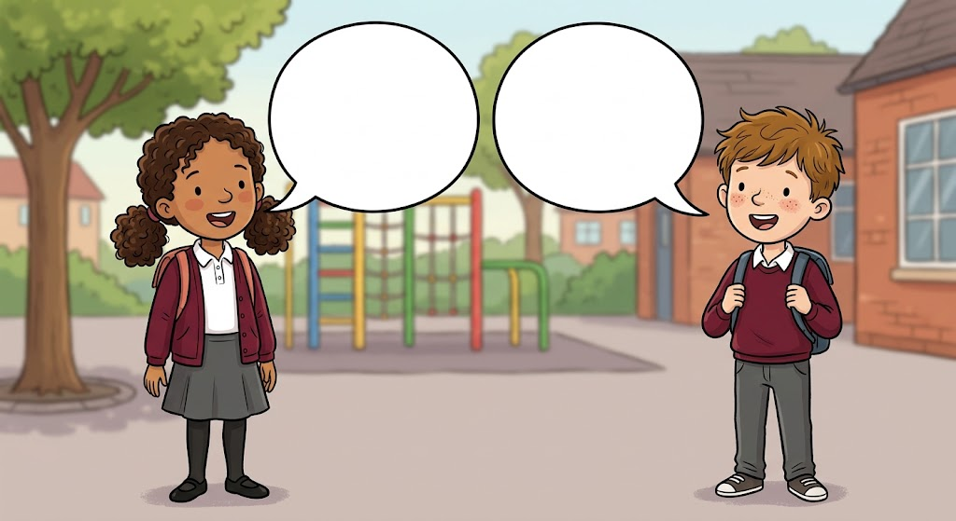


Das ist mein Freund.
Er heißt Stefan.
Er ist sieben.
Ich heiße Klara. Ich bin acht.
Das ist meine Freundin.
Sie heißt Heidi.
Sie ist neun.

Slide 10
1 | 2 | 3 | 4 | 5 | 6
7 | 8 | 9 | 10 | 11 | Er / Sie ist ….
eins
zwei
drei
vier
fünf
sechs
sieben
acht
neun
zehn
elf
Notes:
Lotto

Slide 11
Wie alt sind deine Freunde?
Er ist sieben.
Sie ist neun.
Sie ist zehn.
Er ist vier.
Er ist acht.
Sie ist elf.
Er ist fünf.
Sie ist sechs.
Notes:
Wink murder

Slide 12
Das ist meine Freundin.
Sie heißt ………..
Sie ist …………...
Das ist mein Freund.
Er heißt ………..
Er ist …………...
Notes:
plenary

