Slide 1

Phonetik

Slide 2
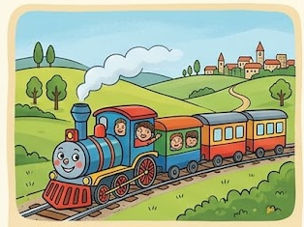

z
Zug

Slide 3
z
Zug

Slide 4
z
Zug

Slide 5




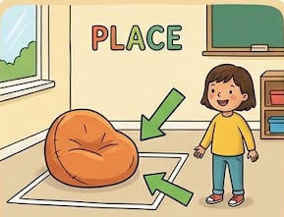
z
Zimmer
zehn
Zug
Arzt
sitzen
Platz
Notes:
Timing: 2 minutes
Aim: To introduce/consolidate SSC [z]
Procedure:
Introduce and elicit the pronunciation of the individual SSC [z] and then the source word again ‘Zug’ (with gesture, if using).
Then present and elicit the pronunciation of the five cluster words.
The cluster words have been chosen for their high-frequency, from a range of word classes, with the SSC (where possible) positioned within a variety of syllables within the words (e.g. initial, 2nd, final etc.). Additionally, we have tried to use words that build cumulatively on previously taught SSCs (see the Phonics Teaching Sequence document) and do not include new SSCs. Where new SSCs are used, they are often consonants which have a similar symbol-sound correspondence in English.
Word frequency (1 is the most frequent word in German):
Zug [613]; Zimmer [609] zehn [314]; Arzt [614]; Platz [344]; sitzen [261].
Source: Jones, R.L. & Tschirner, E. (2006). A frequency dictionary of German: core vocabulary for learners. Routledge

Slide 6
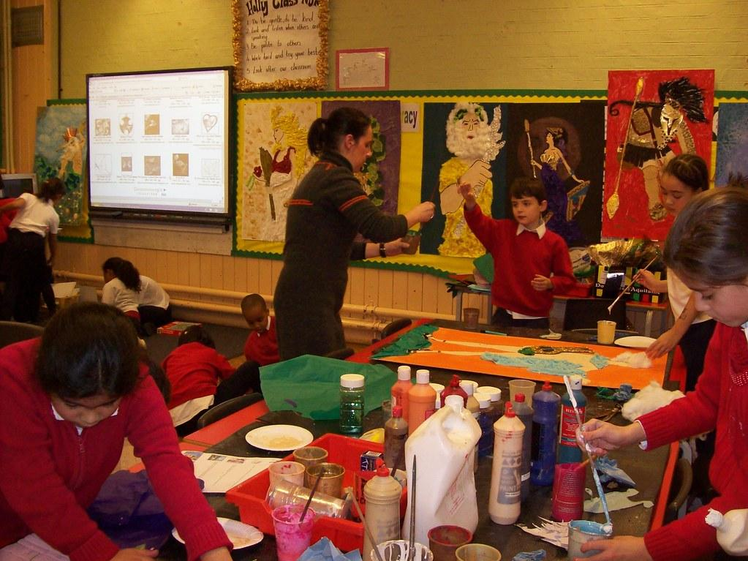
Was gibt es in dem Klassenzimmer?
Notes:
You could insert a picture of your classroom here

Slide 7
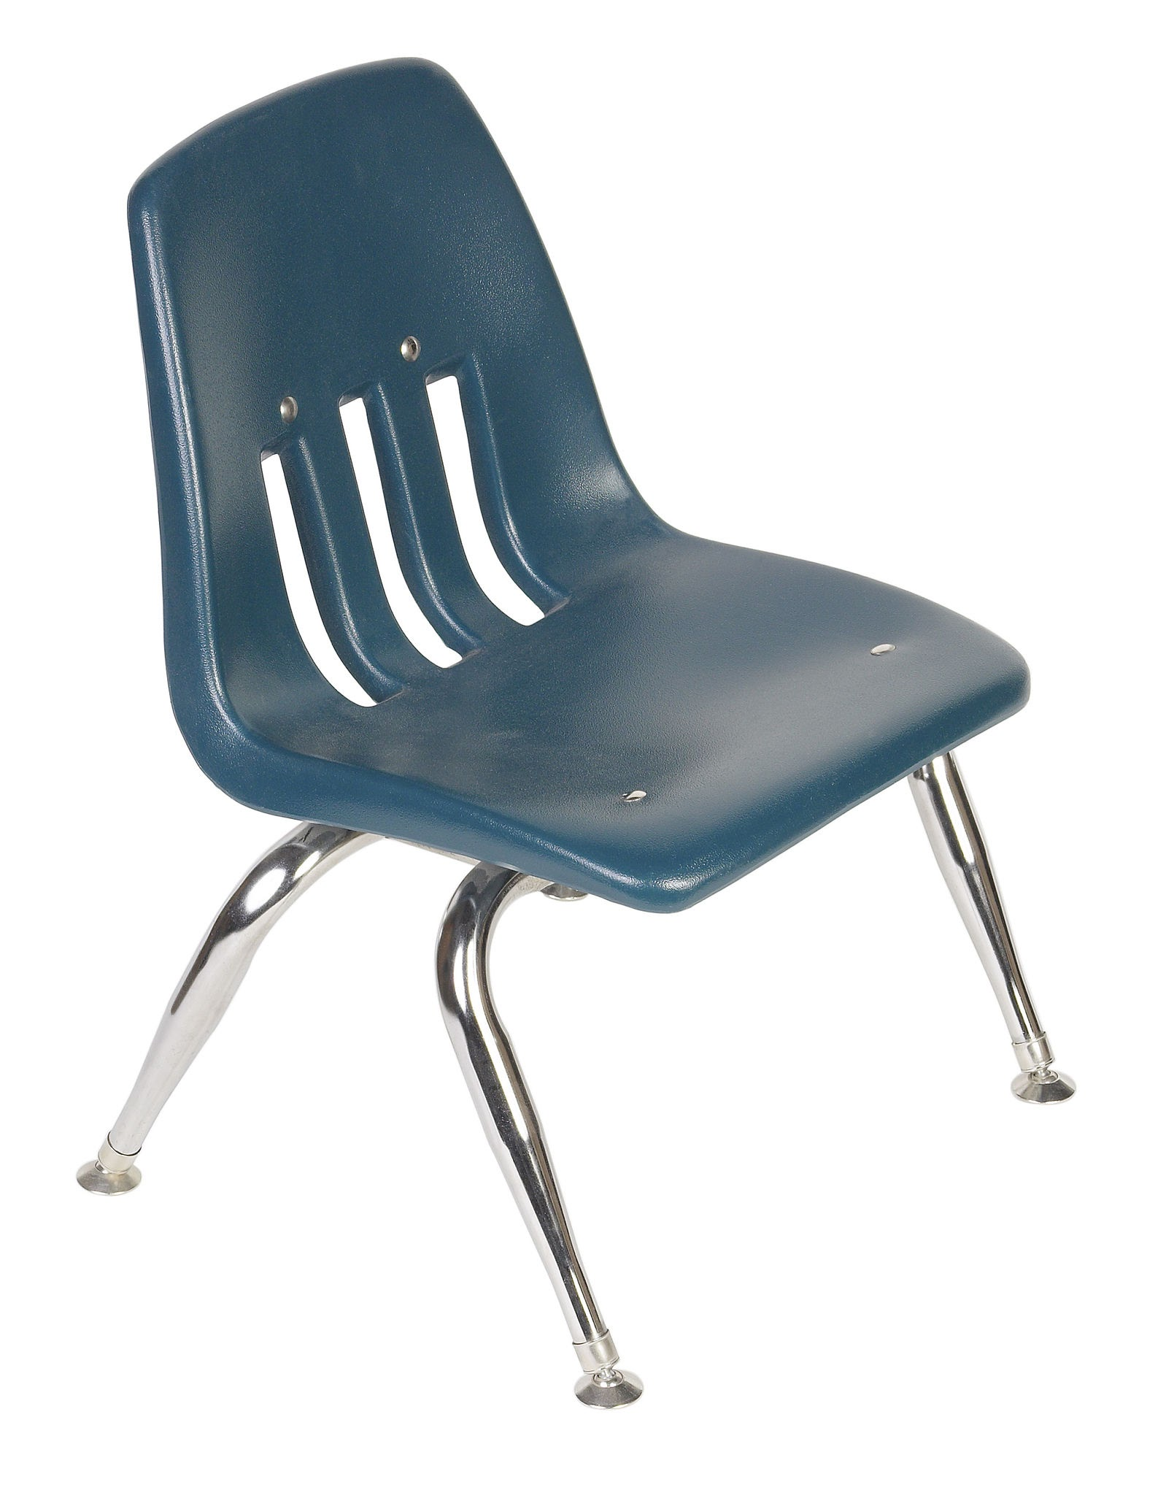
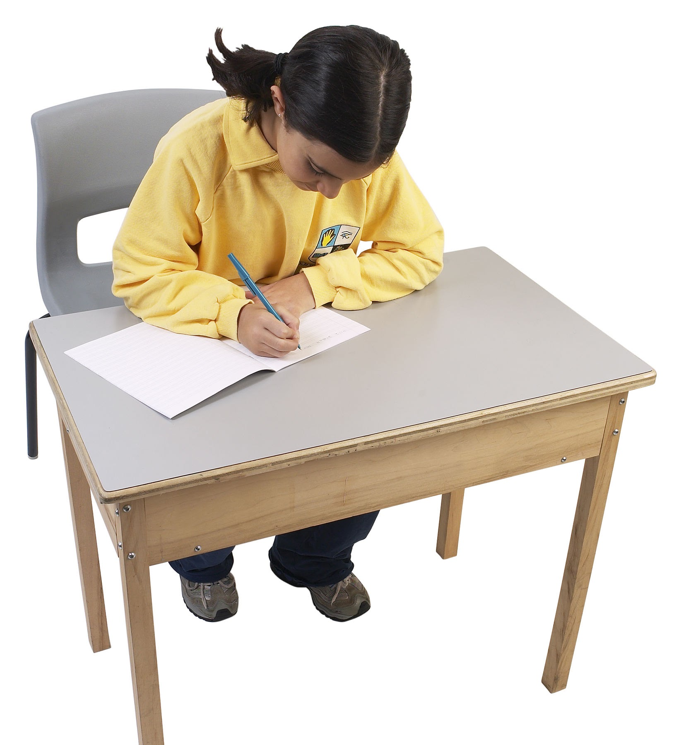

Was gibt es in dem Klassenzimmer? Es gibt…….
einen Stuhl
einen Tisch
ein Fenster

Slide 8


Was gibt es in dem Klassenzimmer? Es gibt…….
einen Computer
ein Smartboard

Slide 9
Was gibt es in dem Klassenzimmer? Es gibt…….
einen Stuhl
einen Tisch
einen Computer
ein
Fenster
ein
Smartboard
Notes:
Support for the listening for pronunciation activities / then later for the repetition activities

Slide 10
Was gibt es in dem Klassenzimmer? Es gibt…….
Notes:
For more challenge in the listening for pronunciation activities / then later for the beat the teacher challenge

