Slide 1

Phonetik

Slide 2
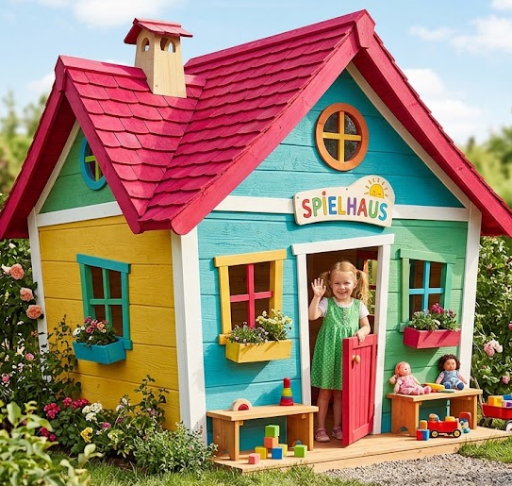

au
Haus
Notes:
Timing: 1 minute
Aim: To introduce/consolidate SSC [au]
Procedure:
1. Present the letter(s) and say the [au] sound first, on its own. Students repeat it with you.
2. Bring up the word ”Haus” on its own, say it, students repeat it, so that they have the opportunity to focus all of their attention on the connection between the written word and its sound.
3. A possible gesture for this would be to form a roof shape by touching your fingertips together, in front of you.
4. Roll back the animations and work through 1-3 again, but this time, dropping your voice completely to listen carefully to the students saying the [au] sound, pronouncing ”Haus” and, if using, doing the gesture.
Word frequency (1 is the most frequent word in German):
Haus [159]
Source: Jones, R.L. & Tschirner, E. (2006). A frequency dictionary of German: core vocabulary for learners. Routledge

Slide 3
au
Haus
Notes:
Timing: 1 minute
Aim: To introduce/consolidate SSC [au]
Procedure:
1. Present the letter(s) and say the [au] sound first, on its own. Students repeat it with you.
2. Bring up the word ”Haus” on its own, say it, students repeat it, so that they have the opportunity to focus all of their attention on the connection between the written word and its sound.
3. A possible gesture for this would be to form a roof shape by touching your fingertips together, in front of you.
4. Roll back the animations and work through 1-3 again, but this time, dropping your voice completely to listen carefully to the students saying the [au] sound, pronouncing ”Haus” and, if using, doing the gesture.
Word frequency (1 is the most frequent word in German):
Haus [159]
Source: Jones, R.L. & Tschirner, E. (2006). A frequency dictionary of German: core vocabulary for learners. Routledge

Slide 4
au
Haus
Notes:
Timing: 1 minute
Aim: To introduce/consolidate SSC [au]
Procedure:
1. Present the letter(s) and say the [au] sound first, on its own. Students repeat it with you.
2. Bring up the word ”Haus” on its own, say it, students repeat it, so that they have the opportunity to focus all of their attention on the connection between the written word and its sound.
3. A possible gesture for this would be to form a roof shape by touching your fingertips together, in front of you.
4. Roll back the animations and work through 1-3 again, but this time, dropping your voice completely to listen carefully to the students saying the [au] sound, pronouncing ”Haus” and, if using, doing the gesture.
Word frequency (1 is the most frequent word in German):
Haus [159]
Source: Jones, R.L. & Tschirner, E. (2006). A frequency dictionary of German: core vocabulary for learners. Routledge

Slide 5


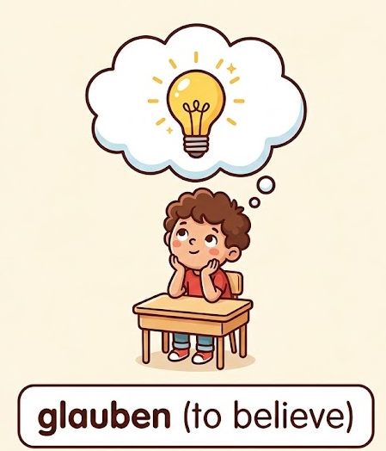
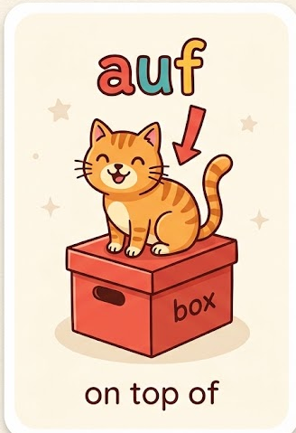
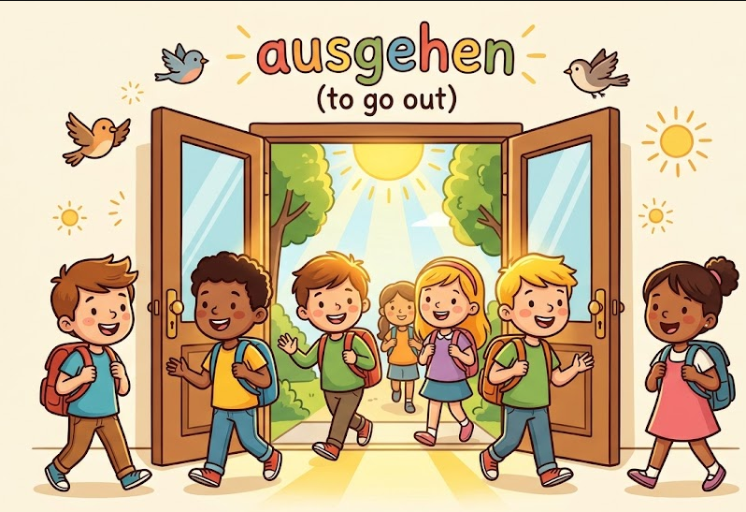
au
genau
auch
Haus
glauben
auf
ausgehen
Notes:
Timing: 2 minutes
Aim: To introduce/consolidate SSC [au]
Procedure:
Introduce and elicit the pronunciation of the individual SSC [au] and then the source word again ‘Haus’ (with gesture, if using).
Then present and elicit the pronunciation of the five cluster words.
The cluster words have been chosen for their high-frequency, from a range of word classes, with the SSC (where possible) positioned within a variety of syllables within the words (e.g. initial, 2nd, final etc.). Additionally, we have tried to use words that build cumulatively on previously taught SSCs (see the Phonics Teaching Sequence document) and do not include new SSCs. Where new SSCs are used, they are often consonants which have a similar symbol-sound correspondence in English.
Word frequency (1 is the most frequent word in German):
Haus [159]; genau [183] auch [16]; glauben [143]; ausgehen [493]; auf [17].
Source: Jones, R.L. & Tschirner, E. (2006). A frequency dictionary of German: core vocabulary for learners. Routledge

Slide 6
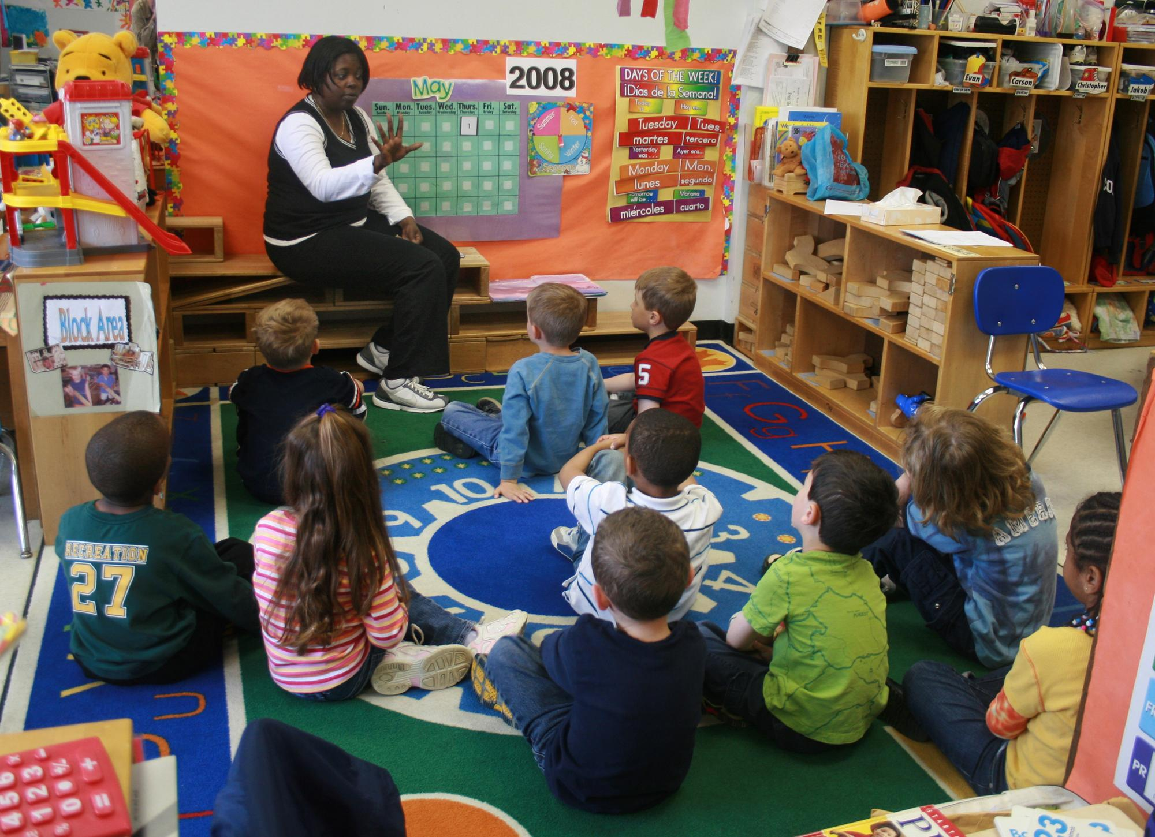
Klassenzimmer
Notes:
To print for slappy hands retrieval

Slide 7
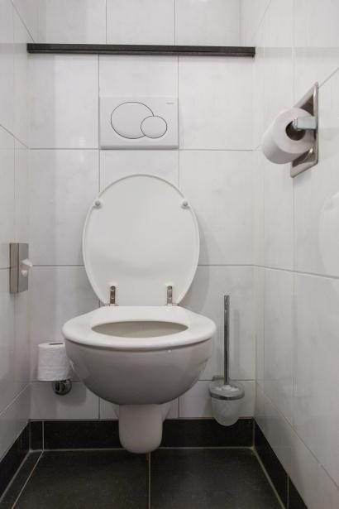
Toiletten
Notes:
To print for slappy hands retrieval

Slide 8
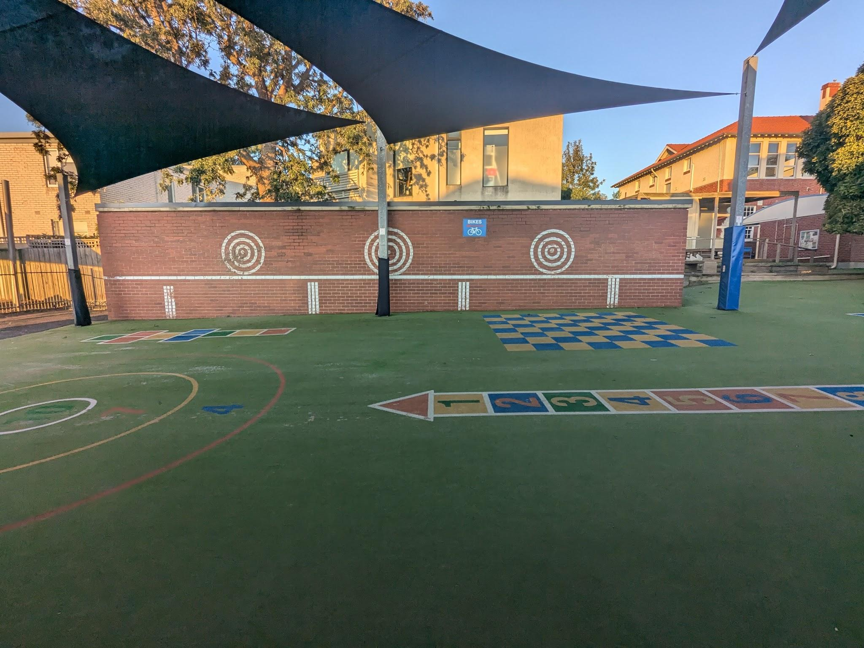
einen Schulhof
Notes:
To print for slappy hands retrieval

Slide 9

eine Bibliothek
Notes:
To print for slappy hands retrieval

Slide 10
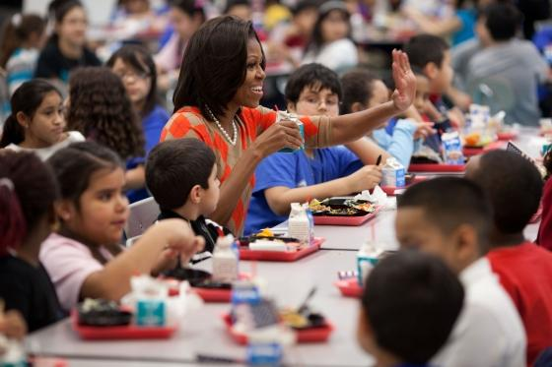
eine Schulkantine
Notes:
To print for slappy hands retrieval

Slide 11
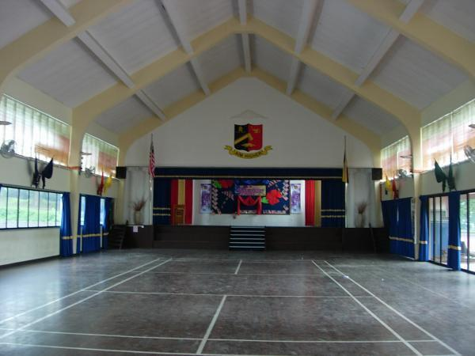
eine Schulhalle
Notes:
To print for slappy hands retrieval

Slide 12
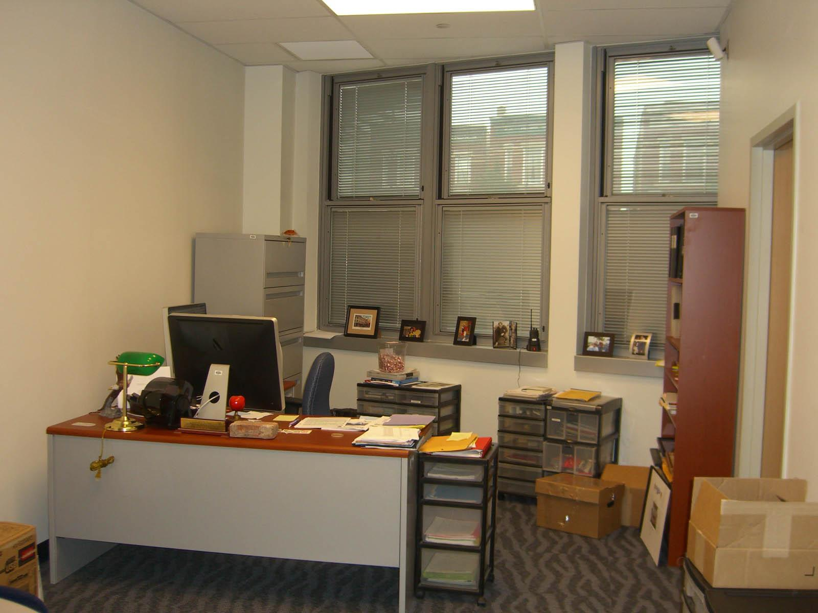
ein Büro
Notes:
To print for slappy hands retrieval

Slide 13
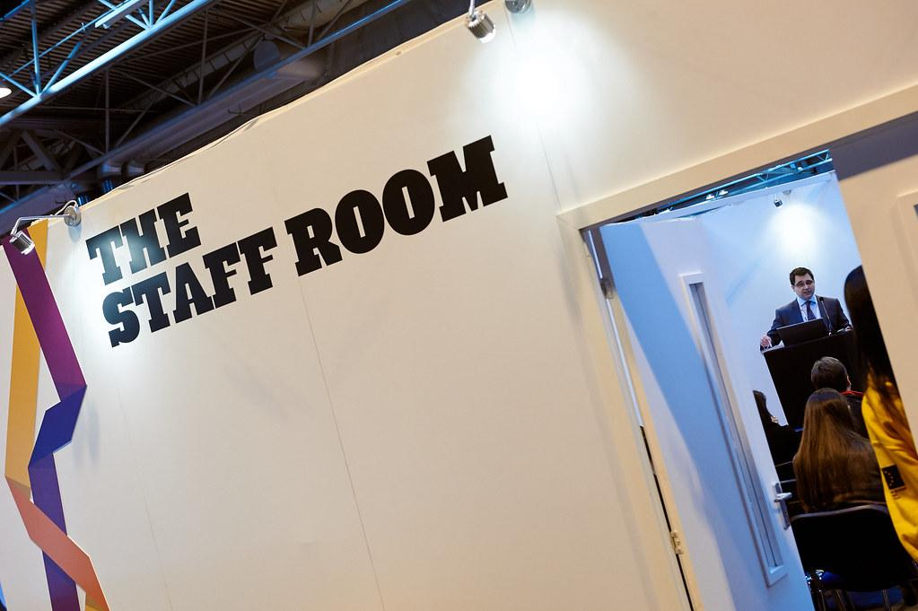
ein Lehrerzimmer
Notes:
To print for slappy hands retrieval

Slide 14
Was haben wir in unserer Schule? Wir haben…….
Klassenzimmer
Toiletten
ein Büro
ein Lehrerzimmer
einen Schulhof
eine Bibliothek
eine Schulkantine
eine Schulhalle
Notes:
For the screen or to print off for pairwork slappy hands retrieval

Slide 15
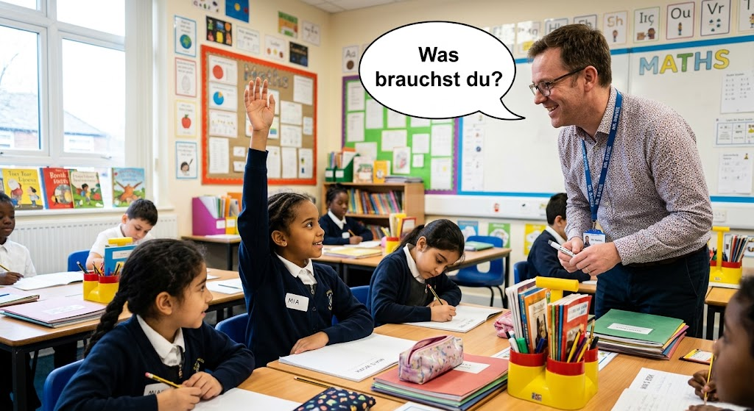
Was brauchst du?
How is the weather today?
How are you?
What do you need?
Notes:
Intro / elicit meaning / four corners

Slide 16
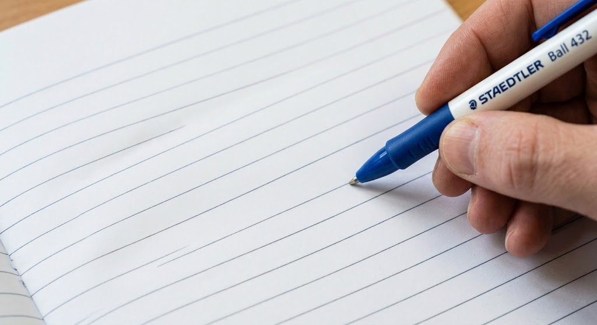


Was brauchst du? Ich brauche…..
einen Kuli
eine Schere
ein Buch
Notes:
To intro items

Slide 17
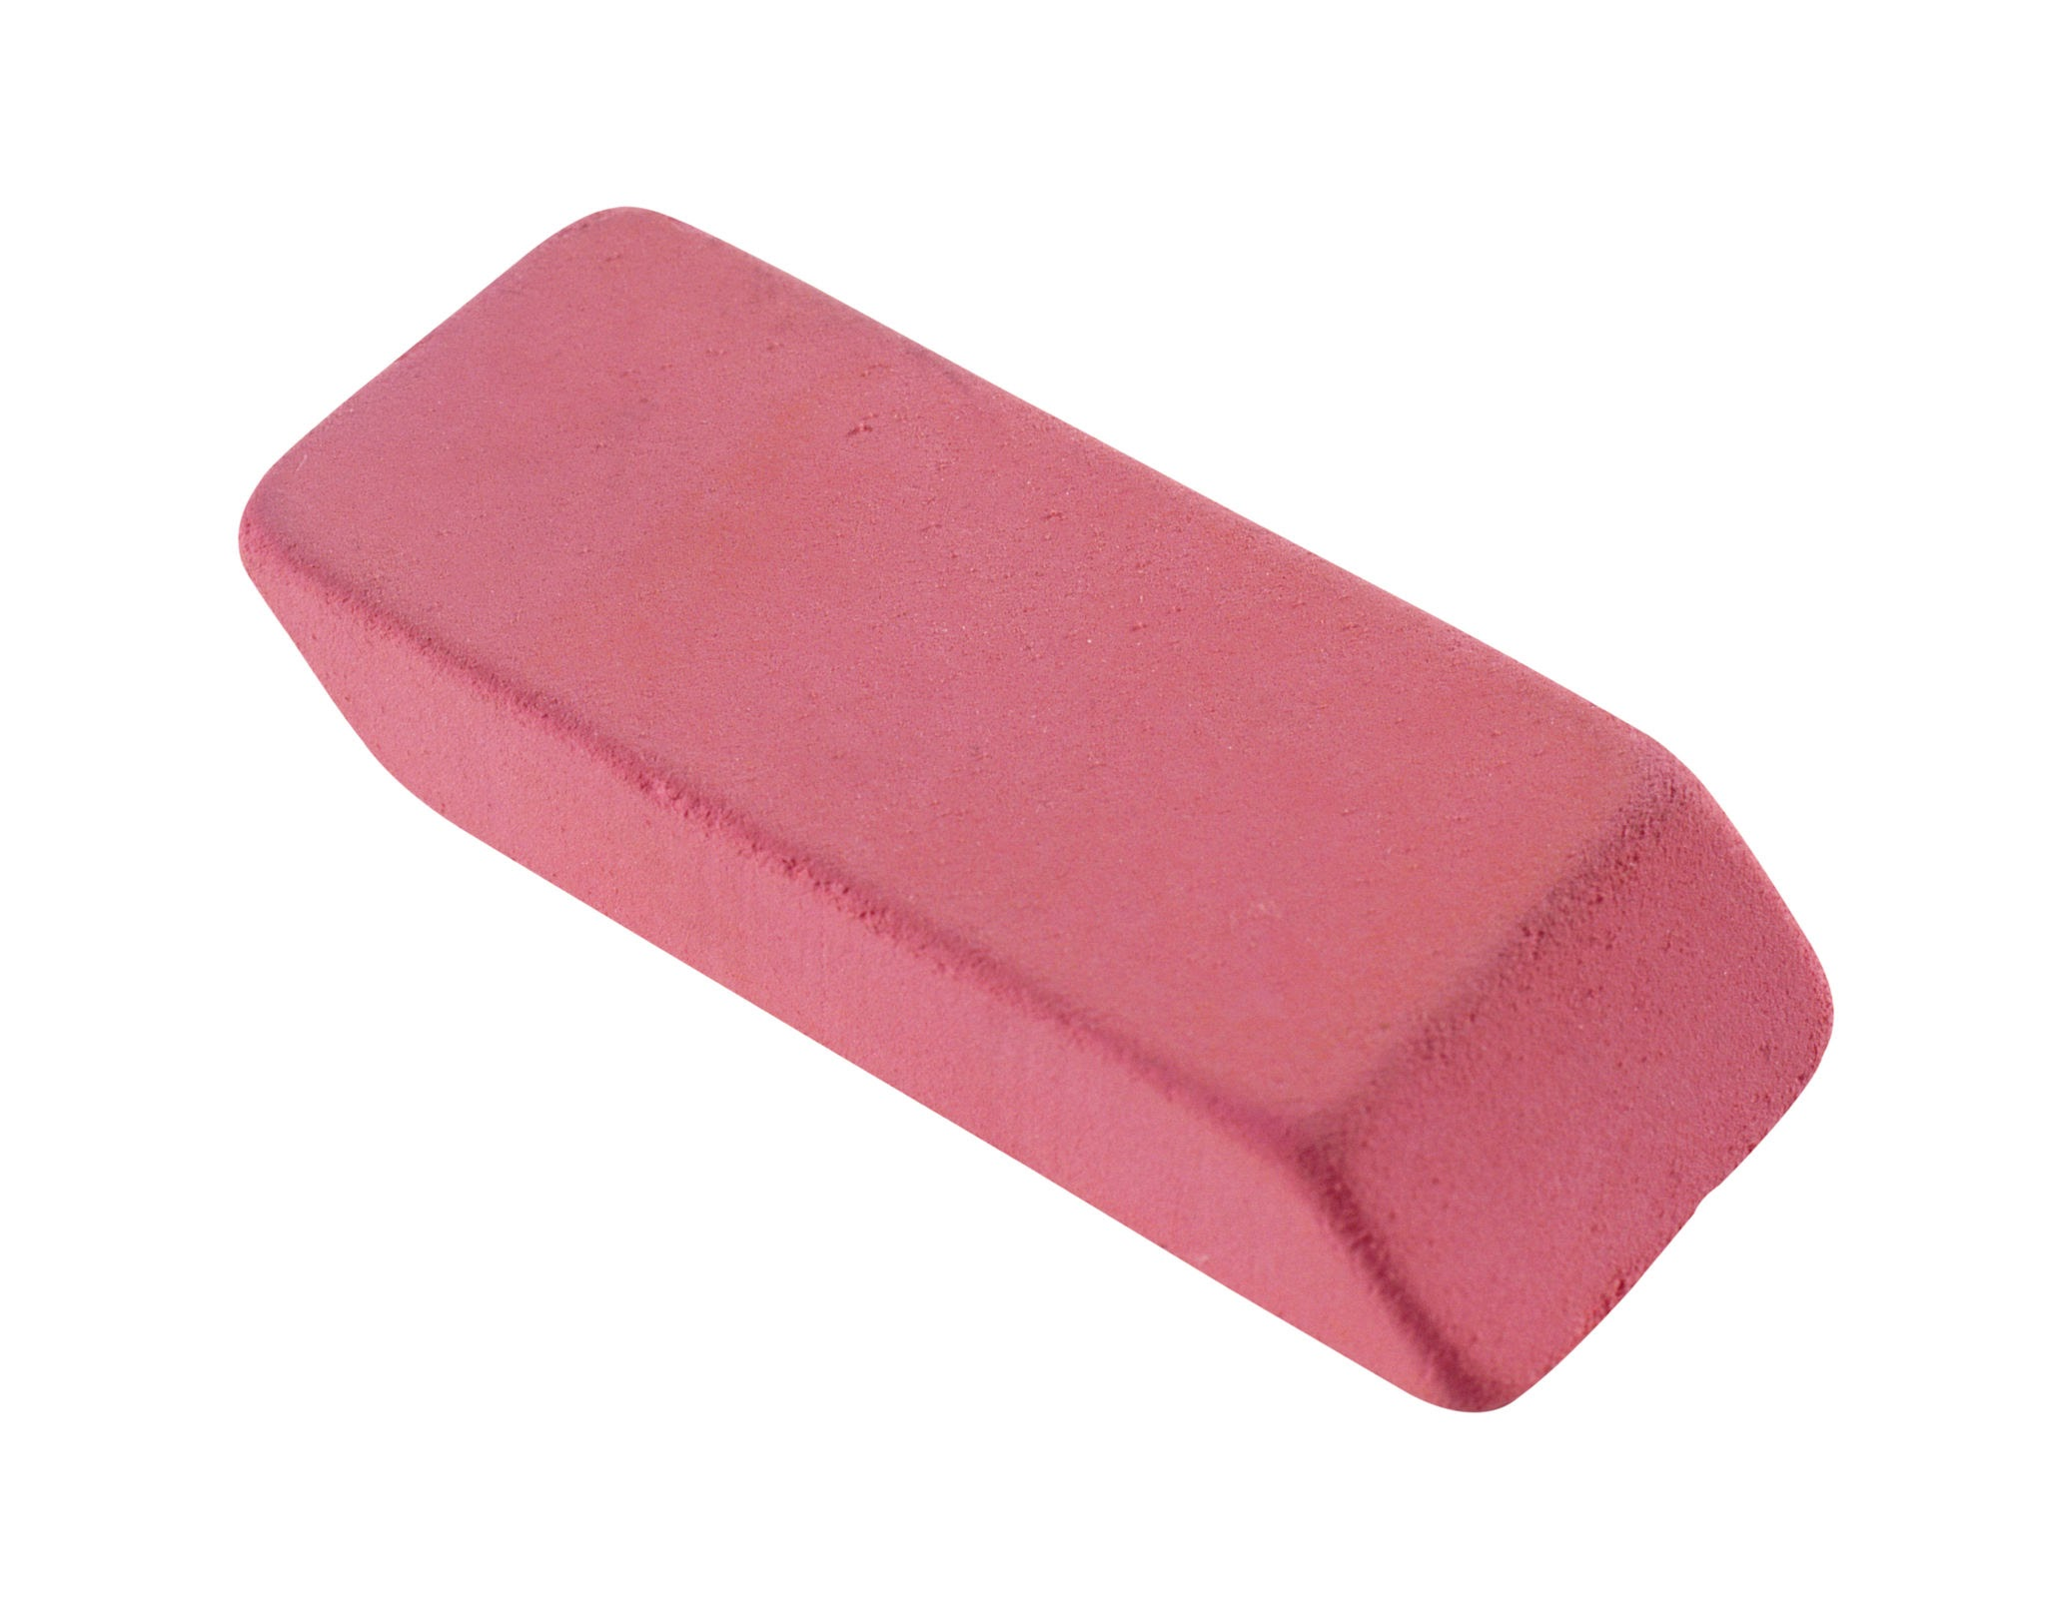
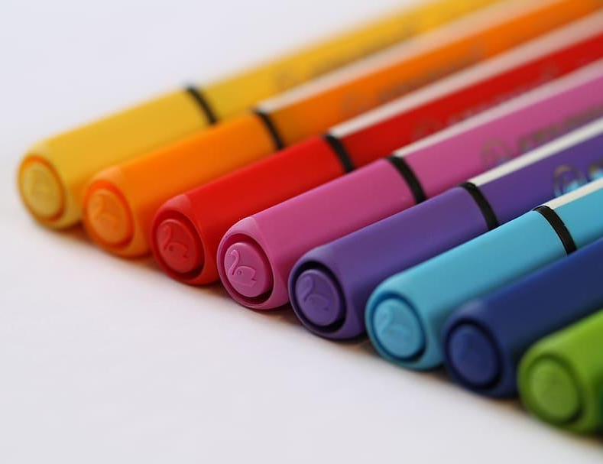
Was brauchst du? Ich brauche…..
einen Radiergummi
Filzstifte
Notes:
To intro items

Slide 18
Was brauchst du? Ich brauche…..
einen Kuli
eine Schere
ein Buch
einen Radiergummi
Filzstifte
Notes:
For listening for pronunciation and repetition

Slide 19
Was brauchst du? Ich brauche…..

Slide 20
Was brauchst du? Ich brauche…..

